Slide 1
Daily message
Today, we are going to learn new opposite words.

Slide 2
Left and right

Slide 3
I
2

Slide 4
I
2

Slide 5
Top and bottom

Slide 6
I
2

Slide 7
I
2

Slide 8
long and short

Slide 9
I
2

Slide 10
I
2

Slide 11
Empty and full

Slide 12
I
2

Slide 13
I
2

Slide 14
in and out

Slide 15
I
2

Slide 16
I
2

Slide 17
Thick and thin

Slide 18
I 2

Slide 24
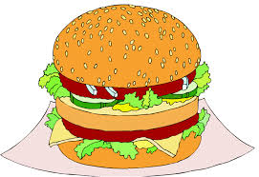

Slide 25
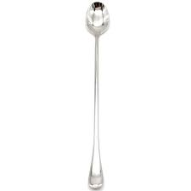
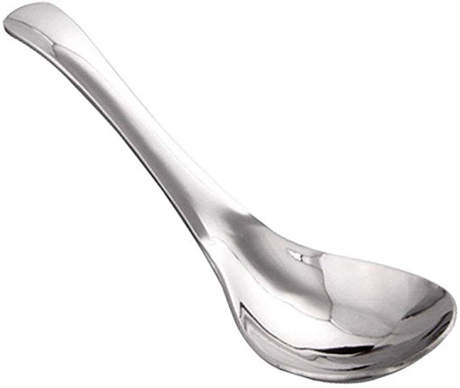

Slide 26
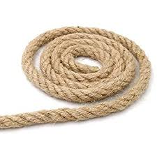
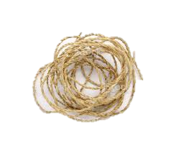

Slide 27
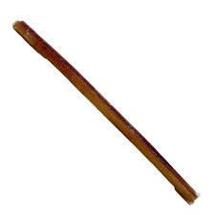

Slide 28
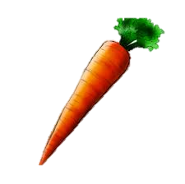
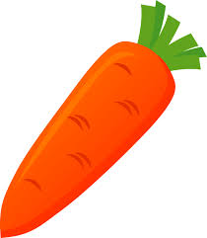

Slide 31
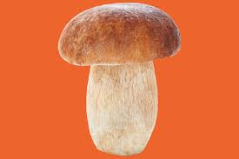
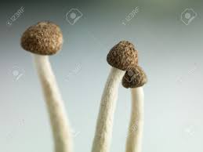

Slide 32
