Slide 1
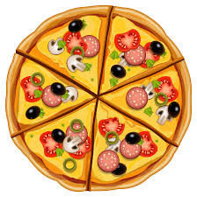
pizza

Slide 2
pineapple

Slide 3
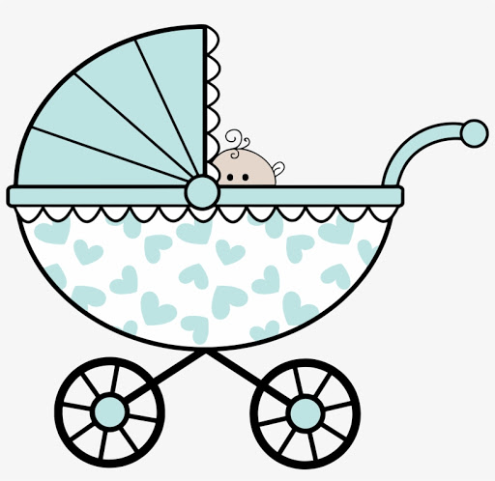
pram

Slide 4
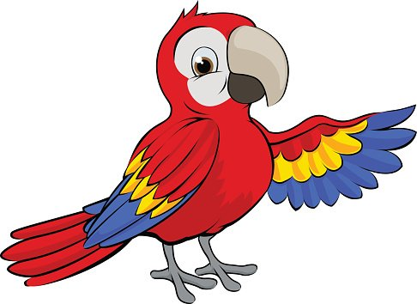
parrot

Slide 5
pie

Slide 6
pencil

Slide 7
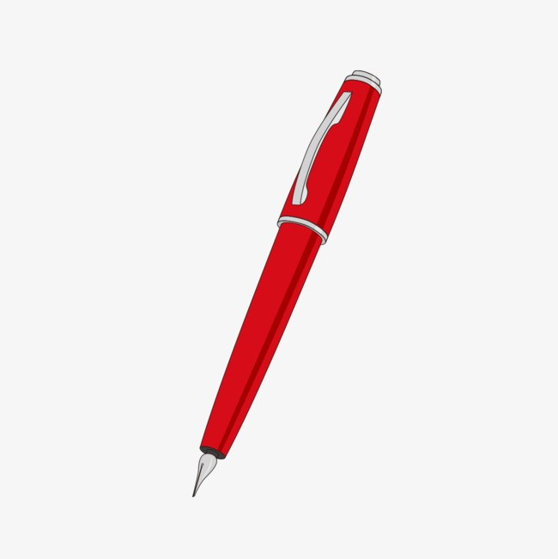
pen

Slide 8
pan

Slide 9
pink

Slide 10
popcorn

Slide 11
purple

Slide 12
cap

Slide 13
sleep

Slide 14
p i t
pit

Slide 15
p a t
pat

Slide 16
t i p
tip

Slide 17
t a p
tap

