Slide 1
Chapter 10
Lesson: (Reactions of metals with acids)
Scholastic Year: 2022-2023
Grade: 7CS

Slide 2
Metal+ Acid →Salt+ Hydrogen MASH reaction
When metals react with acids, they produce salt and hydrogen gas.
The type of the salt depends on the type of the acid used in the reaction.
Nitric acid HNO3 gives nitrate salts.
Sulfuric acid H2SO4 gives sulfate salts
Hydrochloric acid HCl gives chloride salts

Slide 3
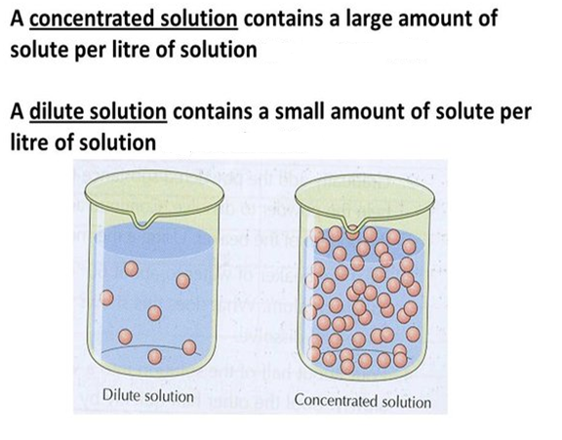
What is the difference between diluted and concentrated acid?
In a concentrated acid, more acid particles will be involved in the reaction, the reaction will be faster.

Slide 4
How to test for Hydrogen gas?

Slide 5
Sodium Na
With diluted acid
Vigorous reaction.
Exothermic reaction
Hydrogen gas is produced
Hydrochloric acid

Slide 6
Calcium Ca
With diluted acid
The reaction between calcium and hydrochloric acid is slower and less violent than when G1 metals react with acid.
Exothermic reaction ( less heat is produced than G1 elements).
Hydrogen gas is given out

Slide 7
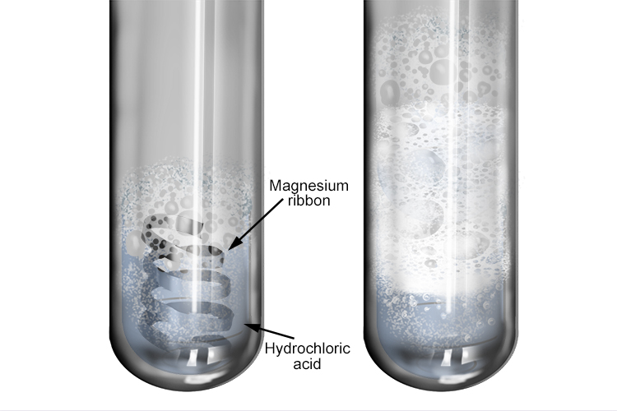
Magnesium Mg
With diluted acid
With concentrated acid
Slow reaction in the beginning.
Bubbles of hydrogen gas are formed on the surface of magnesium.
Fast reaction.
Mg ribbon disappeared.
More bubbles are formed.
Exothermic reaction ( less heat than Ca is produced)

Slide 8
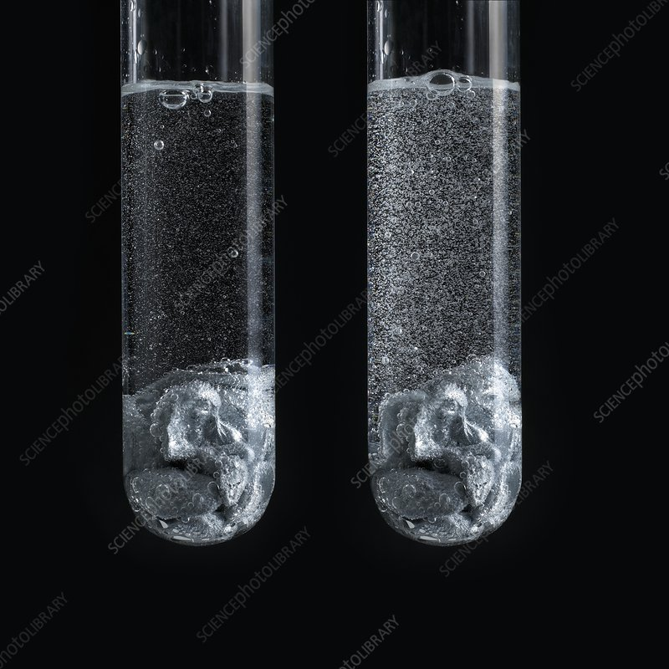
Zinc Zn
With diluted acid
Slow reaction
Few bubbles are formed on the surface of zinc ( less than the amount of bubbles formed on Mg ribbon)
With concentrated acid
Stronger reaction than in diluted acid ( but slower than Mg ribbon reaction)
More Bubbles are formed on the surface of zinc.

Slide 9
Iron Fe
With diluted acid
With concentrated acid
No reaction
The reaction between iron and acid is slower than the reaction with zinc, with much smaller hydrogen bubbles produced.

Slide 10
Copper Cu
With diluted acid
No reaction
With concentrated acid
No reaction

