Slide 1
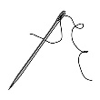
needle

Slide 2
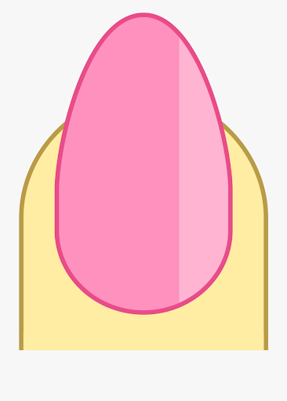
nail

Slide 3
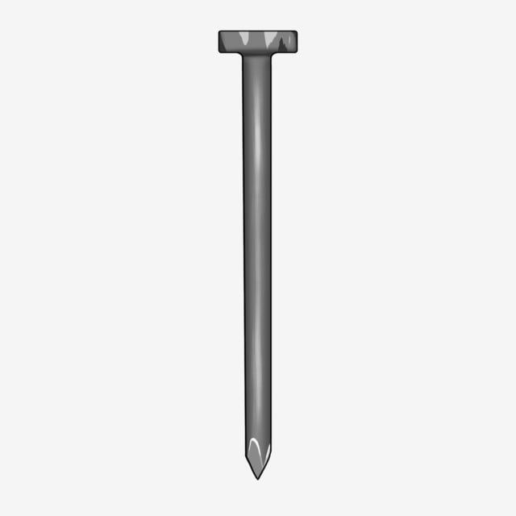
nail

Slide 4
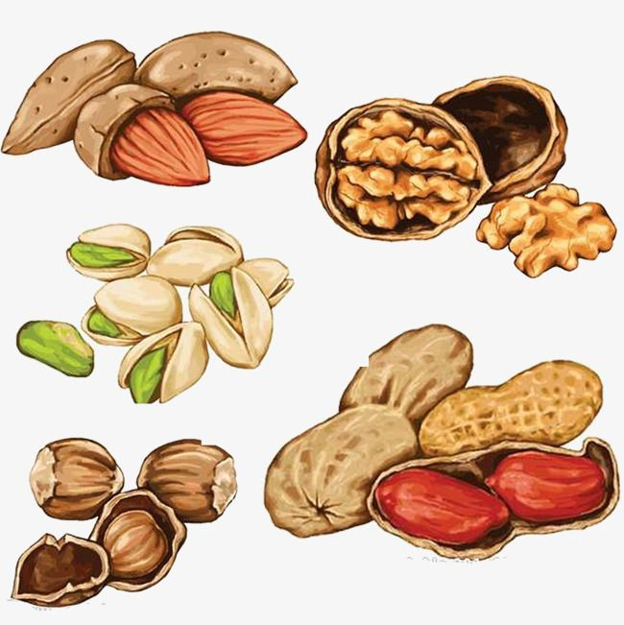
nuts

Slide 5
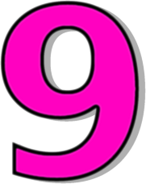
nine

Slide 6
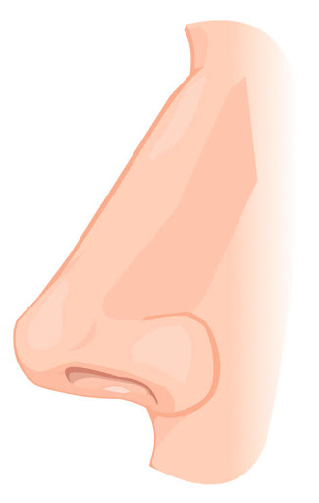
nose

Slide 7
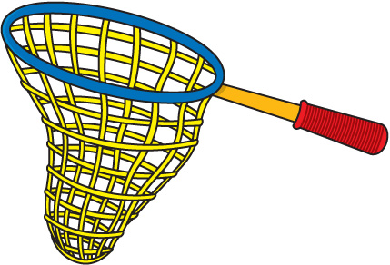
net

Slide 8
nest

Slide 9
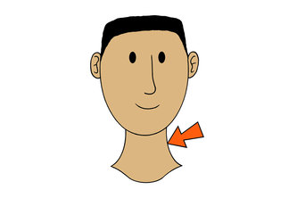
neck

Slide 10
nurse

Slide 11
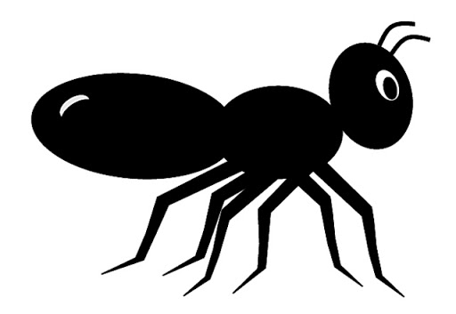
ant

Slide 12
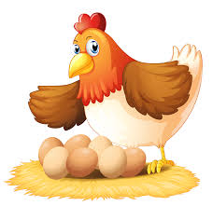
hen

Slide 13
fin

Slide 14
nap

Slide 15
nip

Slide 16
pan

Slide 17
pin

Slide 18
tin

Slide 19
tan

Slide 20
ant

Slide 21
. . .
sat

Slide 22
. . .
pat

Slide 23
. . .
sit

Slide 24
. . .
pit

Slide 25
. . .
tip

Slide 26
. . .
tap

