Slide 1
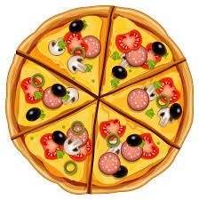
pizza

Slide 2

pineapple

Slide 3
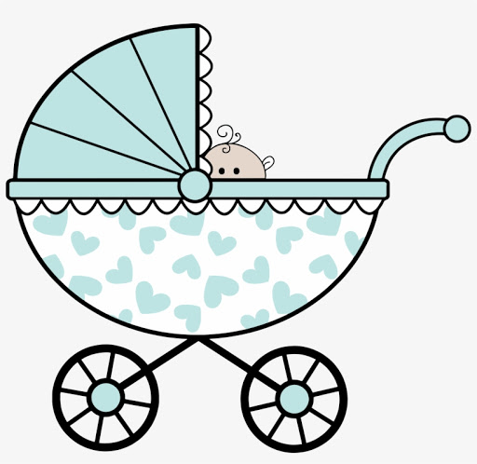
pram

Slide 4
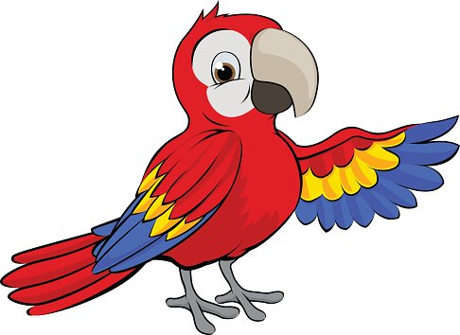
parrot

Slide 5

pie

Slide 6

pencil

Slide 7
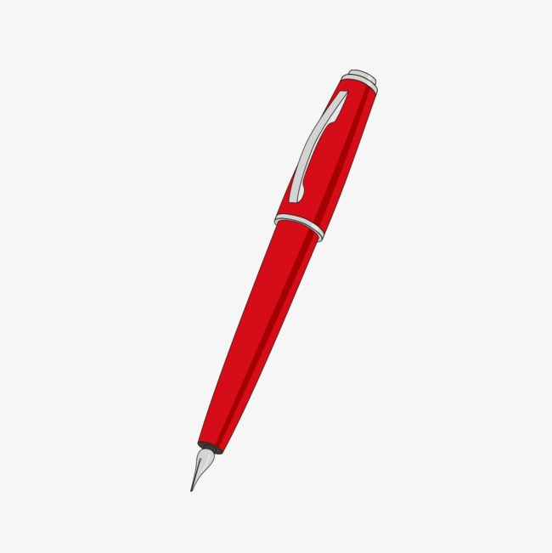
pen

Slide 8

pan

Slide 9

pink

Slide 10

popcorn

Slide 11

purple

Slide 12

cap

Slide 13

sleep

Slide 14
p i t
pit

Slide 15
p a t
pat

Slide 16
t i p
tip

Slide 17
t a p
tap

