Slide 2
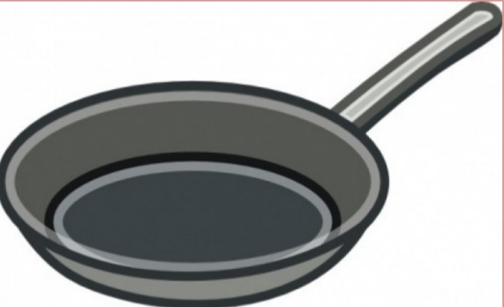
pan

Slide 3
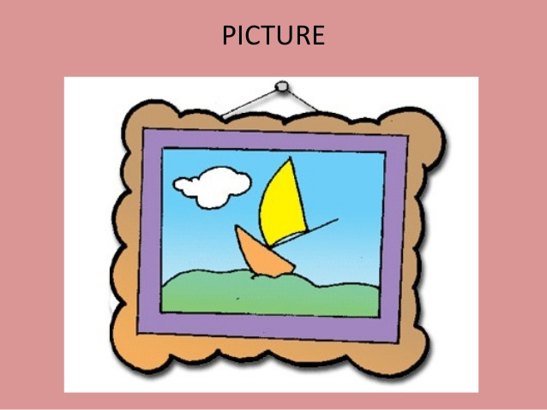
picture

Slide 4
panda

Slide 5
pencil

