Slide 1
Exploring Neutralisation
Neutralisation in Everyday Life

Slide 2
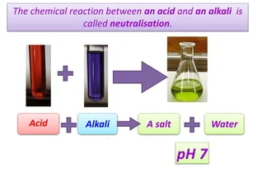
What is Neutralisation?
Neutralisation is a chemical reaction between an acid and an alkali to produce salt and water.

Slide 3
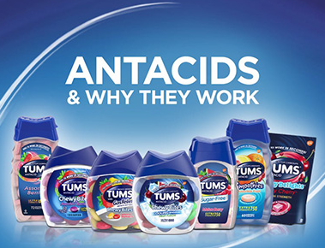
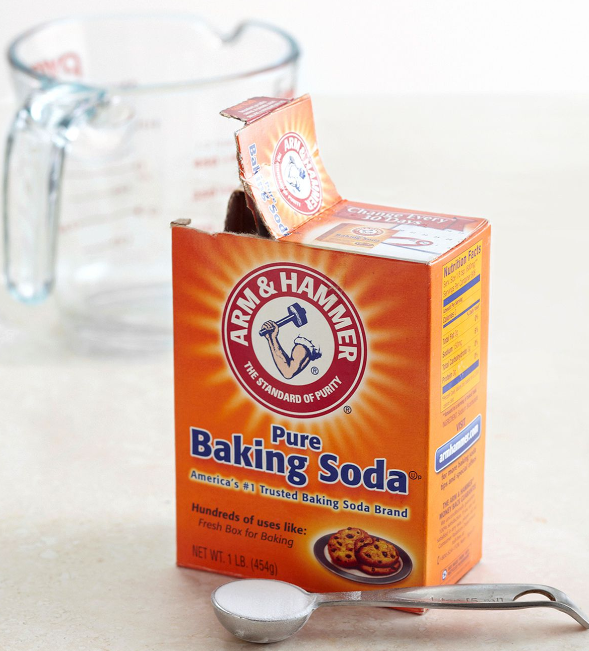
Examples of neutralisation in everyday life
Antacids are bases that are used to neutralise stomach acid.
Baking soda is a base that can be used to neutralise stomach acid, treat bee stings, and clean surfaces.

Slide 4
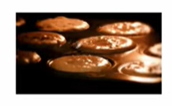
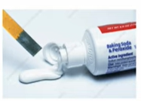
Baking powder contains Sodium hydrogen carbonate (NaHCO₃).
When water is added to baking powder, CO₂ is released to help rise cakes and dough.
Toothpastes are alkaline to help prevent acidic decaying food particles in our teeth

Slide 5
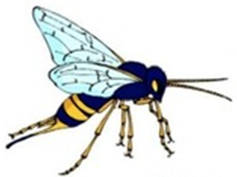
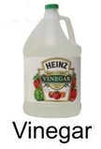
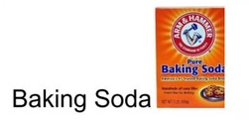
Wasp stings are Alkaline.
To neutralize them we use
an acid such as
Bee stings are Acidic.
To neutralize them we use
An alkali such as

Slide 6
Conclusion
Neutralisation reactions are important in many everyday applications. They can help to improve our health, our environment, and our homes.

Slide 7
Answers to questions pages 134- 135
1. the reaction between acids and alkalis; in which acids and alkalis cancel each other out
2. the pH increases; as the solution becomes less acidic
3. the pH decreases; as the solution becomes less alkaline
4. if the water became too alkaline, it would kill the plants and animals living there

Slide 8
5.
Situation | Neutralised by
stomach acid | anatcid tablets
bee sting | bicarbonate of soda
wasp sting | vinegar
alkaline liquid waste | treated with acid
acidic bacteria in our mouth | alkaline saliva alkaline toothpaste
6. purple; to blue; to green
7. The solution could change from green to yellow, orange or red. This is because the solution is becoming more acidic.
8. the acid can be added more precisely; it is easier to reach the end point

