Slide 1
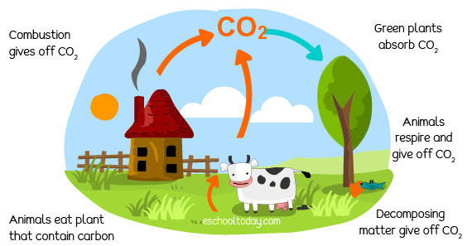
The carbon cycle
https://www.youtube.com/watch?v=p3R-dB9K4ss

Slide 2
The Carbon Cycle
The carbon cycle in nature is a series of processes that move carbon between living organisms and the physical environment. It returns carbon dioxide from organisms to the atmosphere, to be taken up and used again in photosynthesis. It involves several processes.
Carbon is removed from the atmosphere by photosynthesis. It passes into other organisms through feeding. It is returned to the atmosphere through respiration, decomposition, and combustion.

Slide 3
Respiration
Respiration takes place in all living organisms. Glucose molecules are
broken down using oxygen, producing carbon dioxide (CO2) and water.
This releases energy to be used by cells.
Photosynthesis
Photosynthesis takes place in the green parts of plants and in algae. It uses energy from light, trapped by chlorophyll in the chloroplasts. Carbon dioxide is taken in from the air and combined with water to produce glucose and oxygen. This in turn is used to build the biomass of plants.

Slide 4
Feeding
Animals feed. They eat plants or other animals. They take in the biomass of plants, break it down, and build it back up into animal biomass. Carbon is passed from one organism to another in this way. Some is released into the environment through respiration at the same time.
Decomposition
Decomposition is the process carried out by the decomposers. Microorganisms such as bacteria and fungi feed on the waste materials produced by animals, the dead leaves produced by plants, and the dead bodies of animals and plants. They break them down, releasing carbon dioxide back into the atmosphere.

Slide 5
Combustion
Combustion is the scientific word for burning. When a substance burns, it reacts with oxygen in the air. In combustion, the energy transferred heats the surroundings and produces light. Many fuels, from wood to fossil fuels, are carbon compounds. When these fuels burn, they produce carbon dioxide and water which are released into the atmosphere.

