Slide 1
Deficiency diseases
https://www.youtube.com/watch?v=WWAl1tIUlCU

Slide 2
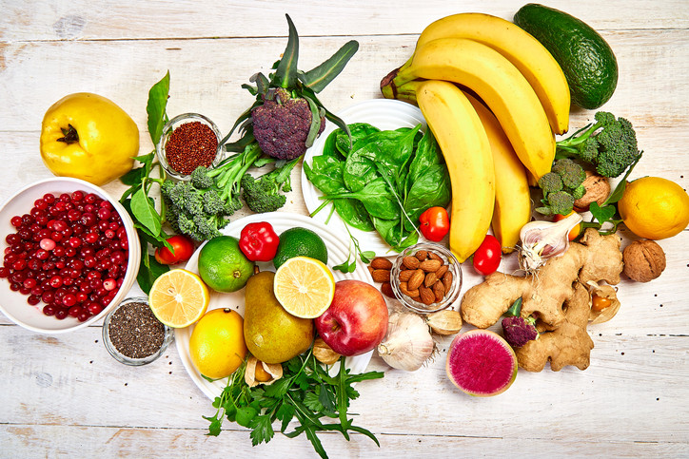
Vitamins and minerals
Vitamins and minerals are only required in very small amounts, but a diet insufficient in these can cause deficiency diseases.
A deficiency disease is a disease caused by a lack of dietary elements (nutrients). Deficiency diseases can often be cured by supplying the missing nutrient.

Slide 3
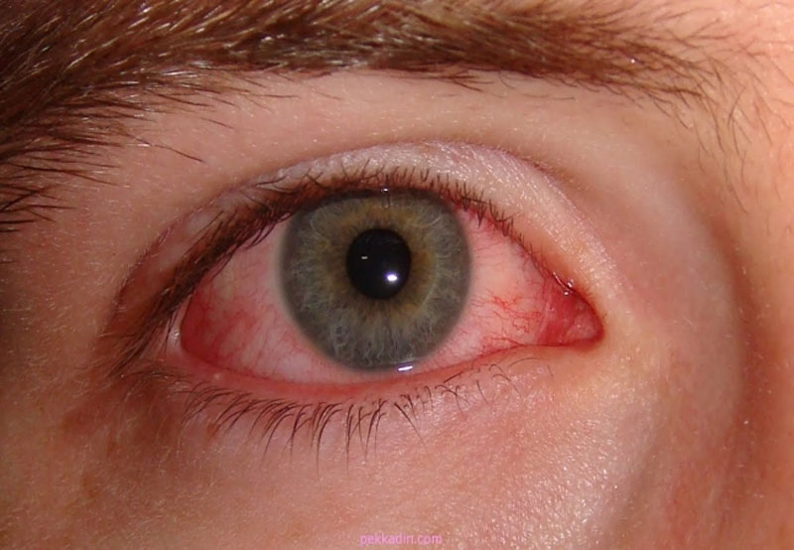
Night blindness
Night blindness is caused by a deficiency of Vitamin A.
It causes poor vision in dim light or at night and can progress to more severe eye problems if left untreated.

Slide 4
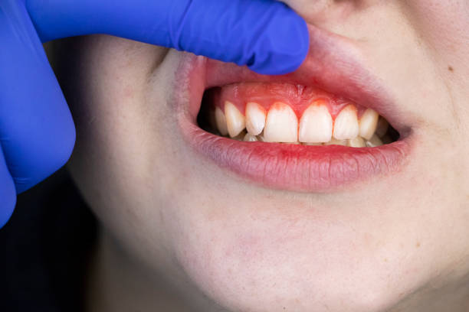
Scurvy
Scurvy is caused by a deficiency of Vitamin C.
Symptoms include weakness, swollen and bleeding gums, the skin peels and the aerobic respiration stops.

Slide 5
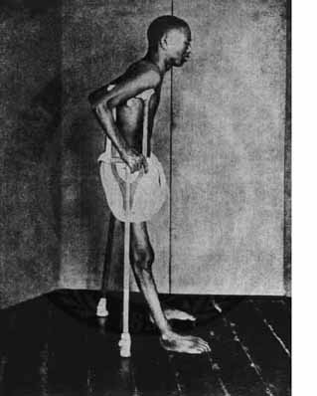
Beriberi
Beriberi is a disease caused by deficiency of Vitamin B1.
It can lead to muscle weakness, loss of appetite, partial paralysis and mental confusion.

Slide 6
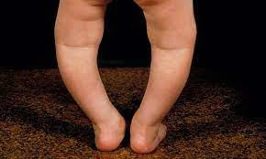
Rickets
Rickets is caused by a deficiency of Vitamin D/ Calcium.
Bones become soft and leg bones of children may bend and curve outwards.

Slide 7
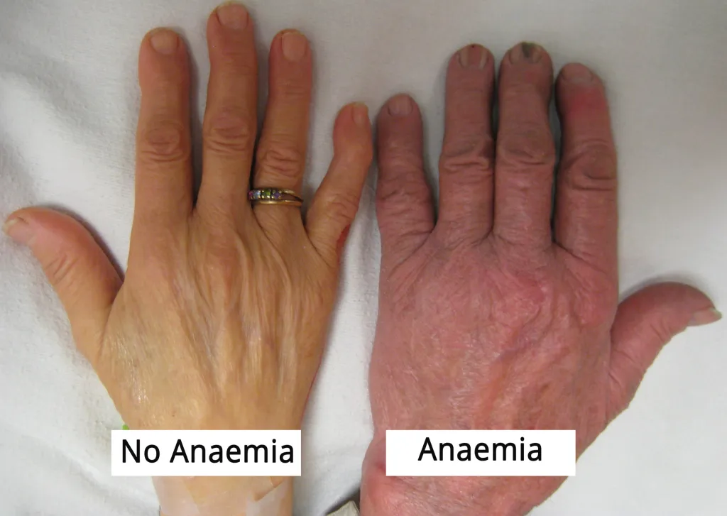
Anaemia
Anaemia is a disease caused by deficiency of Vitamin B12/ Iron.
(A problem of not having enough healthy red blood cells or hemoglobin to carry oxygen to the body's tissues.)
fatigue, weakness, pale skin, shortness of breath.

Slide 8
Deficiency diseases associated with vitamin/ mineral deficiencies:
Nutrient deficiency | Name of the disease | Symptoms of the disease | Good food sources of the nutrient
Vitamin A | Night blindness | Cannot see in dim light | Fish, egg yolks, green vegetables and dairy products
Vitamin C | Scurvy | The gums bleed, the skin peels, the legs swell and aerobic respiration stops | Oranges, lemons, guava and tomatoes
Vitamin B1 | Beriberi | Partial paralysis and mental confusion. | Brown rice, potato, milk
Vitamin D / Calcium | Rickets | Bones become soft and leg bones of children may bend and curve outwards. | Egg yolk, butter, fish liver oil Note: vitamin D is made when the skin is exposed to sunlight
Vitamin B12 / Iron | Anaemia | Tiredness Weak nails pale skin | Meat, egg yolks, chicken, green leafy vegetables

