Slide 1
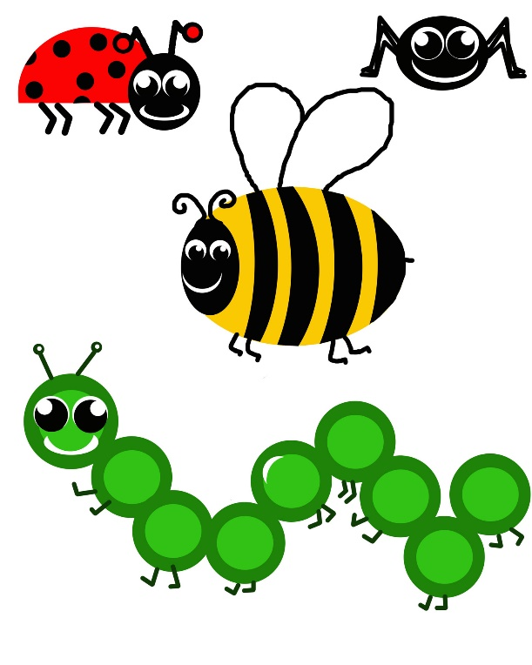
insects

Slide 2
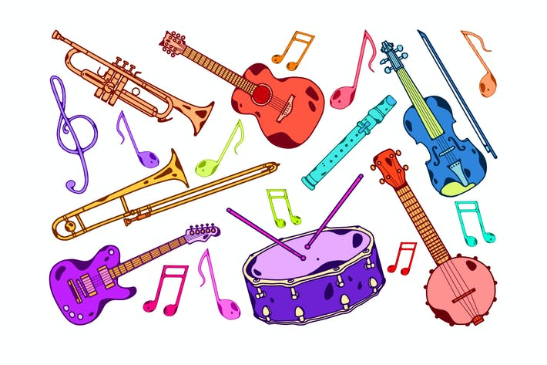
instruments

Slide 3
igloo

Slide 4
ink

Slide 5
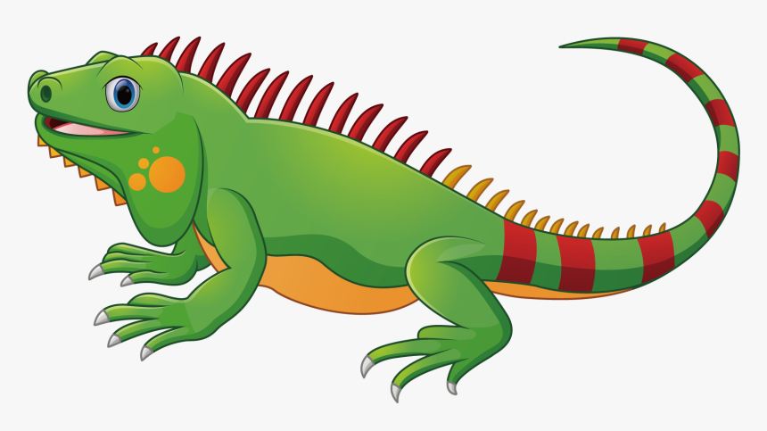
iguana

Slide 6
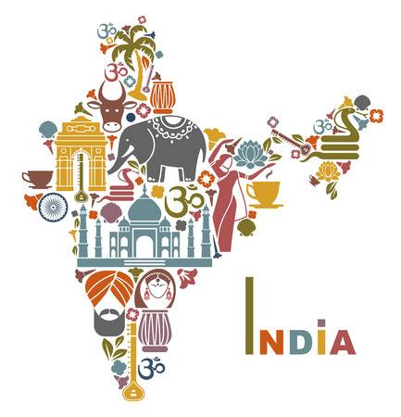
India

Slide 7
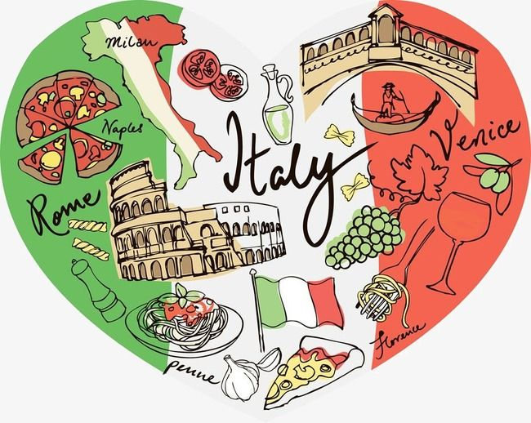
Italy

Slide 8
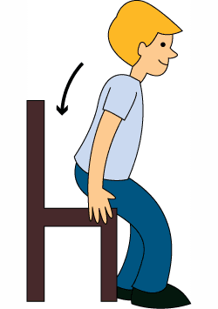
sit

Slide 9
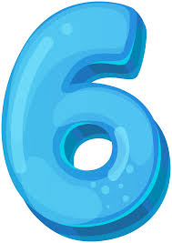
six

Slide 10
i t
it

Slide 11
s i t
sit

