Slide 1
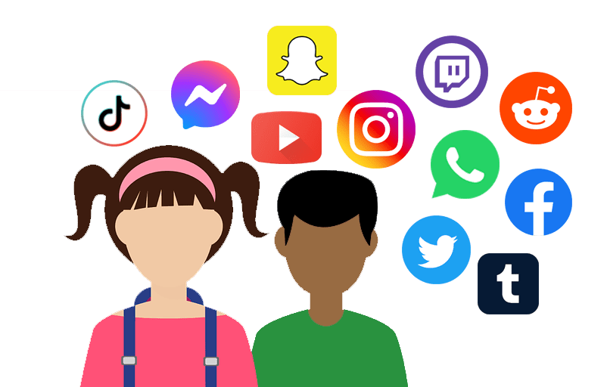
Staying safe online

Slide 2
Digital citizenship

Slide 3
Digital citizenship
Digital citizenship means using the internet and technology in a responsible, safe, and respectful way. It's about being a good online citizen and knowing how to use digital tools wisely.

Slide 4
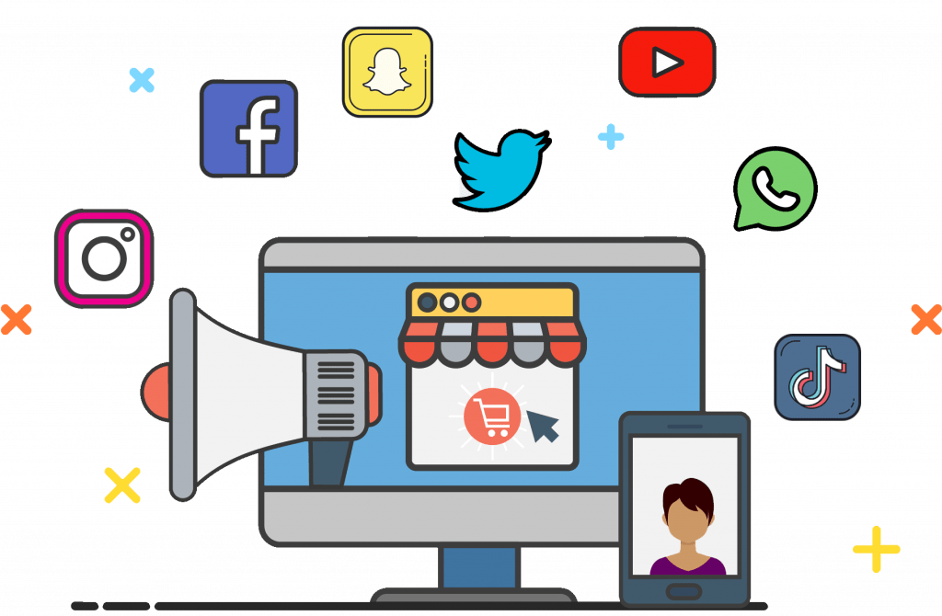
What activities can be applied online
Finding Information Online
Online Shopping
Social Media
Online Games

Slide 5
Collecting Data online
Why do you need to look for information
Websites usually ask you to register before you can use them

Slide 6
Online registration
Websites such as social media and internet shopping sites usually ask you to register before you can use them.
Registration means becoming a member of a website.
Registration requires filling an online form.

Slide 7
Which information should you give?
Required Information
Username
Password
Confirm password.
First Name
Last Name
Optional Information
Name
Phone number
Date of birth
Username *
Password *
Confirm Password *
Phone Number
Date of birth

Slide 8
Benefits of registration
Read pages that are hidden from non-registered users.
Leave messages in chat rooms and on message boards.
Add content.
Get email updates when new content is added to the site.
Download software.

Slide 9
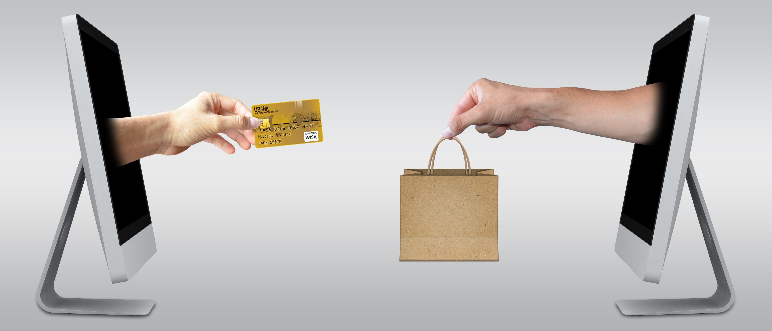
Online shopping

Slide 10
Online shopping
Buying online is called internet shopping or e-commerce.
Internet shopping sites collect data when people buy things.
Some of the data that shopping sites collect is personal, like:-
Bank details
Address
Mob Number
This Photo by Unknown Author is licensed under CC BY-SA

Slide 11
Online shopping
Internet shops use secure sites to protect data.
A secure site encrypts Information that is sent over the internet.
Encrypted data is coded, if a criminal steals the data they will not be able to read or use data.

Slide 12
Secure shopping sites
When you are browsing the web, there are two clues that tell you a website is secure.
There is a small locked padlock symbol.
The URL of a secure site starts with https://.
The “s” stands for secure
It tells you that data is encrypted when it is sent over the internet.

Slide 13
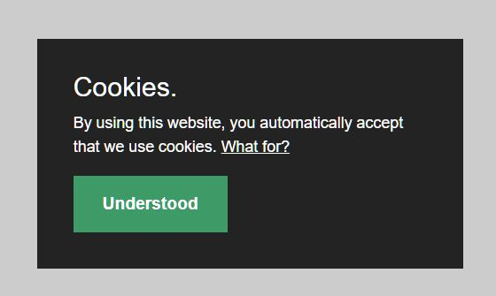
Cookies

Slide 14
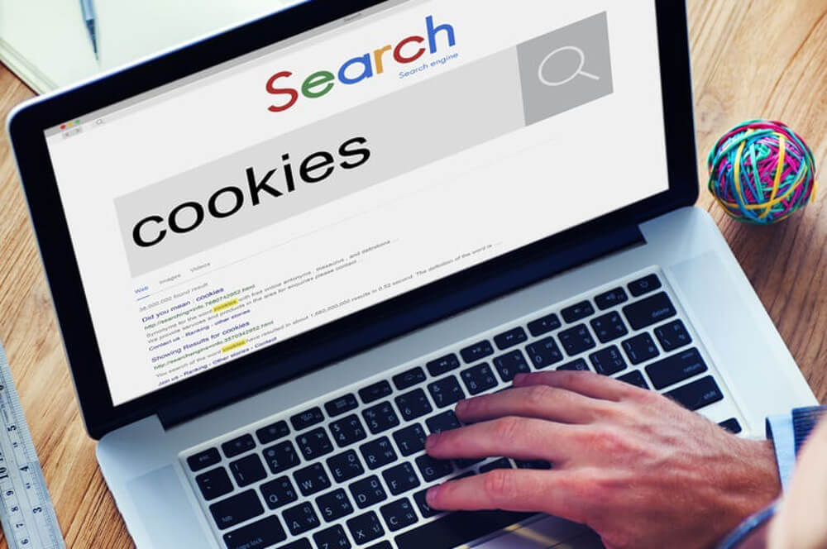
Cookies
A cookie is a small file that is stored on your computer when you visit a website.
A cookie saves information about the way you use web pages. The website uses this information to improve your experience of using the website.

Slide 15
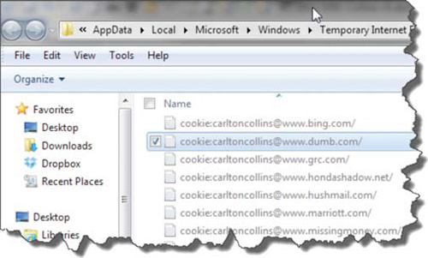
What are Cookies used for
Cookies make it easier to use websites because the Information is saved in a cookie.
Cookies are used to personalize a website,
Examples:
Store your location.
Advertisers use cookies.
The news stories that you see can be customized to match your interests.

Slide 16
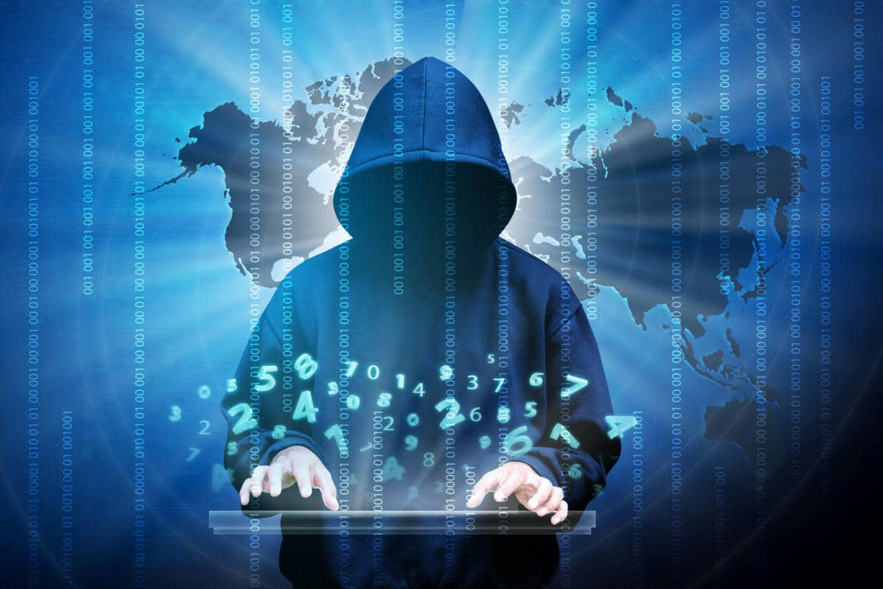
Danger online (cybercrime)

Slide 17
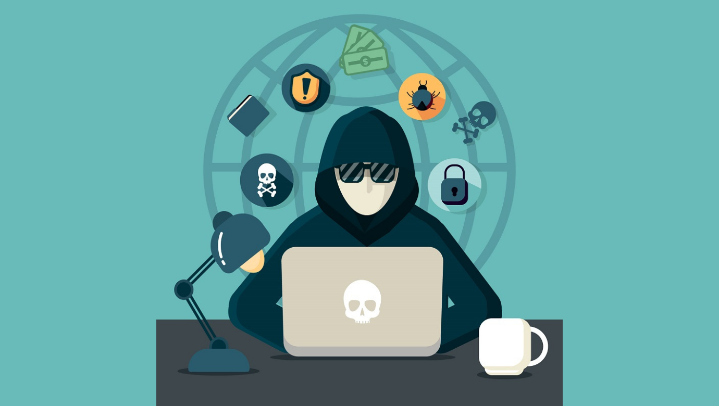
Danger online (cybercrime)
Cybercriminal is someone who uses the internet to commit their crimes.

Slide 18
Identity theft
A criminal steals personal information such as:
Name
Address
Social security number
Passport number
They can open a bank account or a credit card account in someone else’s name.
The then use these fake accounts to buy or steal money from banks.

Slide 19
phishing
A criminal creates a fake website that looks like the official website of a real bank or shopping website.
They send an email to tell the Customers there is a problem in their account.
Customers must log in.
Fake website records their user name and password.
The criminal can then use the person’s login details to steal money

Slide 20
Scamming
A criminal sends out an email that asks for money.
The email may offer something for sale at a very low price or asks for donation to charity.

Slide 21
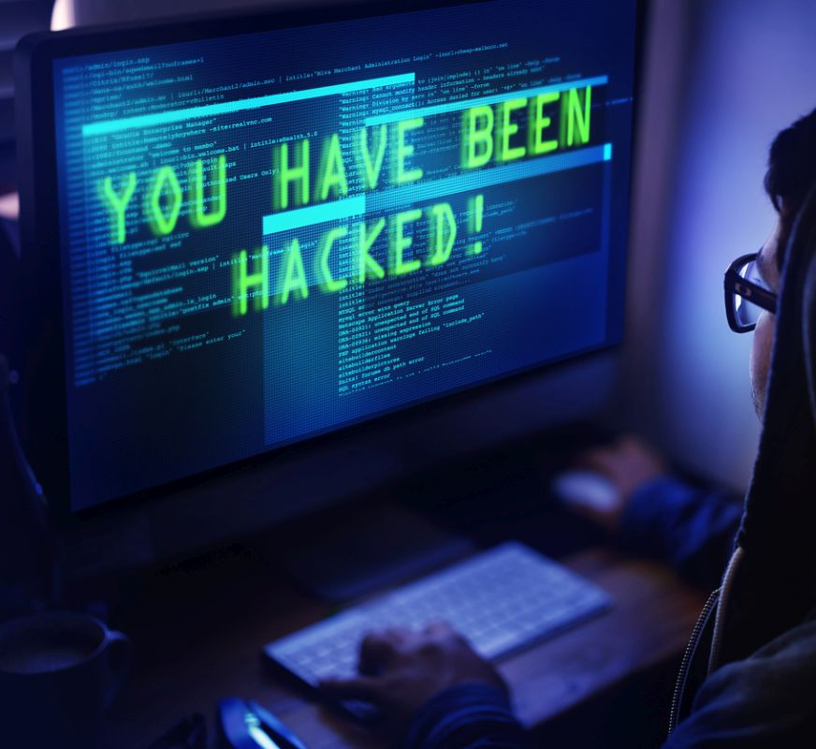
Hacking
A criminal breaks into a computer system, usually to steal files or personal information.

Slide 22
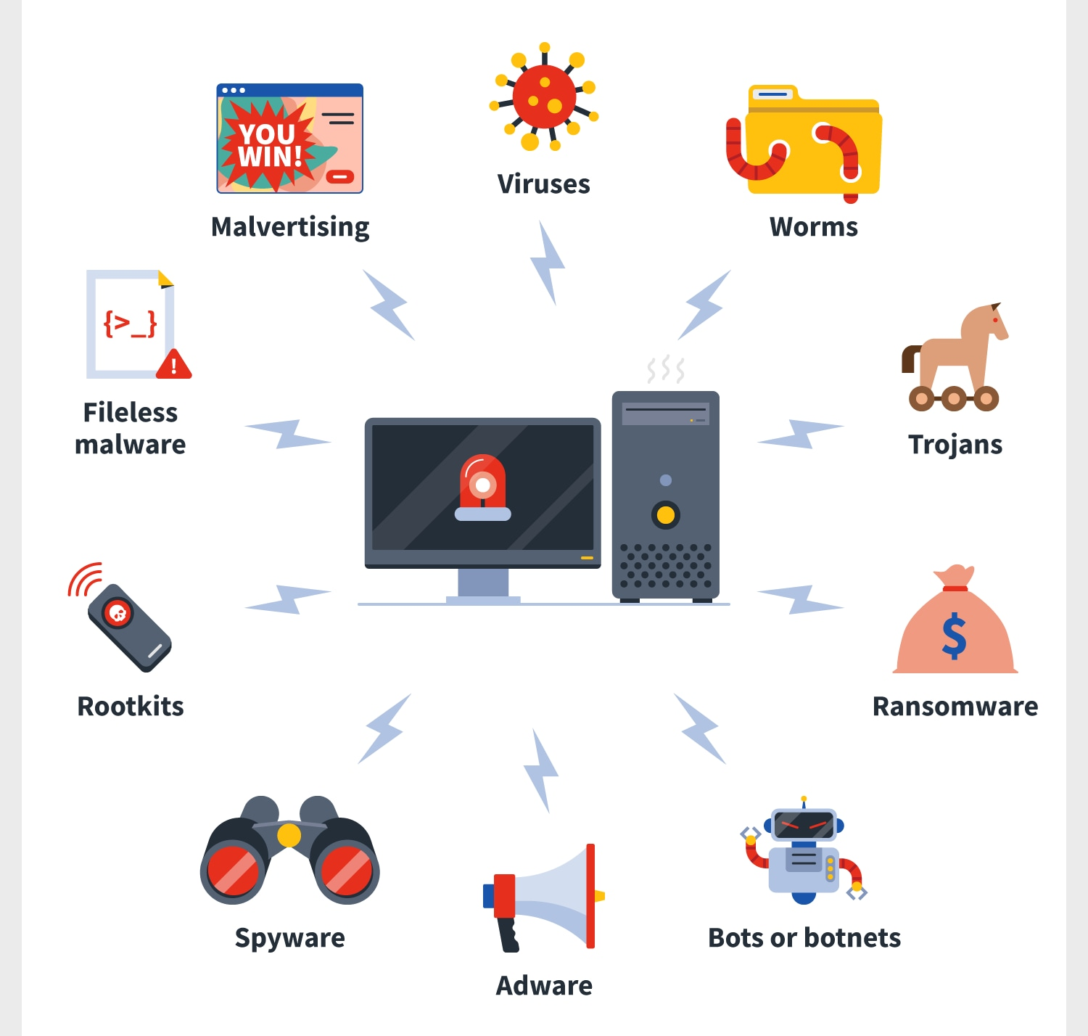
Malware

Slide 23
Malware
Is software that a ceiminal install on a computer.
Some types of malware are designed to steal personal information.
Other malware is designed to damage files or stop a computer from working properly.

Slide 24
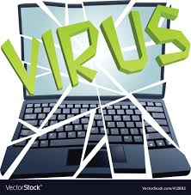
virus
Spreads and infects files that it meets . That makes a virus difficult to cure.
Some viruses are relatively harmless- they make messages pop up on your screen.
Some viruses are dangerous – they can destroy files and steal personal data.

Slide 25
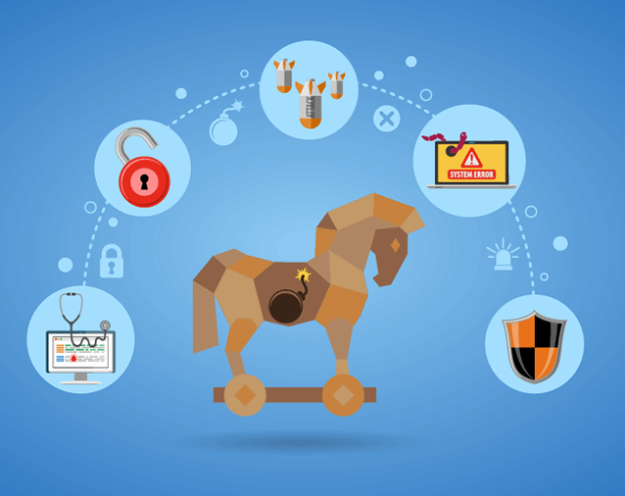
Trojan
Malware that is hidden inside another program, for example in a game.
When someone uses the program, the malware released and starts to work.

Slide 26
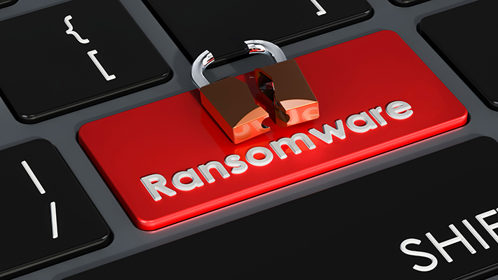
Ransomware
Encrypts all the data on a computer. That means that the data cannot be used.
The victim of a ransomware attack receives a message demanding a payment to remove the encryption.

Slide 27
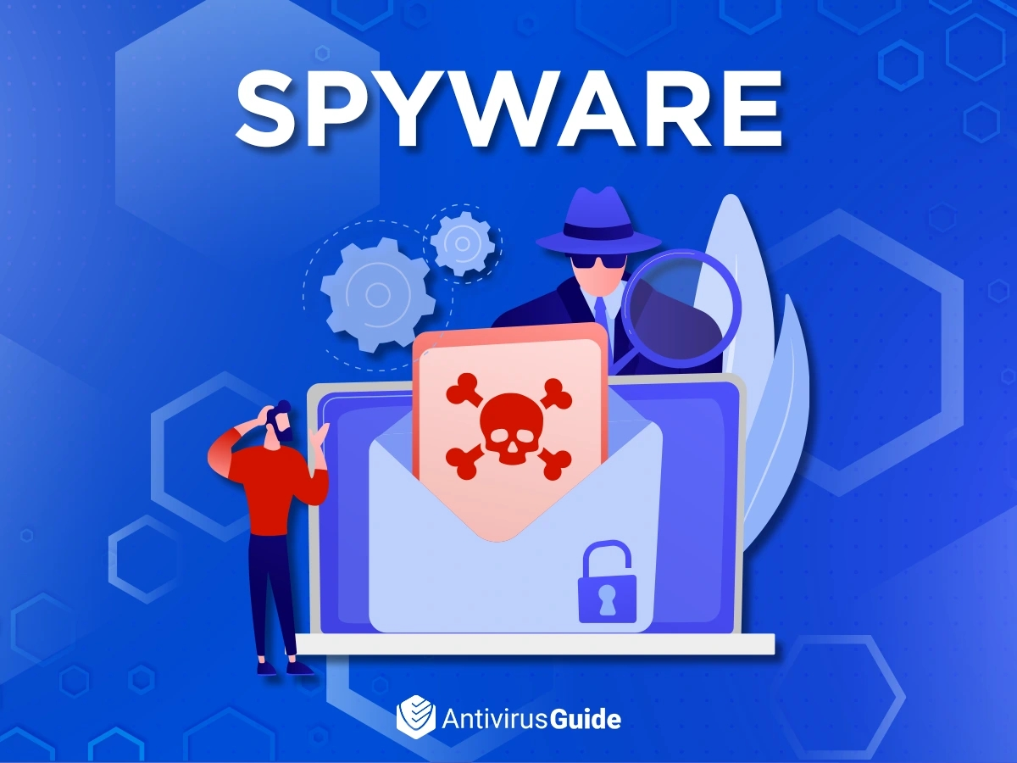
Spyware
Sits on a computer and records what the user is typing. Criminals can use spyware to discover login details.

Slide 28
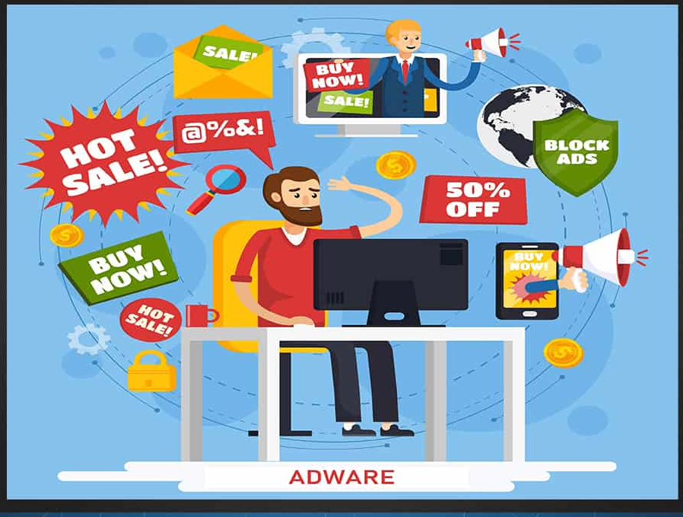
adware
Places unwanted adverts on a computer.
Adware is annoying.
Adware may lead to more dangerous malware.

Slide 30
Anti-virus software
You can prevent malware from doing damage by installing anti-virus software.
Av-software deals with all malware threats, not just viruses.
How Av software works
Every piece of malware has a fingerprint. The fingerprint is a piece of programming code that is unique to the malware ( the fingerprint is called a signature).
Av-software continually checks the files on the computer, if it finds a malware in a file, it puts this file in quarantine and the computer cannot open the file

Slide 31
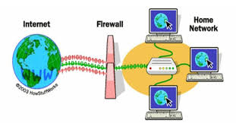
Firewall
A firewall surrounds and protects your computer like the walls of a castle.
A firewall checks all data before it allows the data to pass through the gates in the wall.
Only data that comes from a safe source can pass through the wall.

Slide 32
Use Email safely
Malware can come from files attached to email.
Criminals and hackers use misleading titles to tempt you to open a email:
Congratulations – you won first price.
Warning messages
Emails from strangers
Honest emails will never ask for personal information

Slide 33
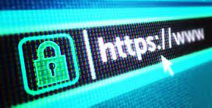
Use the web safely
Only use sites that you trust.
Download software from official sites.
Fake massages may ask you to fix a problem in your computer-do not respond

Slide 34
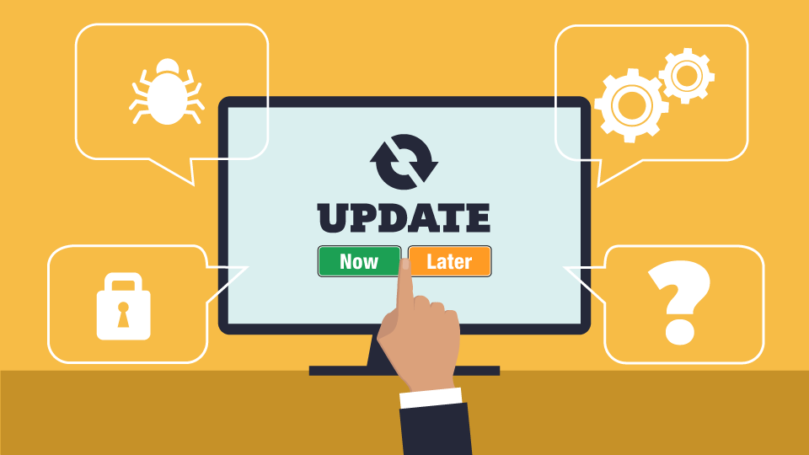
Update your software
Old versions of any software may includes some security errors that criminals and hackers may use to access a computer.
The updated version will make it more difficult for criminals to install malware.

Slide 35
Keep your password safe
Use a strong password that contains : letters (upper & Lower case)– numbers – characters
Change your password regularly.
Do not share your password.

Slide 36
Good Links
https://www.hp.com/us-en/shop/tech-takes/what-are-computer-cookies

