Slide 1
The is NOT used

Slide 2
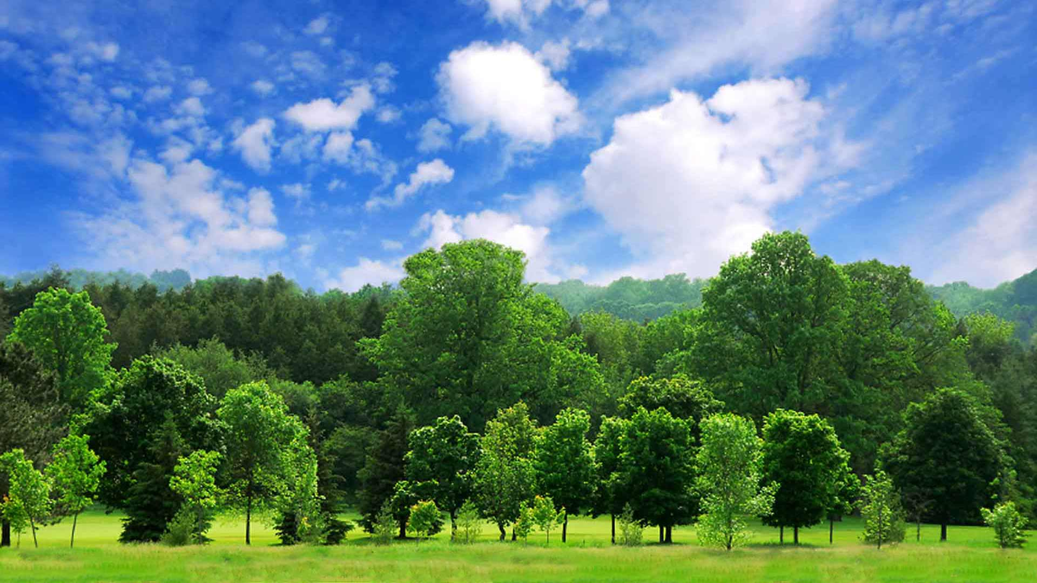
Trees produce oxygen.

Slide 3
Which trees? Trees in GENERAL

Slide 4
This is Tom.

Slide 5
With proper nouns

Slide 6
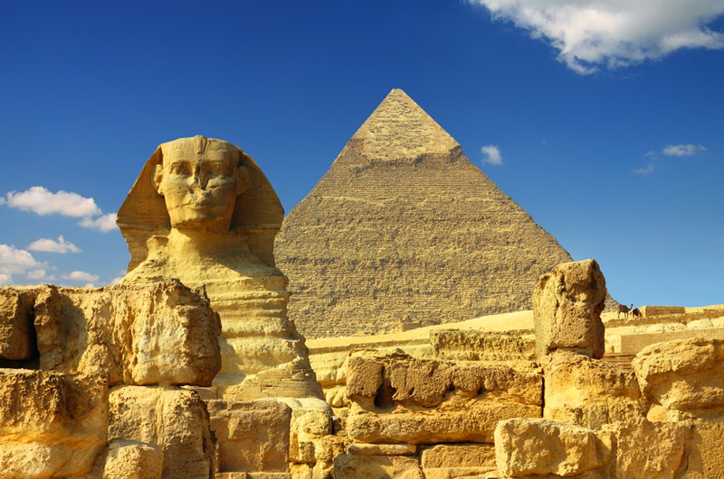
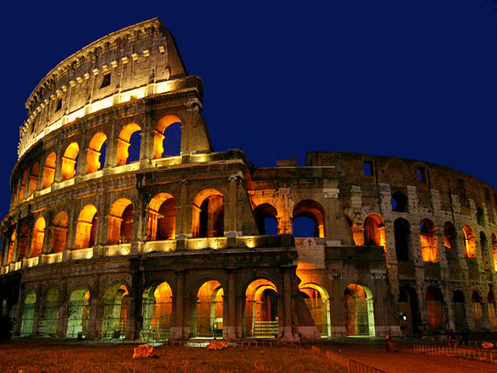
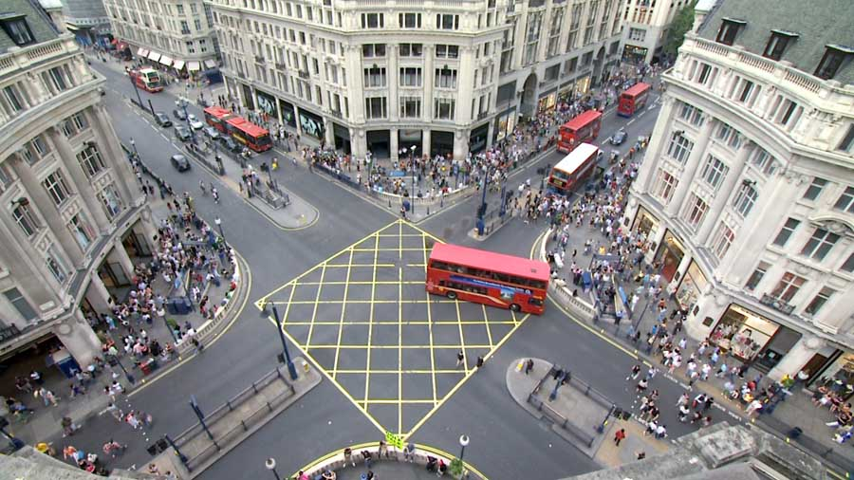
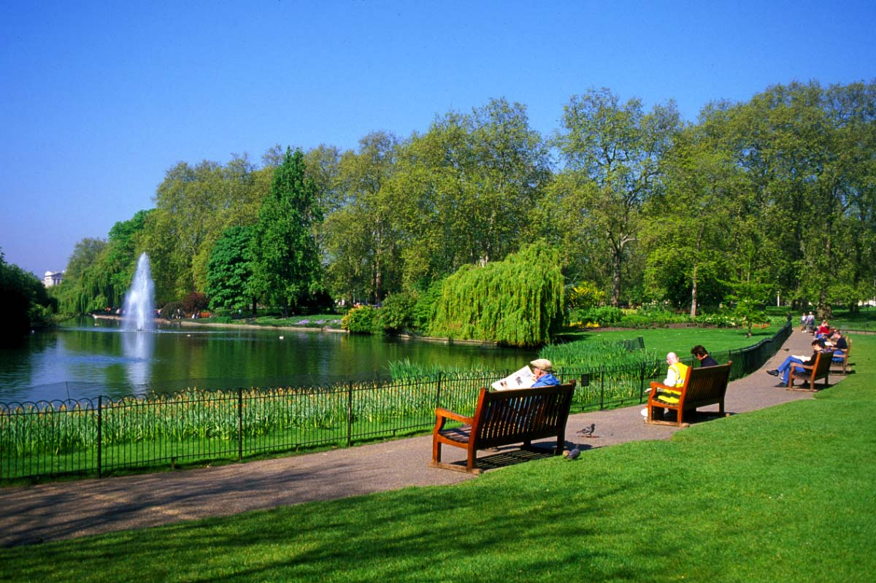

Slide 7
With names of countries Egypt cities Rome streets Oxford Street parks Hyde Park

Slide 8
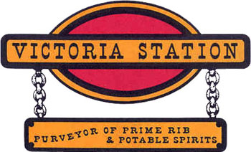
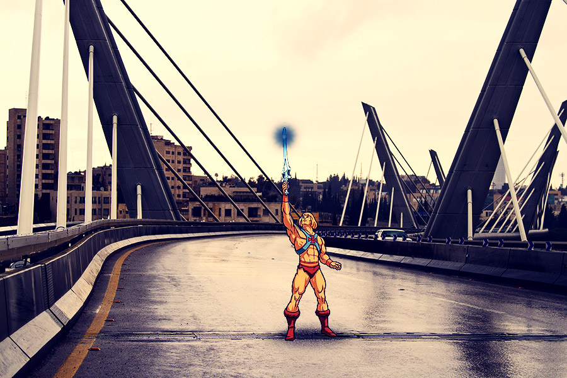
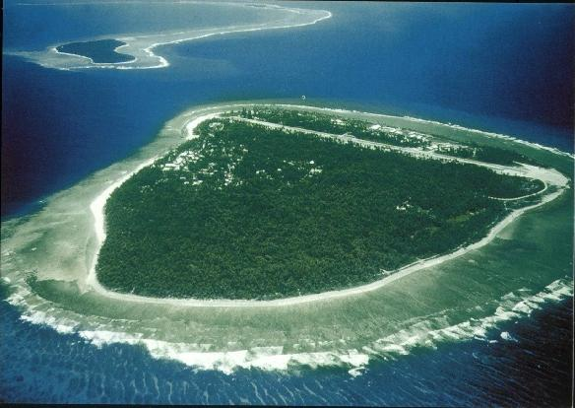
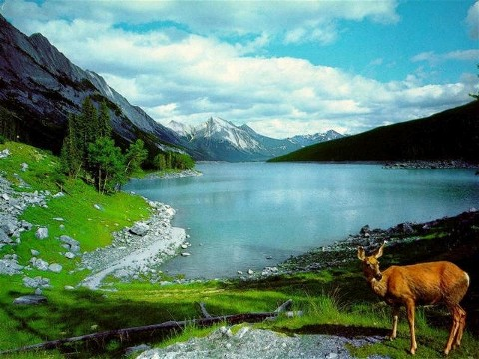

Slide 9
mountains Mont Blanc railway stations Victoria Station bridges Abdoun Bridge and lakes Como lake

Slide 10
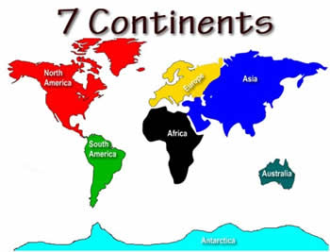
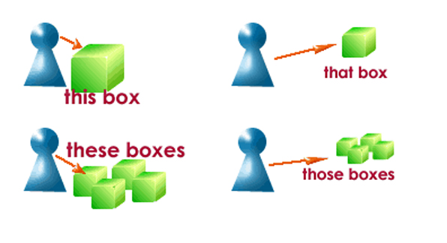

Slide 11
With continents Africa with the words this, that, these and those. This bag NOT the this bag

Slide 12
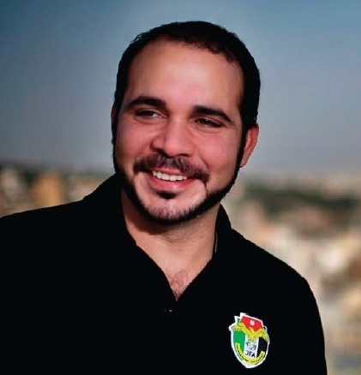

Slide 13
With titles when a person’s name is mentioned Prince Ali

Slide 14
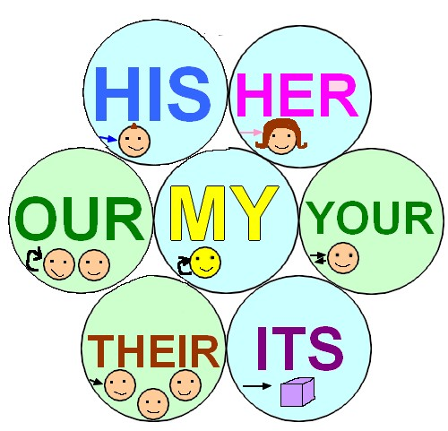
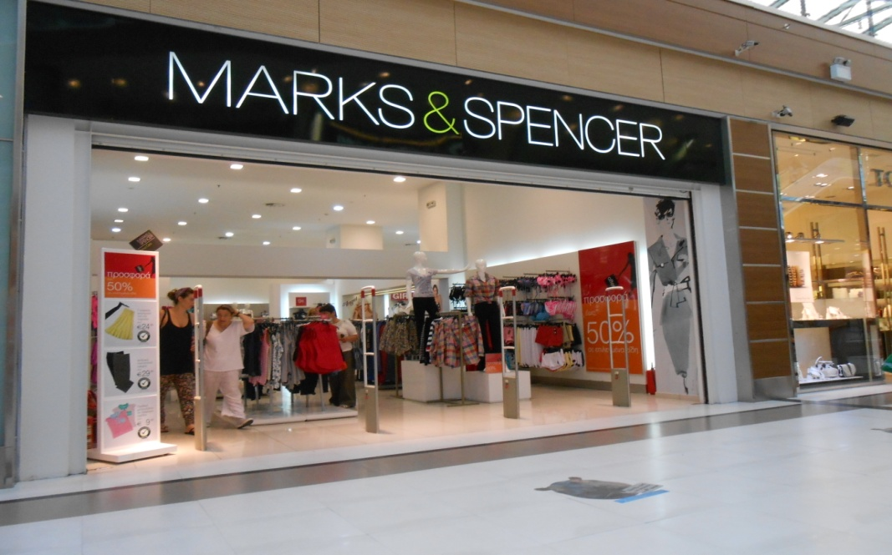
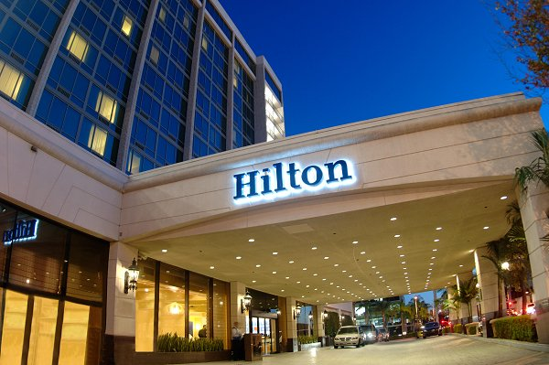
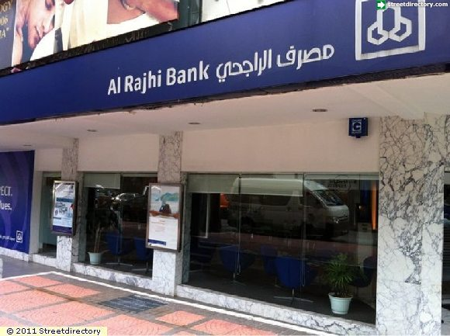

Slide 15
With names of shops, banks, and hotels named after the people who started it.

Slide 16
With the words School, church, bed, hospital, college, university, court, prison, or home.

Slide 17
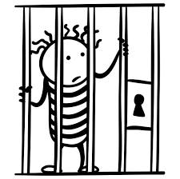
Jack was in a prison. (He was a prisoner) Jack’s mother went to the prison to visit him. ( she went to the prison to visit him.) We refer to the purpose for which they exist.

Slide 18
Transportation / by car, by plane/ by bus/ by train.

Slide 19
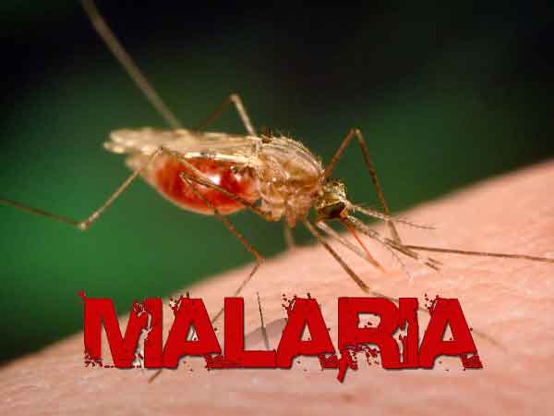
He’s got Malaria. But, the flue/ the measles/the mumps

