Slide 1
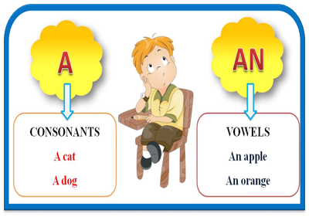
The Indefinite Article A/ An

Slide 2
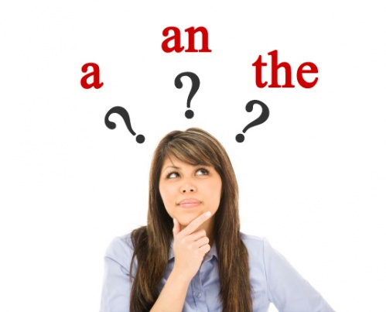
a/ an is used

Slide 3
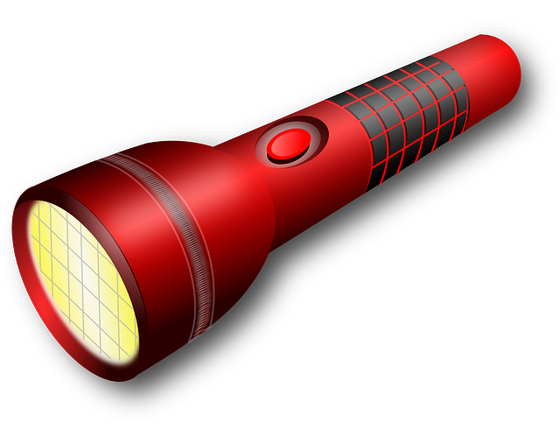
With singular countable nouns after the verb to be to say what someone or something is.
He is a pilot.
It’s a torch.

Slide 4
In certain expressions, when we want to show how often we do something. She goes shopping twice a month.

Slide 5
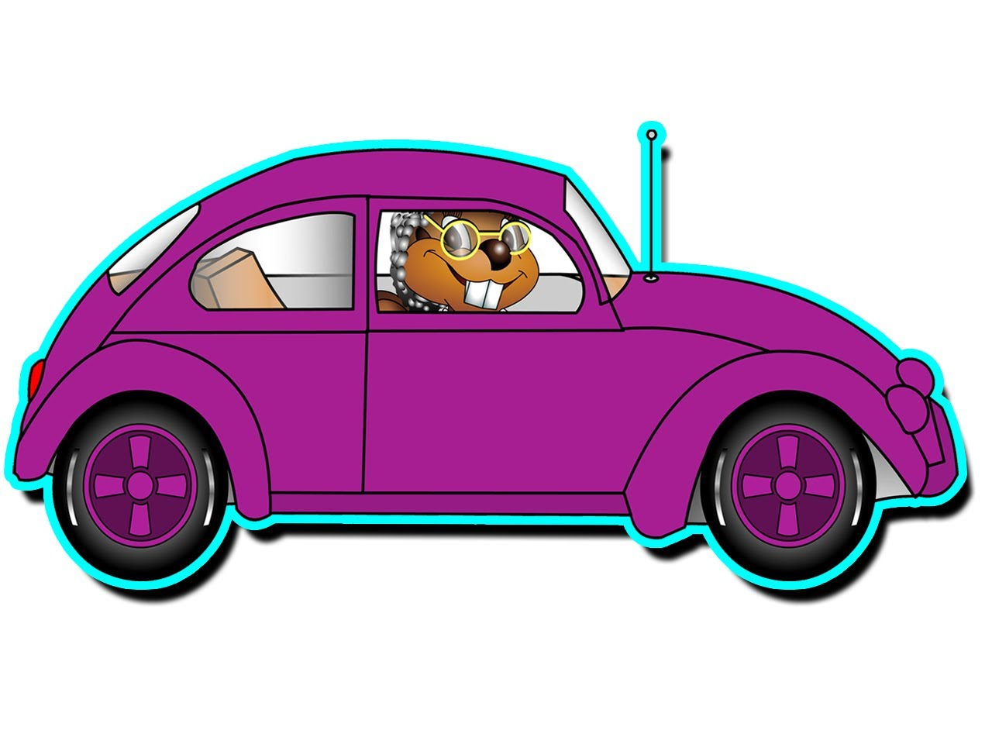
With the verb have got Mary has got a car

Slide 6
a/ an is not used

Slide 7
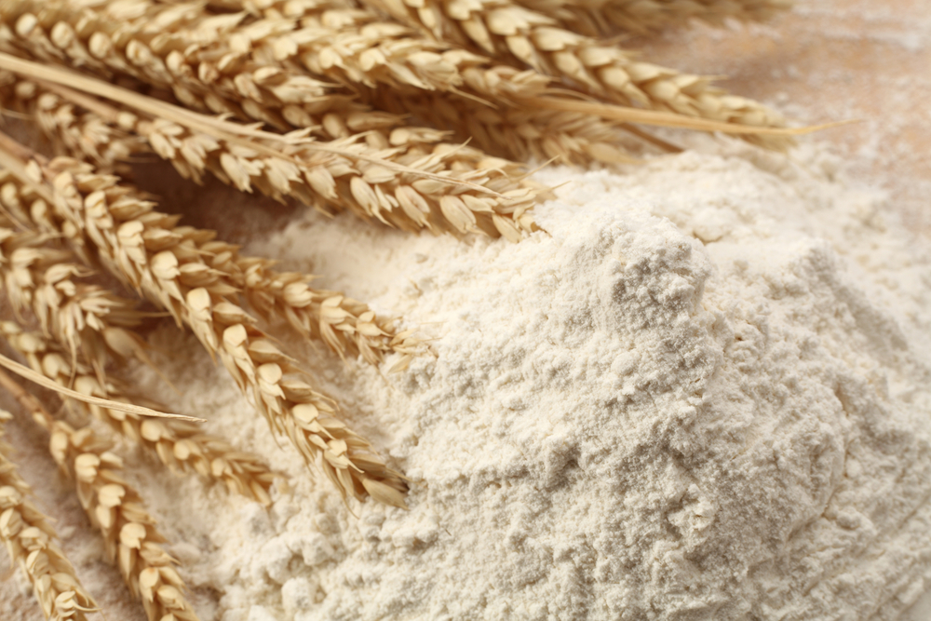
With uncountable nouns or plural countable nouns, we use some instead of a/an. We need some flour and some sugar.

Slide 8
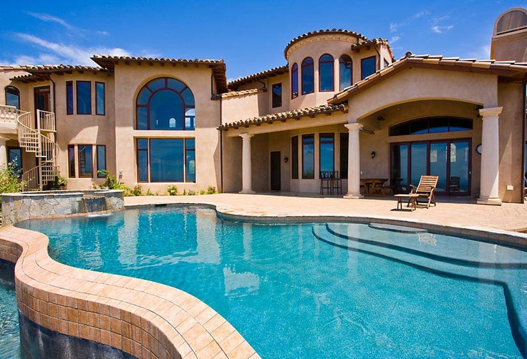
Before an adjective if it’s not followed by a noun. However if the adjective is followed by a noun we use a. It’s a house, it’s big, it’s a big house.

