Slide 2
The definite article the is used when we are talking about something specific, that is when the noun is mentioned for a second time or is already known. I received a letter. The letter was from my parents.

Slide 3
The is used

Slide 4
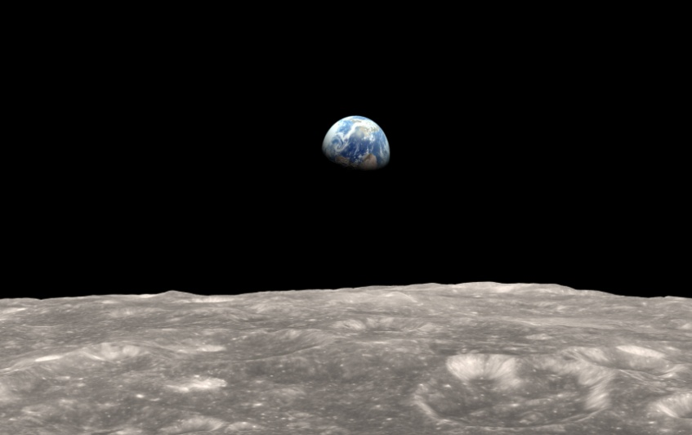
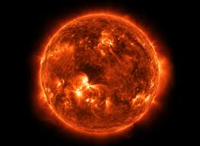
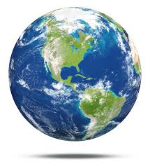

Slide 5
The nouns which are unique. The sun, the moon, the earth

Slide 6
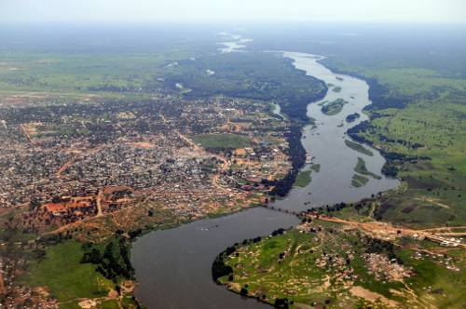
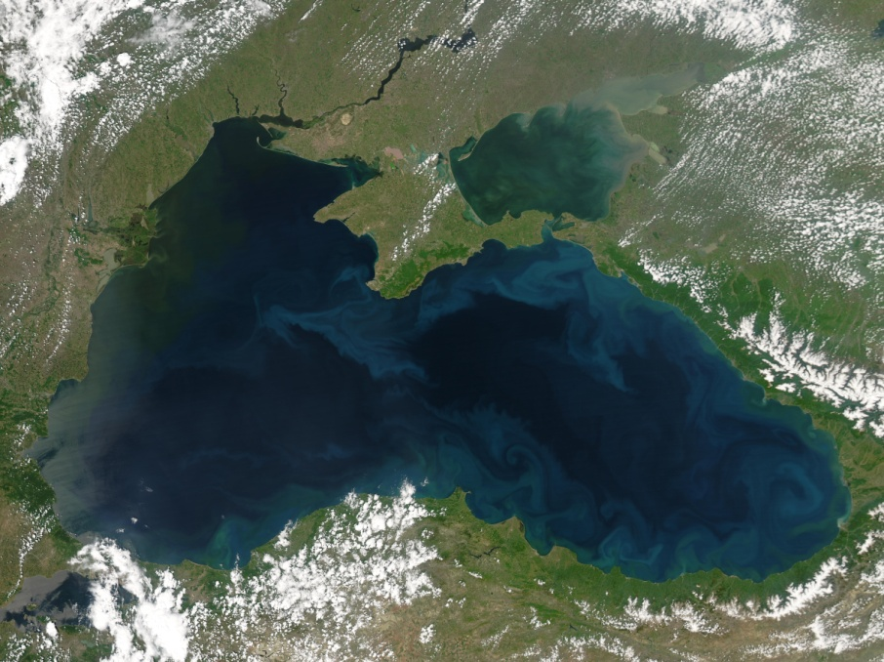
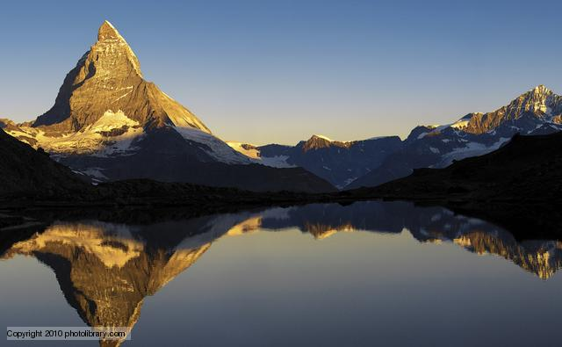
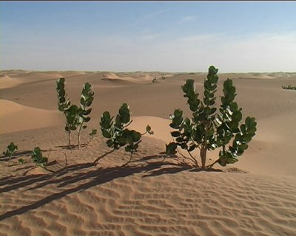

Slide 7
With names of rivers( the Nile) , sees ( The black sea), Ocean( The Indian ocean) deserts( The Sahara )

Slide 8
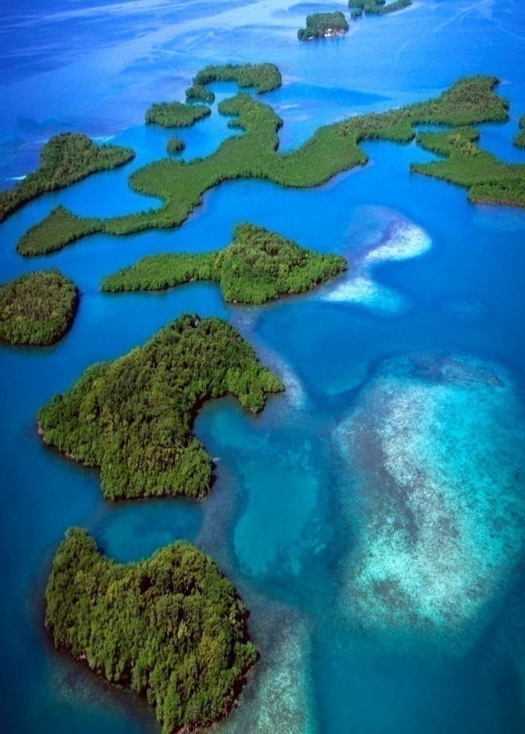
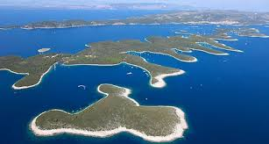
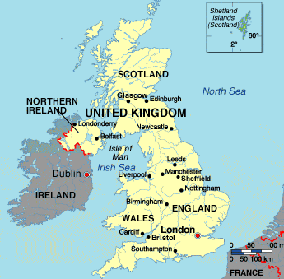
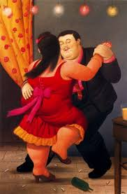

Slide 9
groups of islands( the Canary islands), countries which include words such as states, kingdom or republic ( The united States) With name of musical instruments ( the piano, the dances( the Tango)

Slide 10
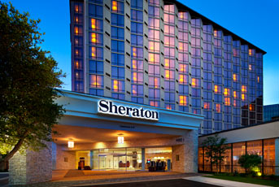
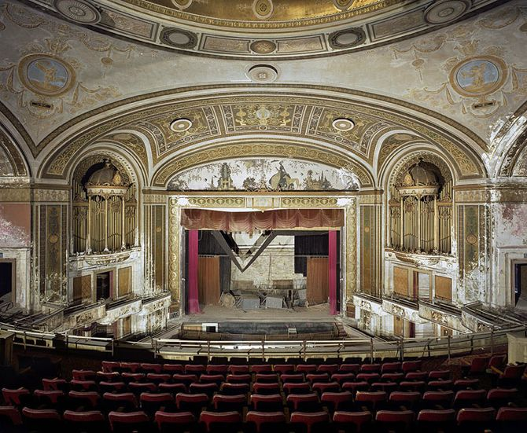
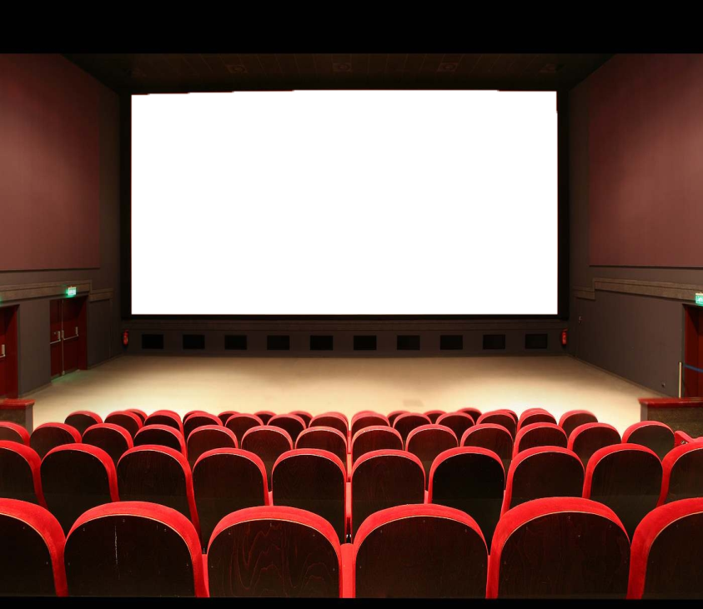
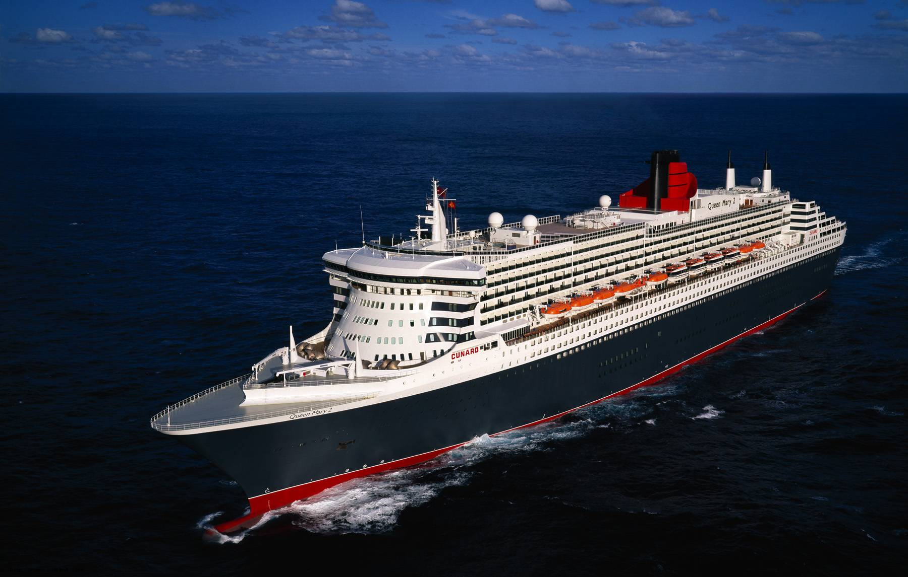

Slide 11
With names of hotels( the Sheraton Hotel) Theaters , Cinemas( the Odeon theatre, ships( The Queen Mary)

Slide 12
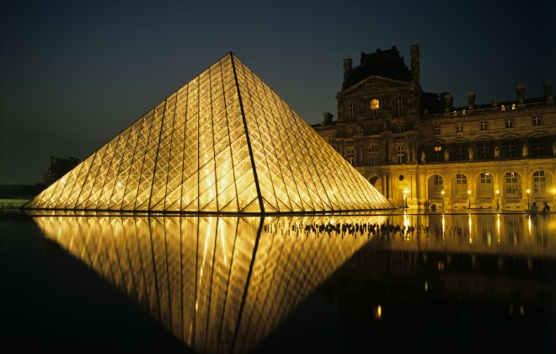
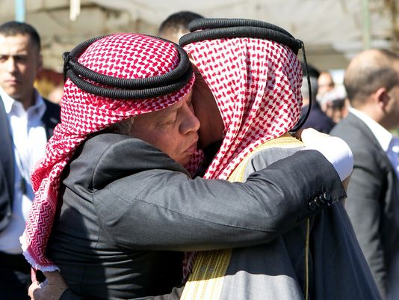

Slide 13
Organization ( the UN), Newspapers ( The Times), the museum( the Louvre)

Slide 14
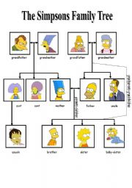
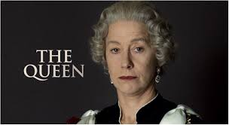
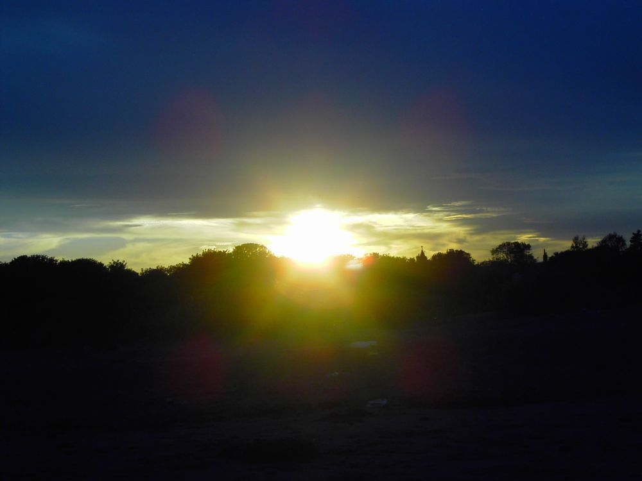

Slide 15
Names of the family( The Johnsons) nationality words (The Jordanians), with words morning, afternoon and evening

Slide 16
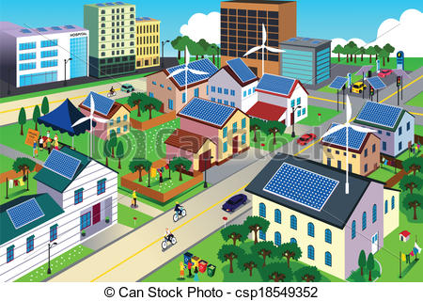

Slide 17
With words station, shop, cinema, library, city and village( she went to the station to meet him)

Slide 18
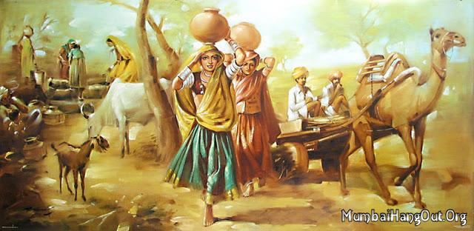
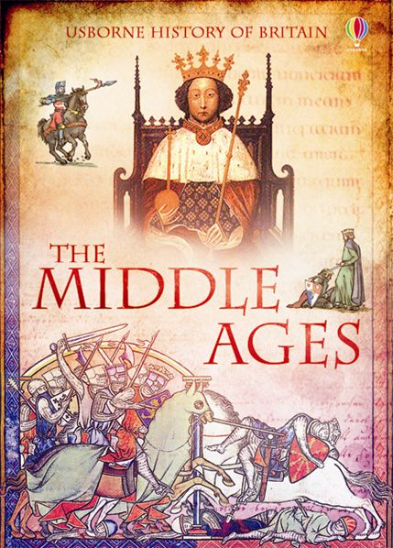
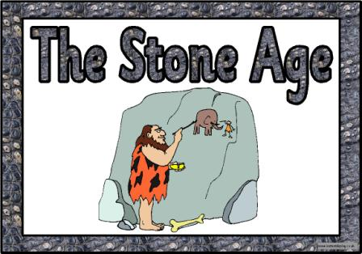

Slide 19
With historical periods, events( The stone age) ( the First world War) BUT World War 1

Slide 20
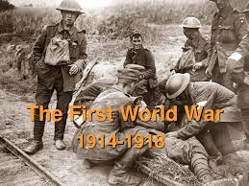

Slide 21
With adjectives, adverbs in superlative form( She is the most intelligent woman I've ever met.) with words only, last and first( used as adjectives)

