Slide 1




ZERO
FIRST
SECOND
THIRD

Slide 2
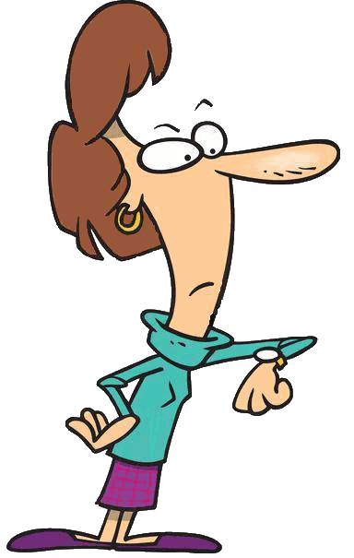

If clause | Main clause
If + Present simple | Present simple
If I am late for school,
my teacher gets angry.

Slide 3
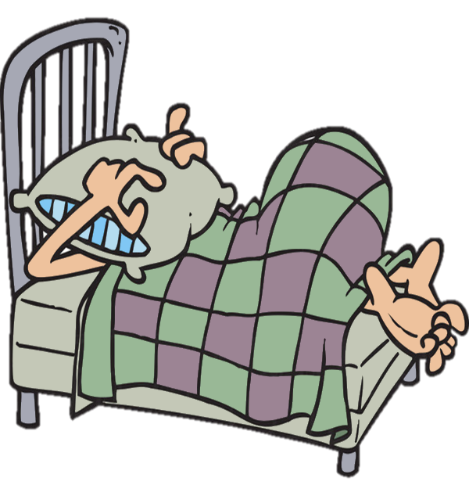

If I oversleep …

Slide 4
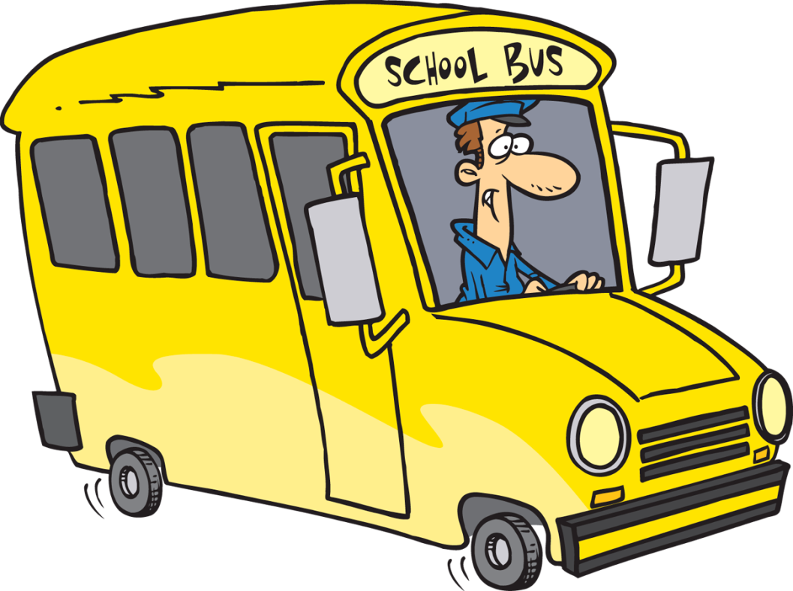
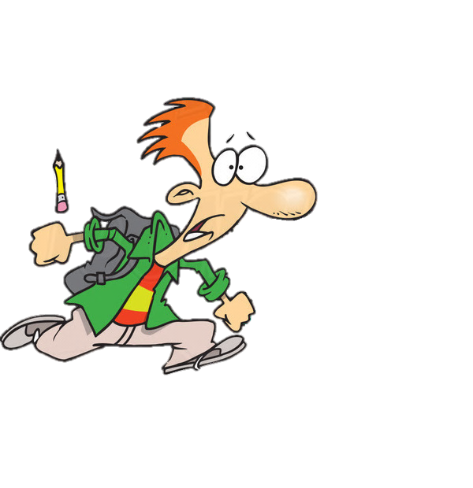
I miss the bus.

Slide 5


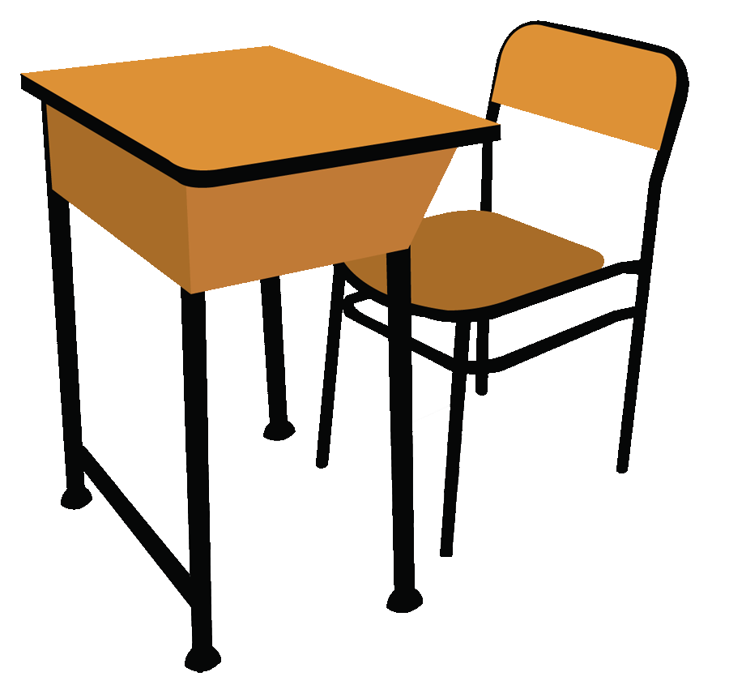
If I miss the bus, I am late for school.

Slide 6
If I am late for school, my teacher gets angry.

Slide 7
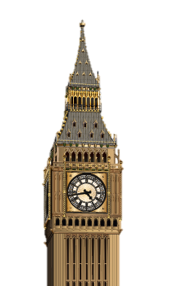

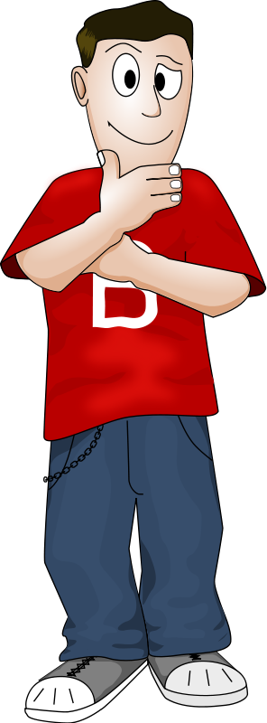
If clause | Main clause
If + Present tense | will / can / may / must + verb
If I go to London,
I will see Big Ben.

Slide 8
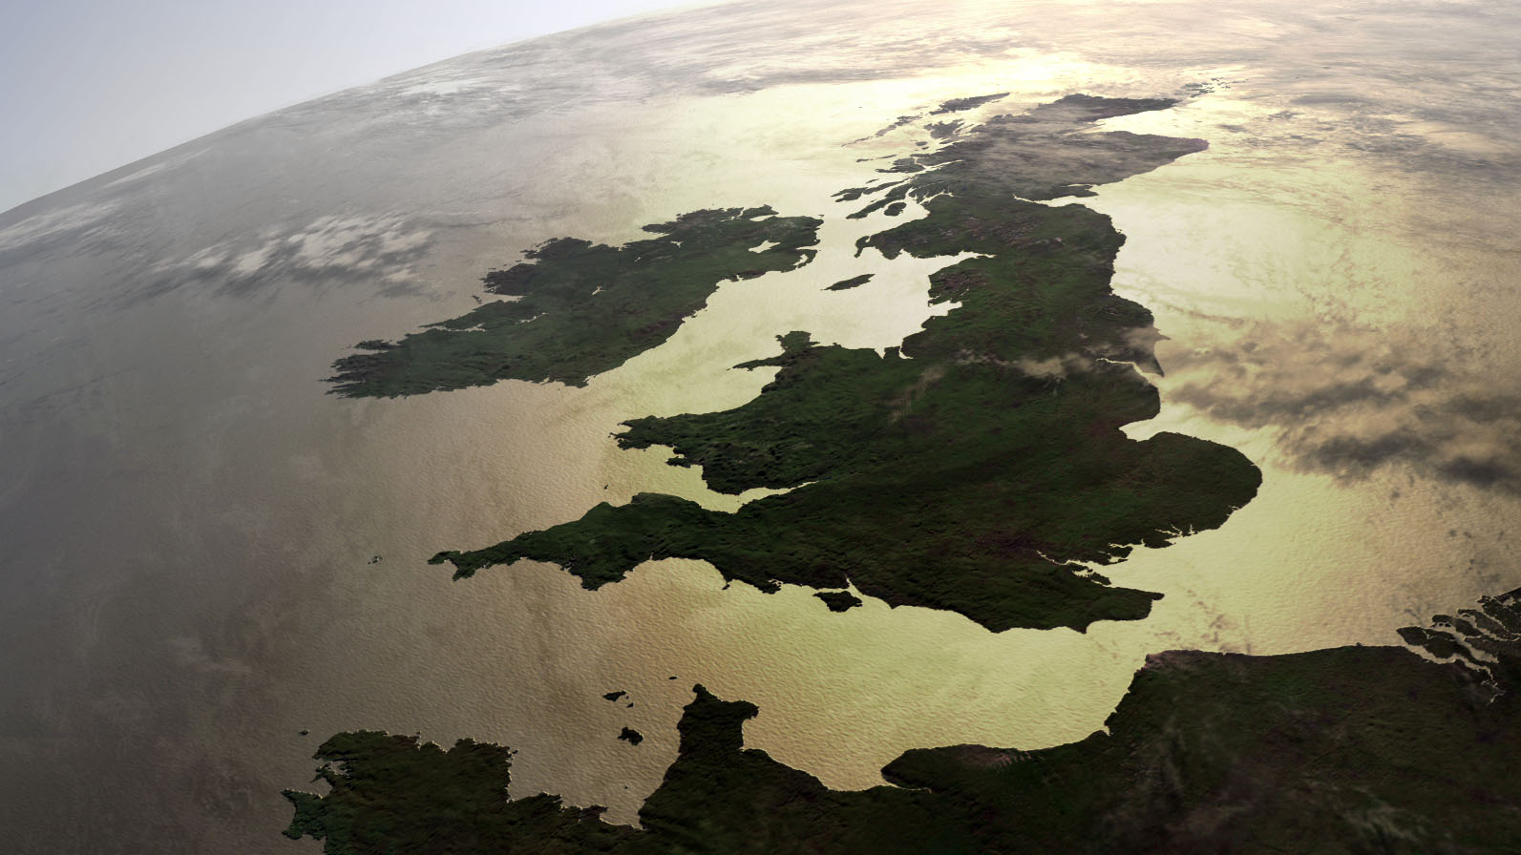
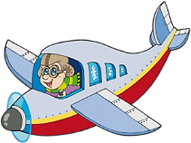

If I go to London …

Slide 9
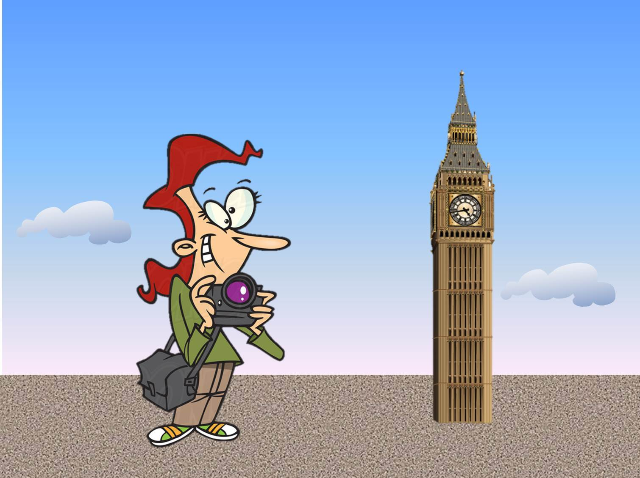
I will see the Big Ben.

Slide 10
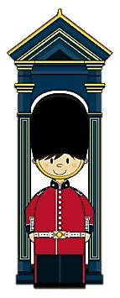

If I go to Buckingham Palace,
I can/will take a photo of the Royal Guard.

Slide 11
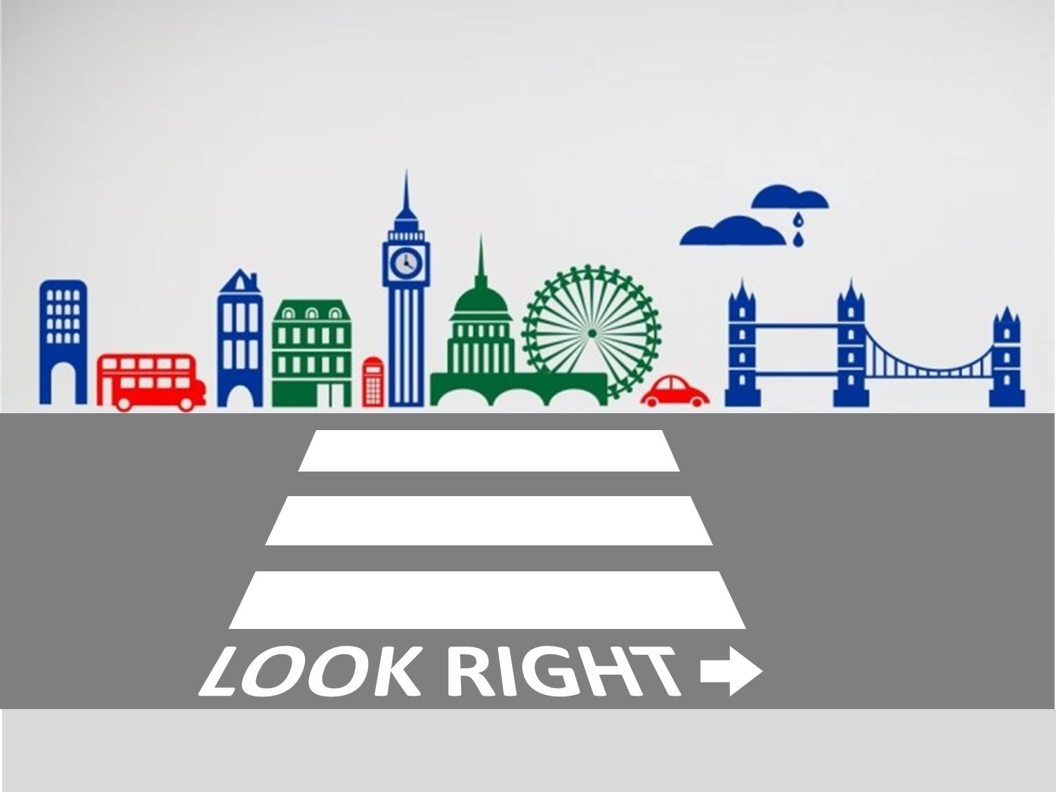
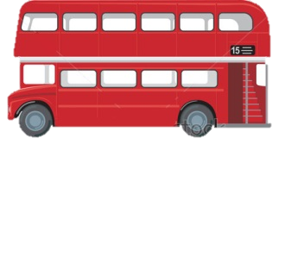

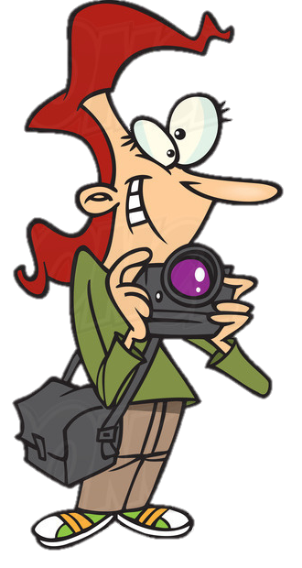
If you go to London,
you must look right before crossing a street

Slide 12


If clause | Main clause
If + Past Simple | would / could / might + verb
If I were an astronaut,
I would travel in a spaceship.

Slide 13
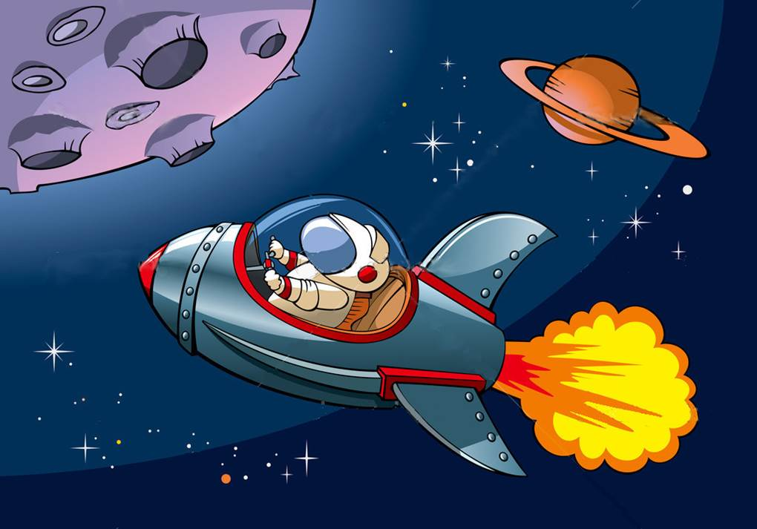
If I were an astronaut,
I would travel in a spaceship.

Slide 14
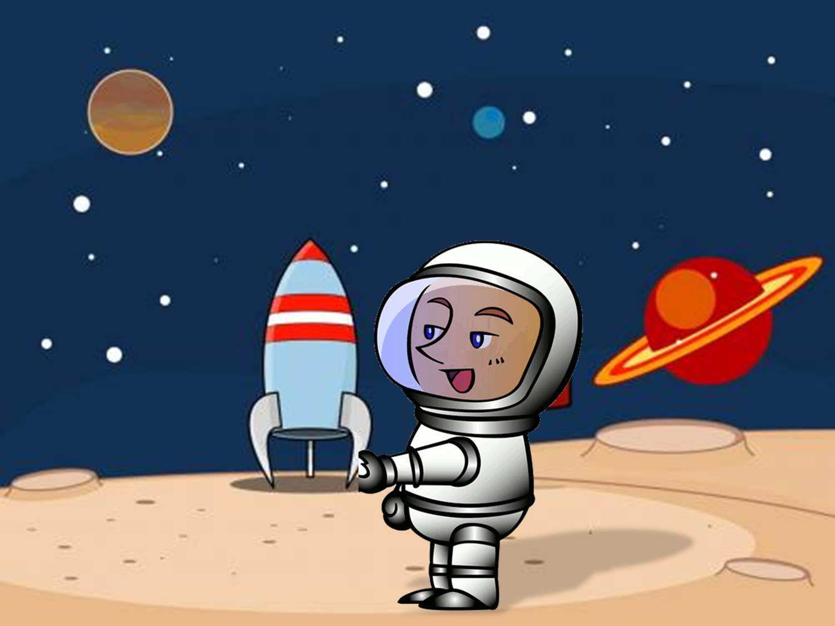
If I travelled in a spaceship,
I would go to Mars.

Slide 15
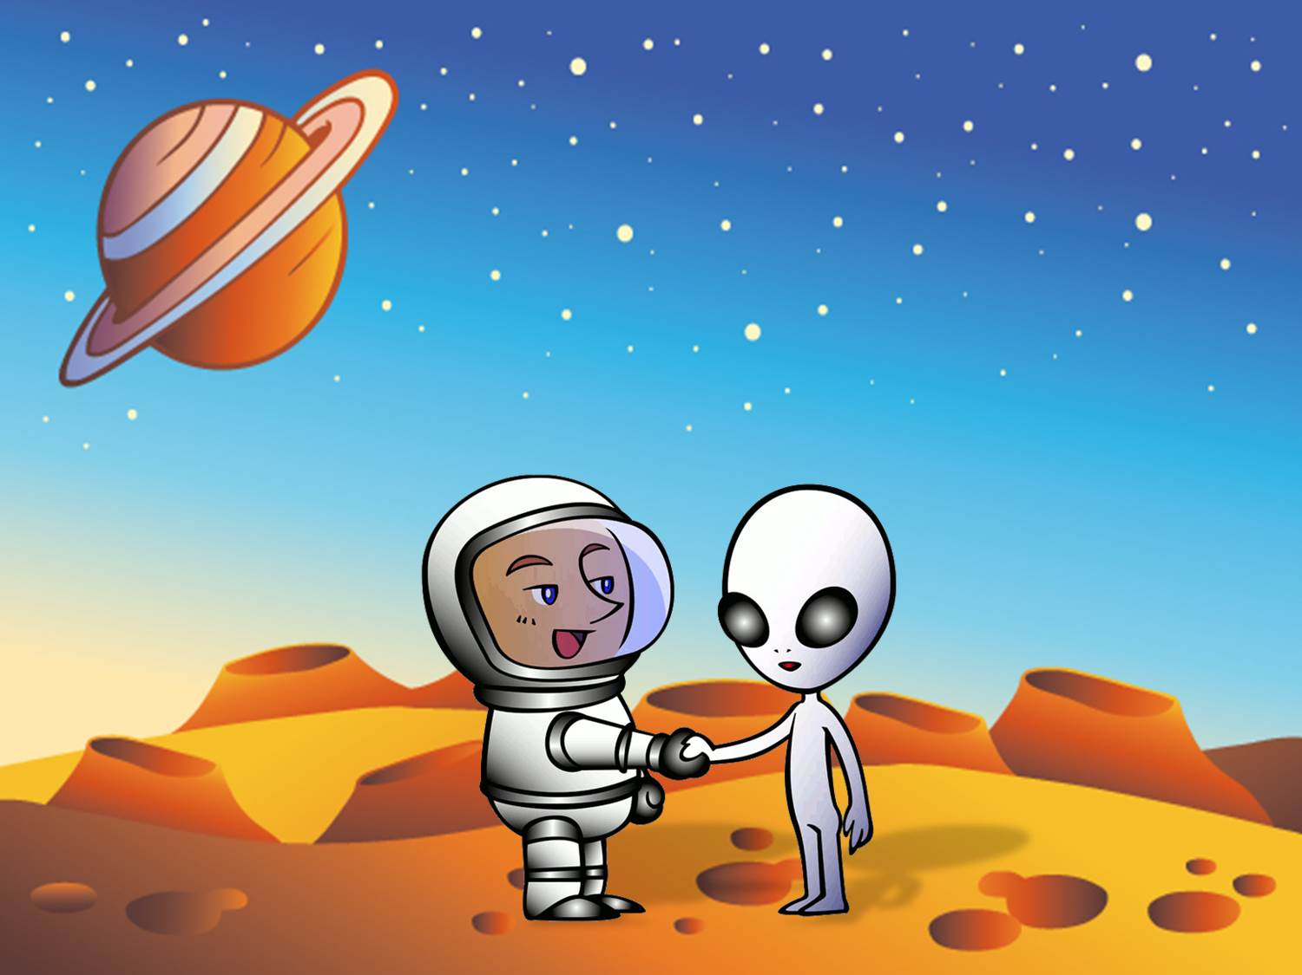
If I went to Mars,
I would meet a Martian.
Nice to meet you!

Slide 16
If I met a Martian,
I wouldn’t understand him.
?
IfI aved

Slide 17
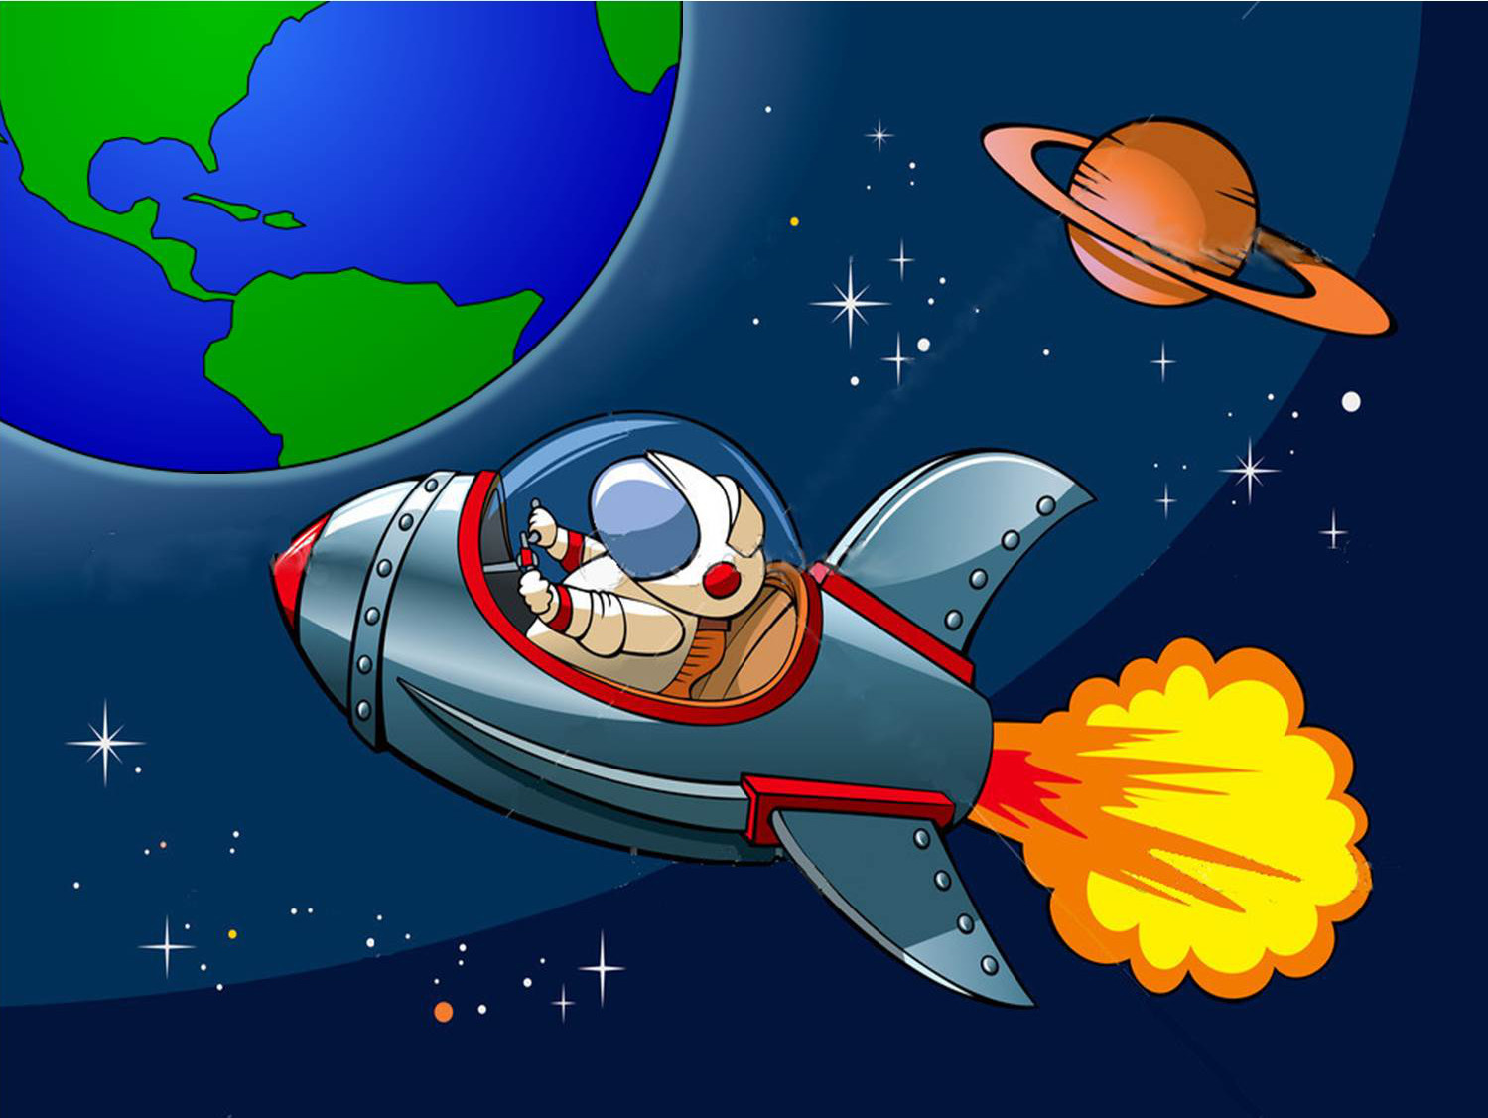
If I didn’t understand him,
I would come back to Earth.

Slide 18


If clause | Main clause
If + Past Perfect tense | would/could/might + have + past participle
If I had studied hard,
I would have passed my exams.

Slide 19
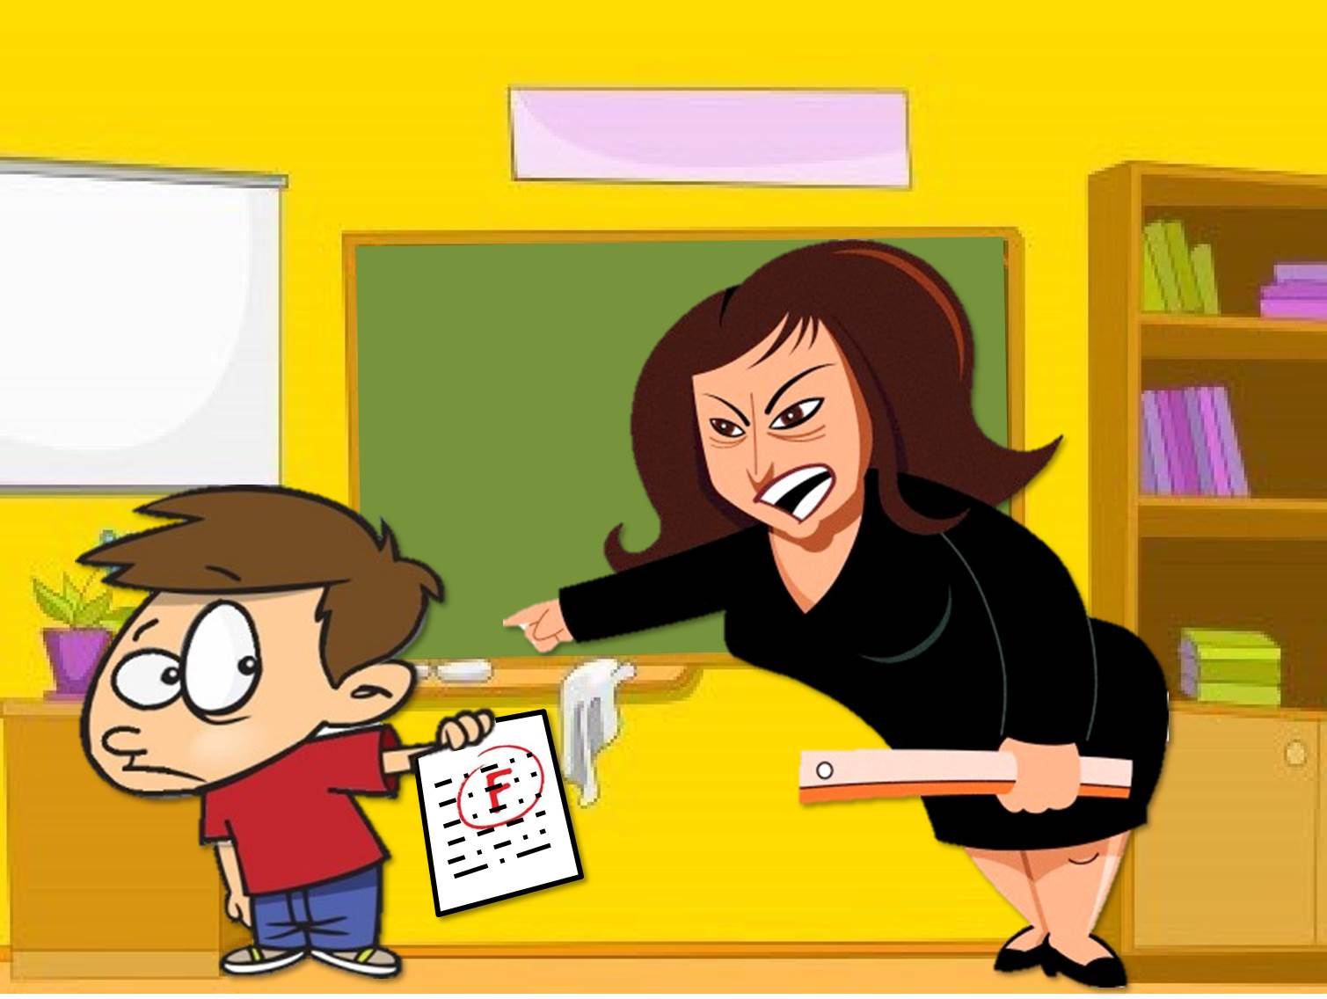
IIf you had studied hard,
you wouldn’t have failed your exam.

Slide 20
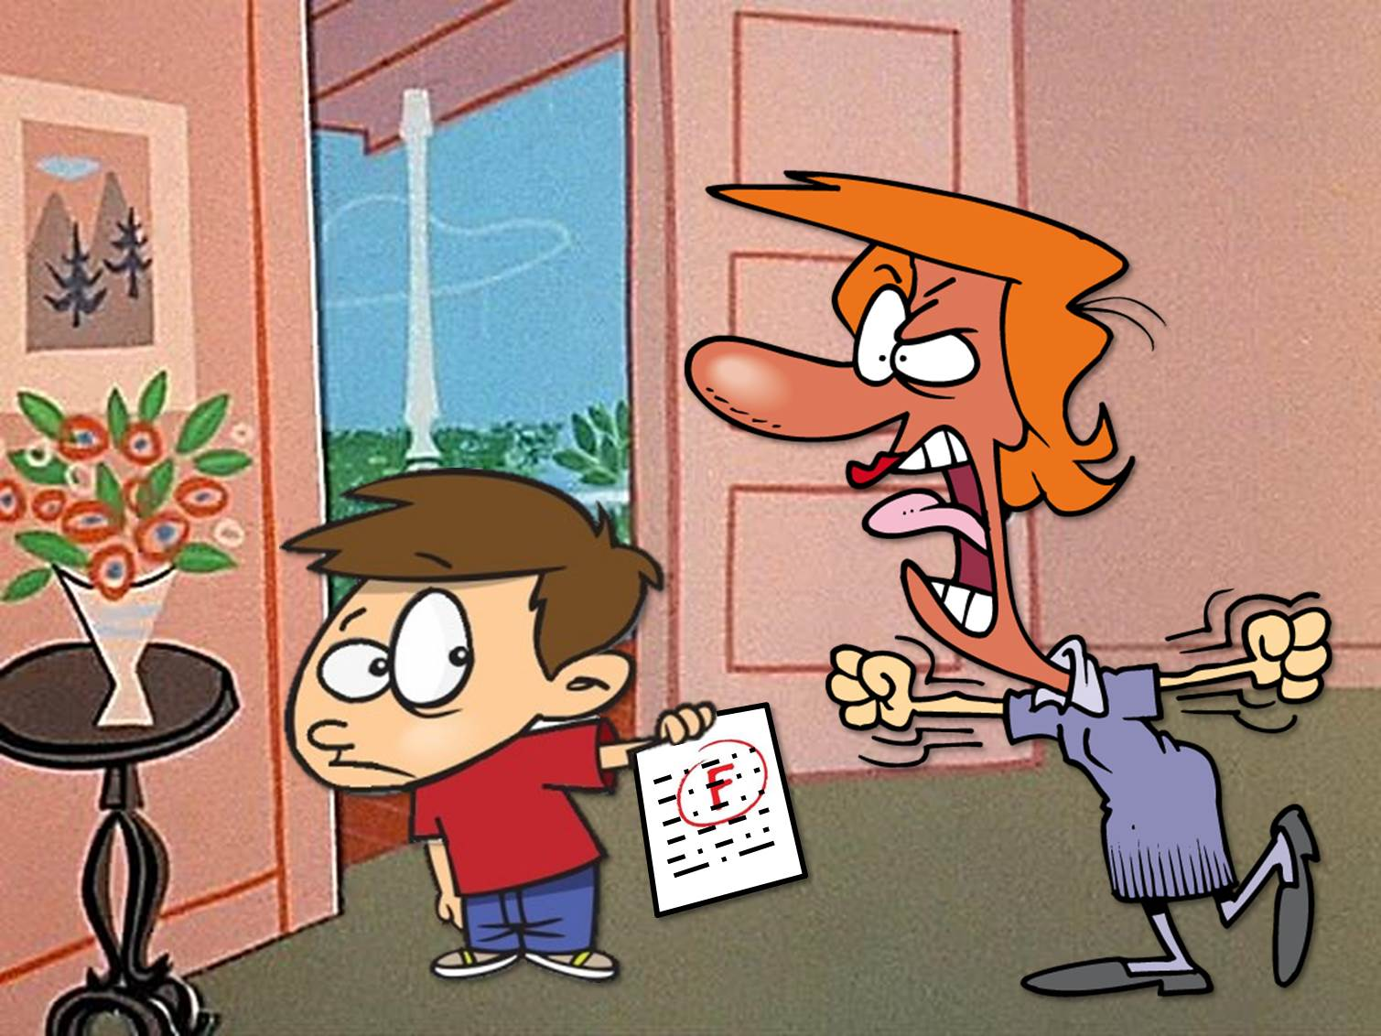
IIf you had passed your exam,
you could have gone to the beach.

Slide 21
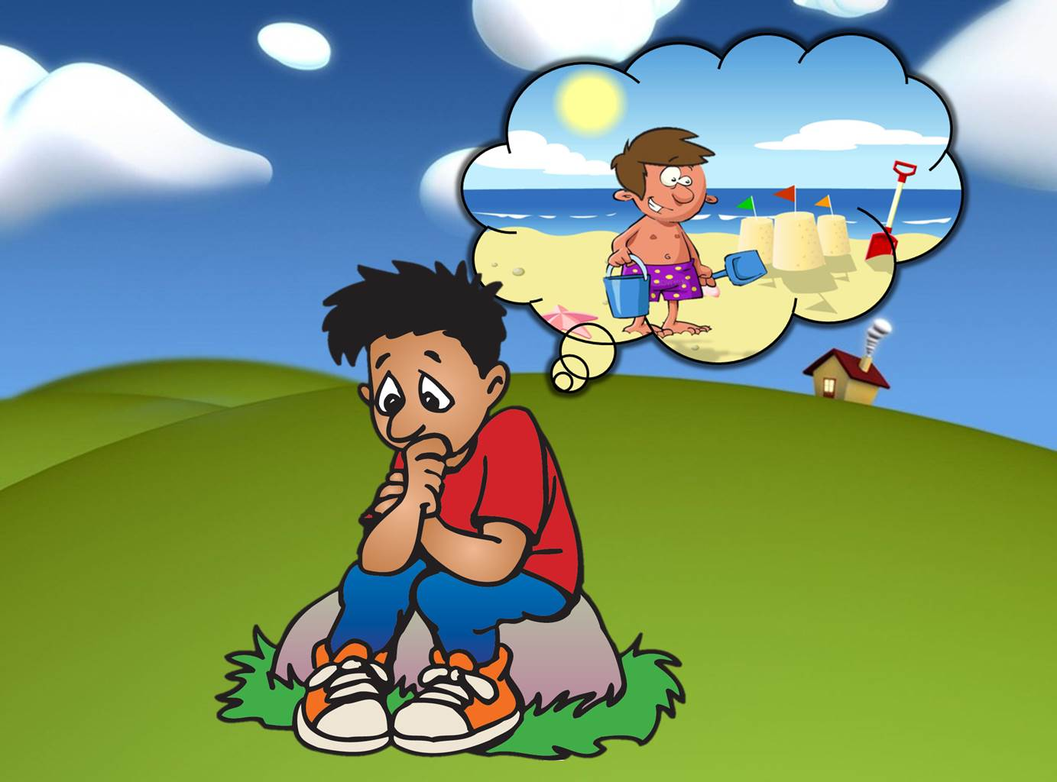
IIf I had gone to the beach, I would have made sand castles.

