Slide 1
apple

Slide 2
arrow

Slide 3
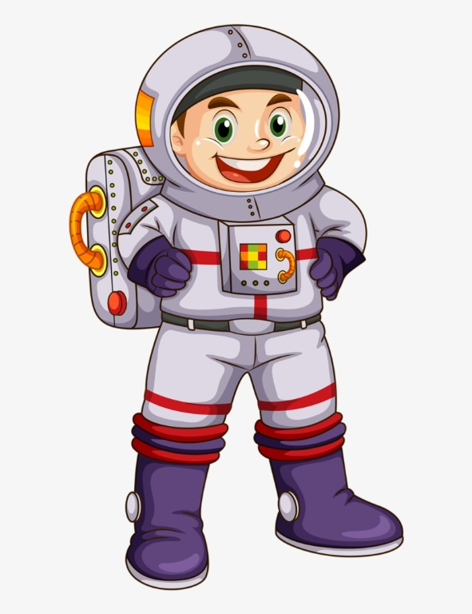
astronaut

Slide 4
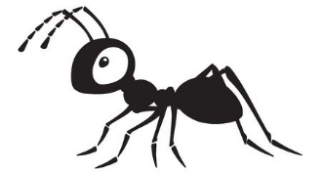
ant

Slide 5
ambulance

Slide 6
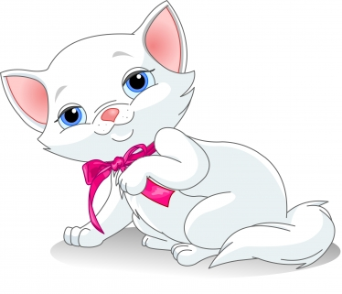
cat

Slide 7
pan

Slide 8
s a
sa

Slide 9
a s
as

