Slide 1

apple

Slide 2

arrow

Slide 3
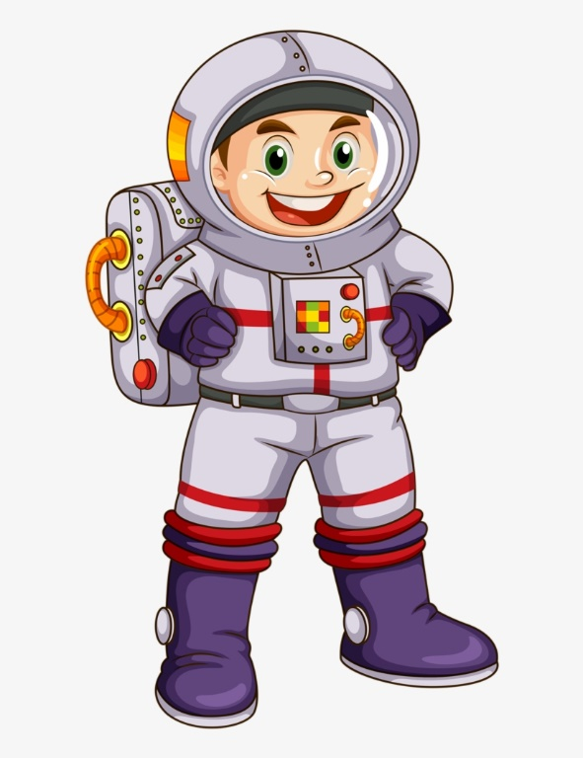
astronaut

Slide 4
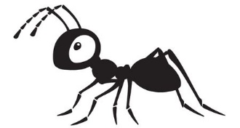
ant

Slide 5

ambulance

Slide 6
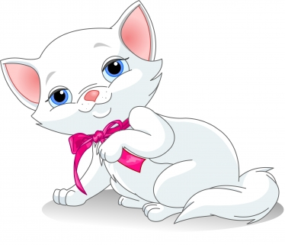
cat

Slide 7

pan

Slide 8
s a
sa

Slide 9
a s
as

