Slide 1
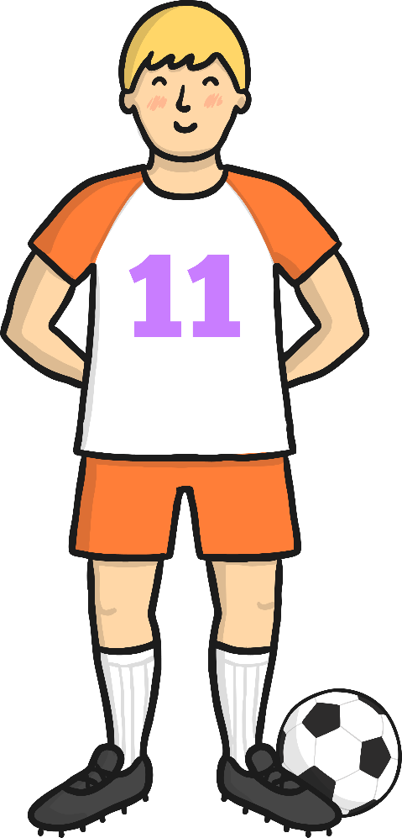
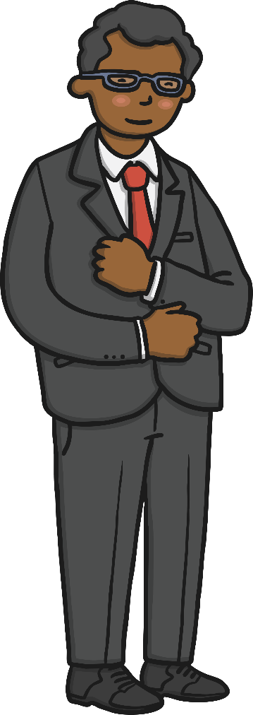
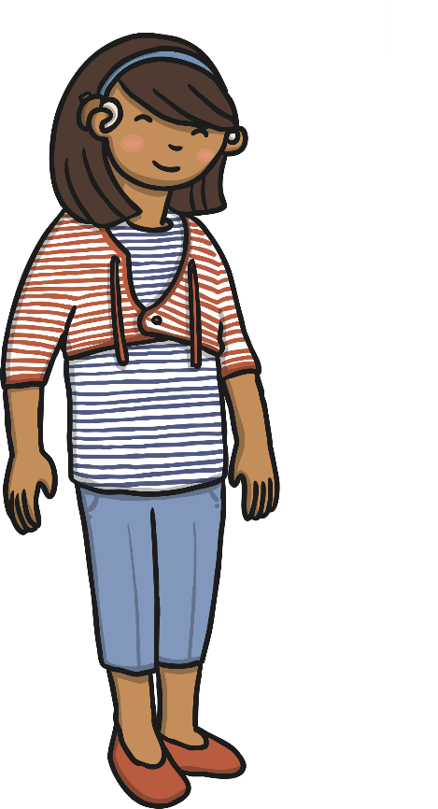
Names of People
Jim
Dr. Smith
Ms. Sara
Uncle Henry
Dana

Slide 2
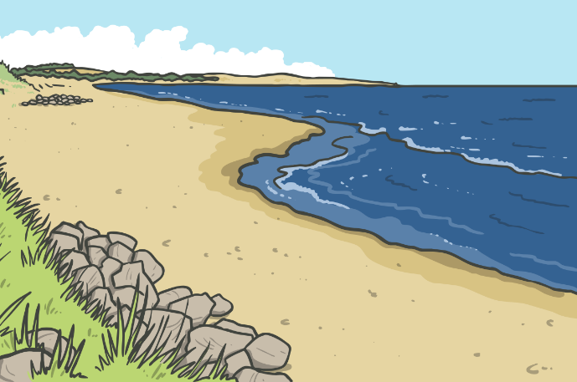
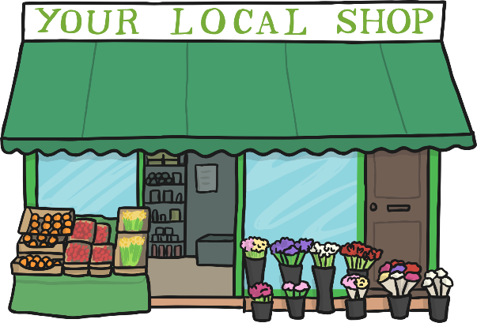
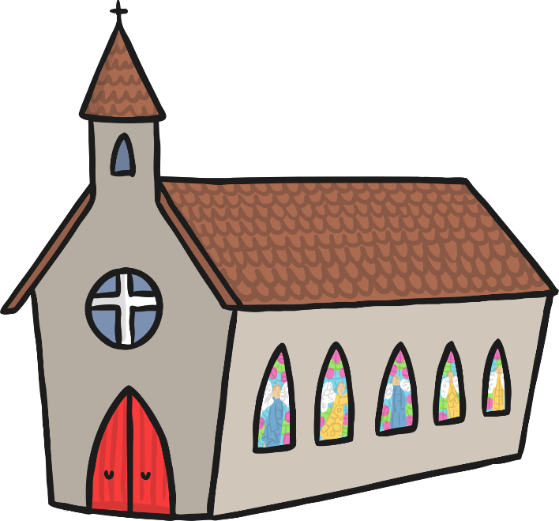
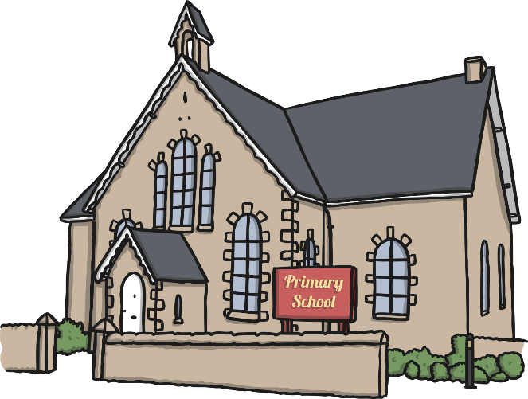
Names of Places
The National Orthodox School
City mall
London
Amman

Slide 3
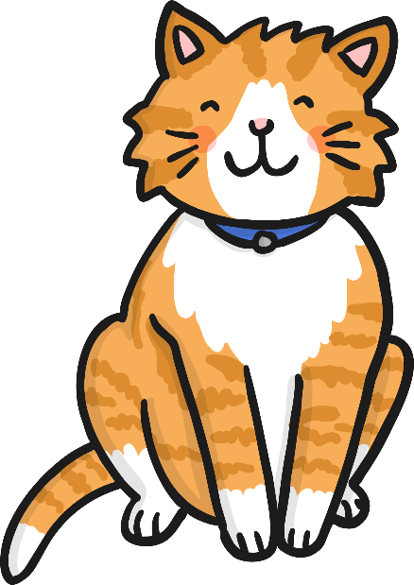
Names of Things
Grammar Rules
Adidas
Samsung
Indian Ocean
McDonalds

Slide 4
Nouns
With Naomi Noun

Slide 5
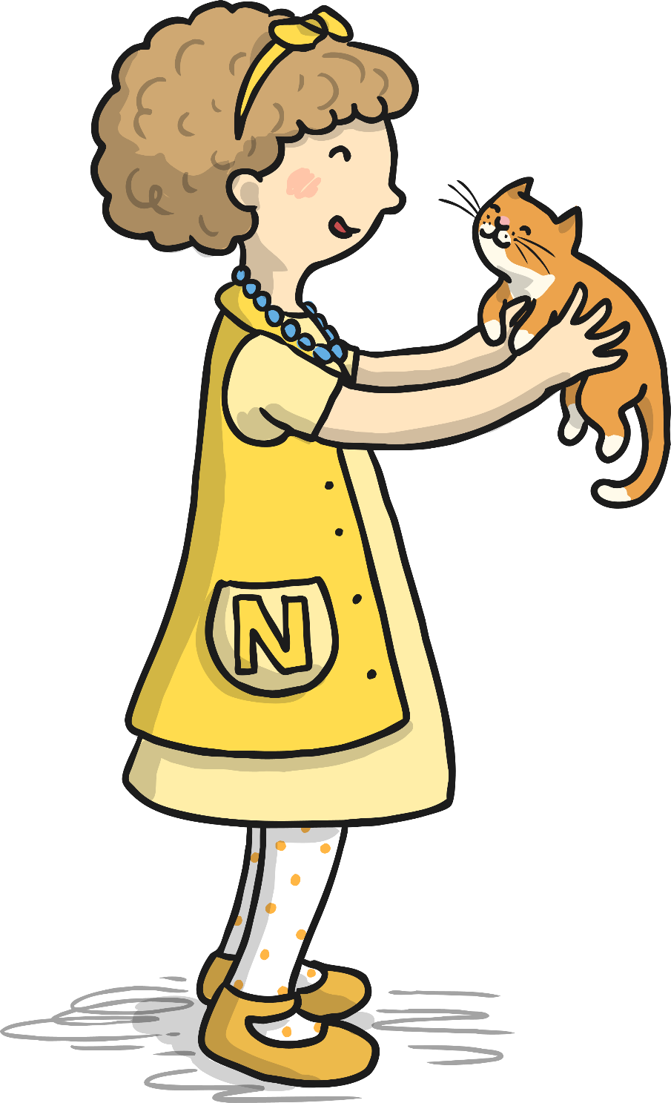
Hi my name is Naomi Noun and I like nouns. My job is to identify people, places, animals and things.

Slide 6
A proper noun can be the name of a person, place, animal or thing.

Slide 7
A proper noun also includes names of days of the week and months of the year.

Slide 8
Find the Proper Nouns
Look at the words below. Which ones are proper nouns?
Sandy
eat
play
Jordan
bird
buy
Africa
red
Toyota
Mrs. Bell
big
Abdali Mall
bat
Sunday
July
water

