Slide 1
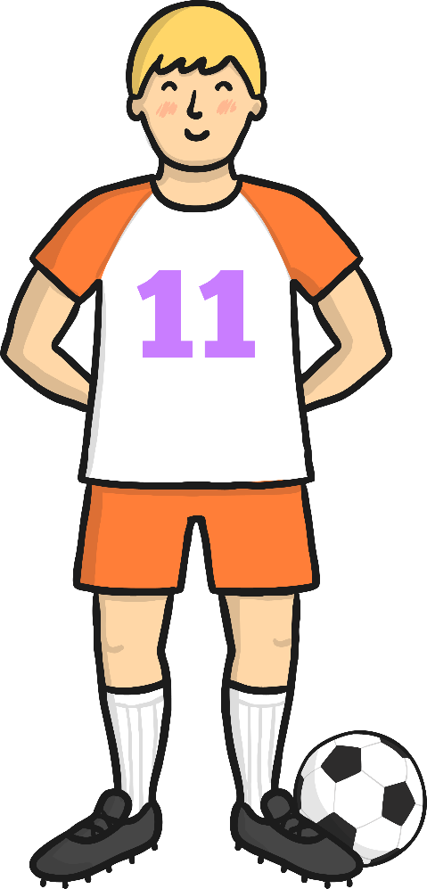
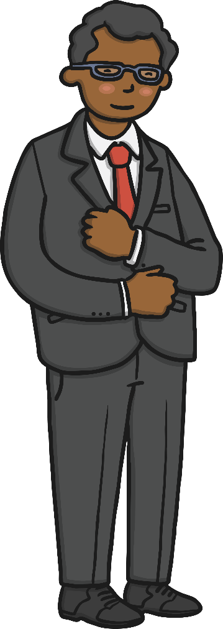
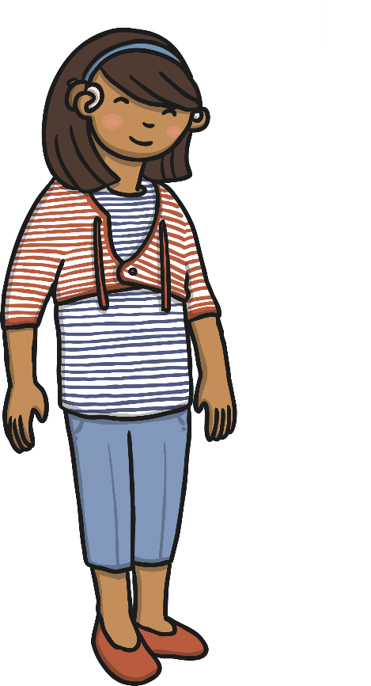
People
footballer
doctor
teacher
boy
girl

Slide 2
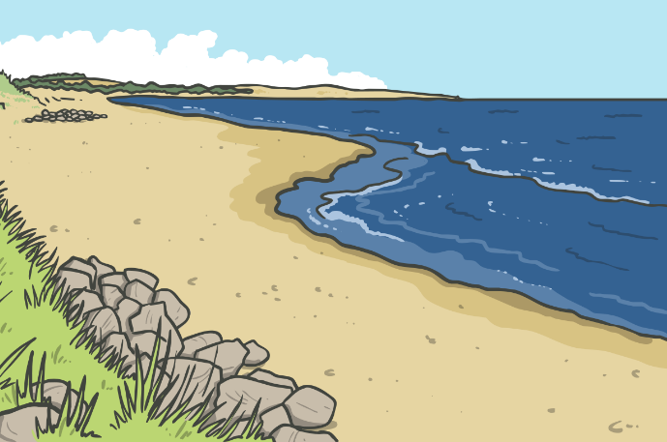
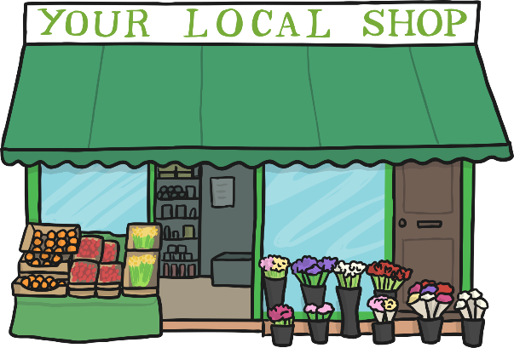
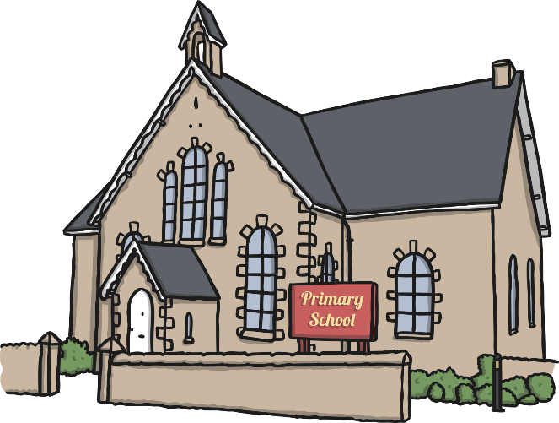
Places
school
shop
church
swimming pool
beach

Slide 3
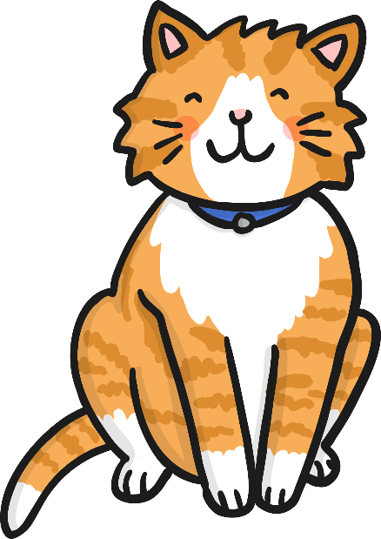
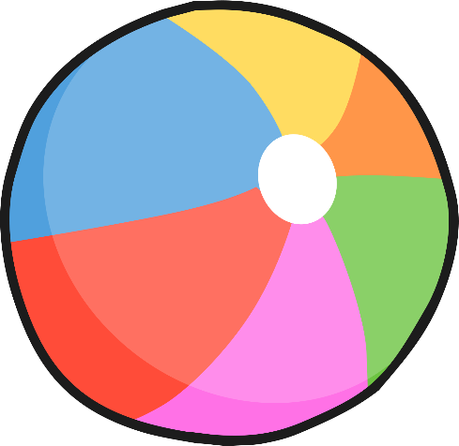
Things
book
cat
television
ball
chair

Slide 4
Nouns
With Naomi Noun

Slide 5
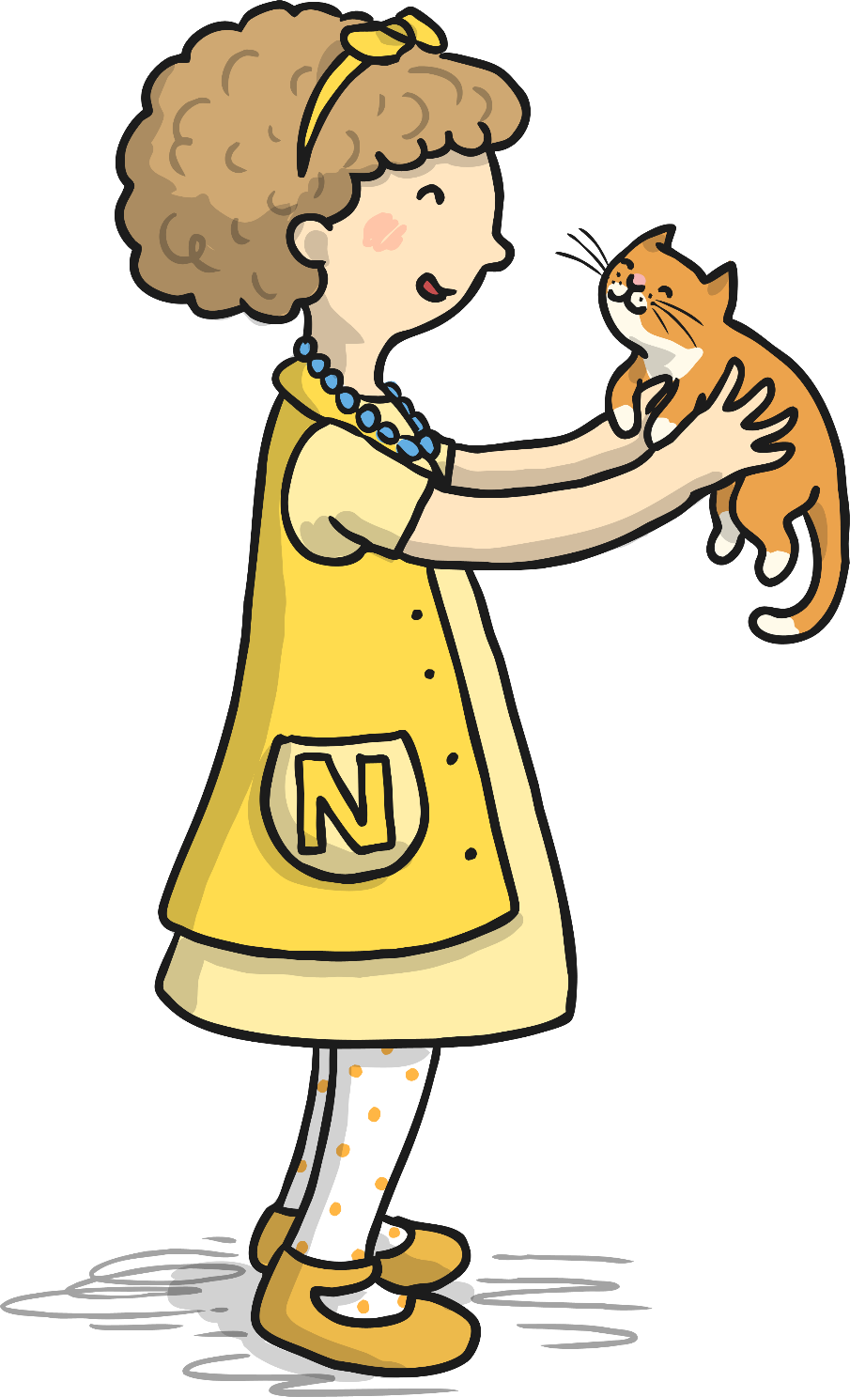
Hi my name is Naomi Noun and I like nouns. My job is to identify people, places, animals and things.

Slide 6
A common noun can be a person, place, animal or thing.

Slide 7
Find the Common Nouns
Look at the words below. Which ones are common nouns?
candle
pretty
dancing
owl
bird
flying
plane
brown
car
tree
tall
man

Slide 8
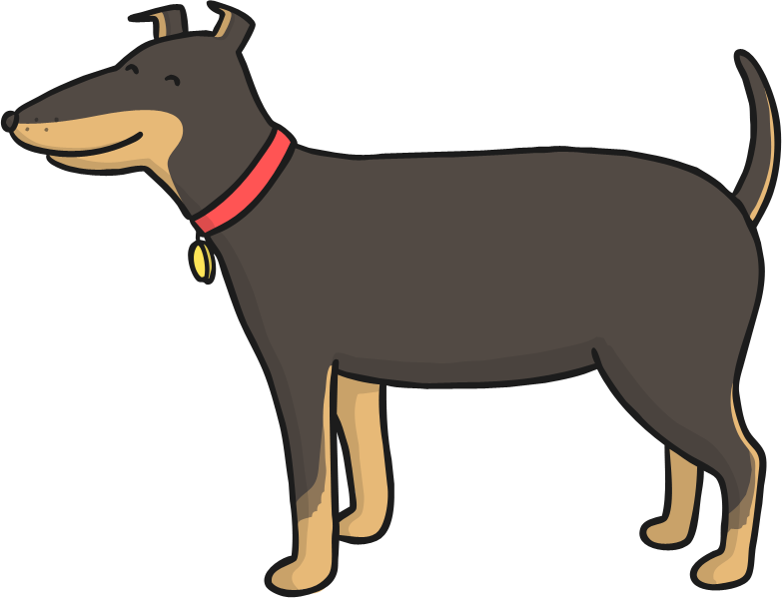
Can you find the noun in this sentence? Click for the answer.
The dog is wet.
Answer: dog

Slide 9
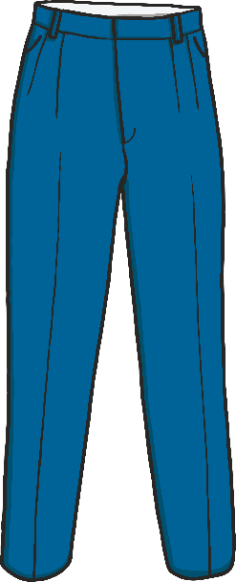
Can you find the noun in this sentence? Click for the answer.
The trousers are blue.
Answer: trousers

Slide 10
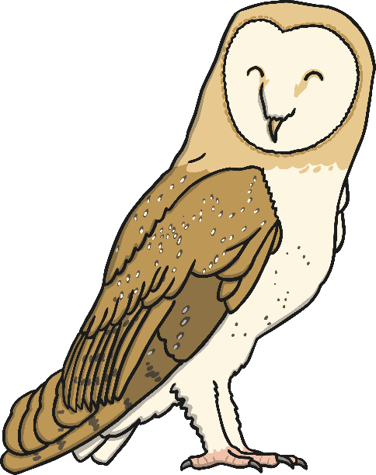
Can you find the noun in this sentence? Click for the answer.
Look at the beautiful owl.
Answer: owl

