Slide 1
Unit 1
1.2 The states of matter

Slide 2
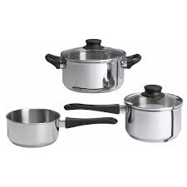
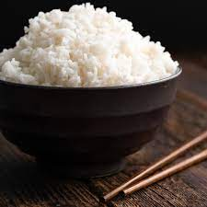
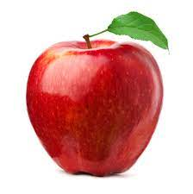
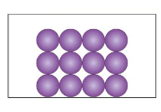
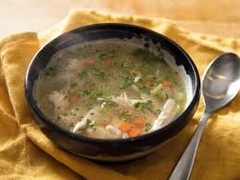
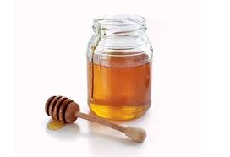
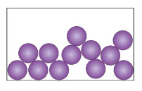
Warm up task
In your copybook Draw the particle model for the following:

Slide 3
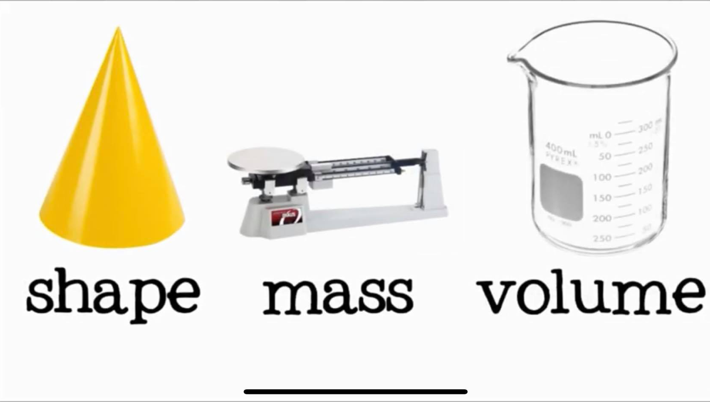
REMEMBER

Slide 4
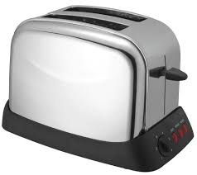
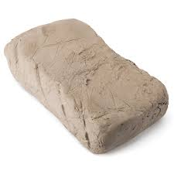
Solids
A solid is matter that has definite size and shape.
They could be hard
Or soft

Slide 5
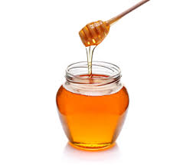
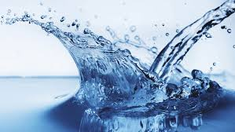
Liquids
A liquid takes the shape of any container.
They could be thick
Or thin

Slide 6
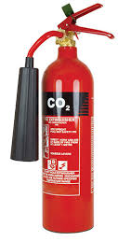
Gas
Gas is a matter that has no definite shape.
Gases take the shape of whatever container they are in .

Slide 7
Shape | Volume | Mass
Fixed | Fixed | Fixed (doesn’t change) | Solid
changes | Fixed | Fixed | Liquid
changes | changes | Fixed | Gas

Slide 8
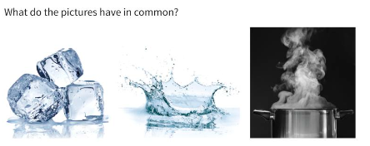
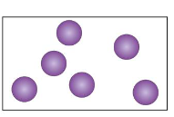
Lesson 1.2

Slide 9
The particles of water are the same in the three states.

Slide 10
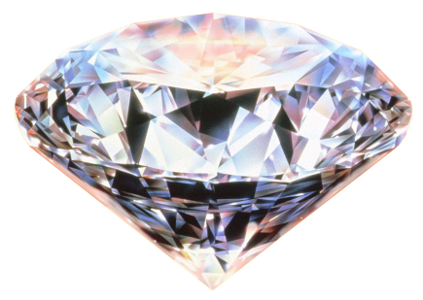
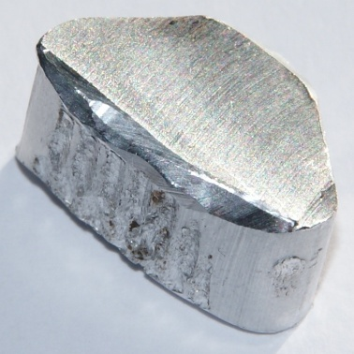
with STRONG BONDS
Particles in a solid are held together

Slide 11
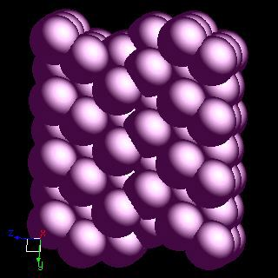
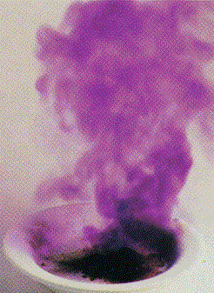
When forces between the particles are WEAK
Little ENERGY is needed to break them ...

Slide 12
The particles of a substance are the same in the three states. But factors are different for particles in the three states.
How particles are arranged
How particles move
How strongly the particles hold together
How far apart the particles are

Slide 13
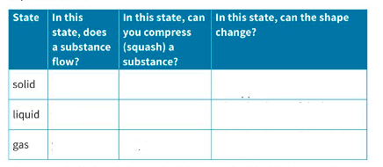
Let’s complete the following table

Slide 14
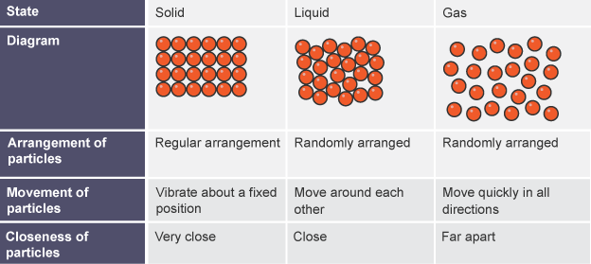

Slide 15
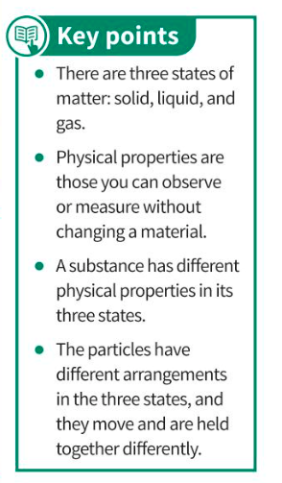

Slide 16
Workbook page 8

Slide 18
Answers to questions page 23
1- solid. Liquid, gas
2- Differences: shape – flowability
Similarity: both can be compressed a little bit
3- Arrangement: particles are not in a pattern
Movement: particles move around randomly, sliding over each other
Separation : particles touch each other
4- Particles in a liquid are held more strongly than particles in a gas.

Slide 19
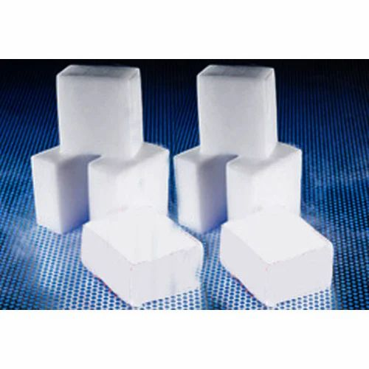
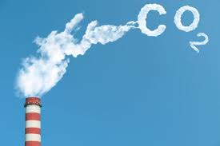
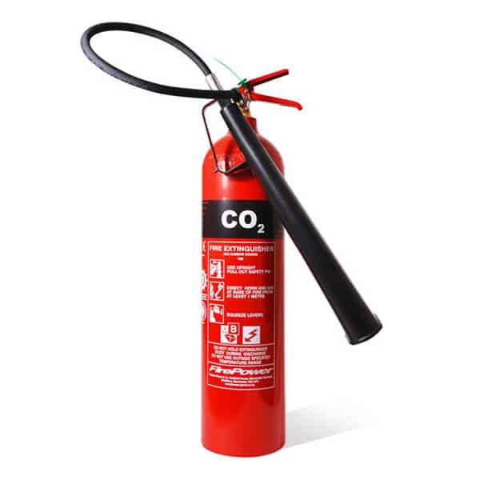

Slide 20
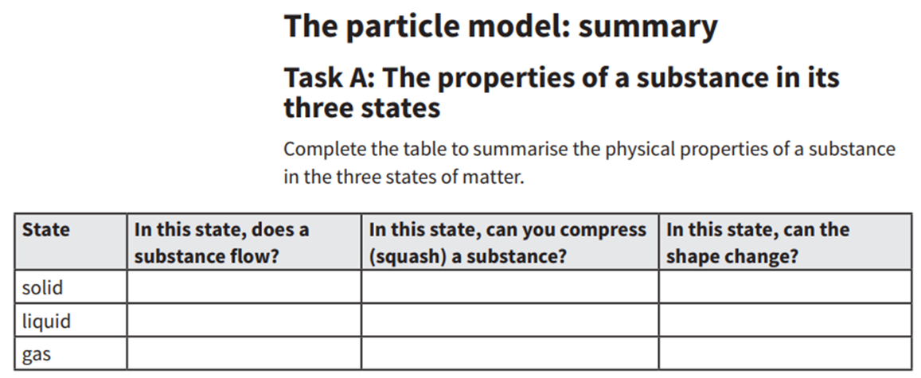
No
Only a little bit
No, unless you apply force
Yes
Only a little bit
Yes, it takes the shape of the bottom of the container
Yes, a lot
Yes, it takes the shape of the whole container
Yes

Slide 21
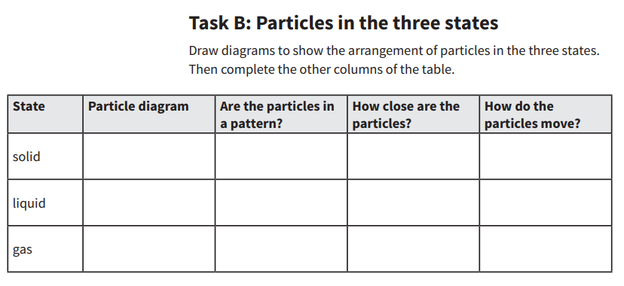
Yes
Tightly packed
Vibrate on the spot
No
Touching
Randomly, slide over each other
No
Randomly, in all directions
Far apart

