Slide 1





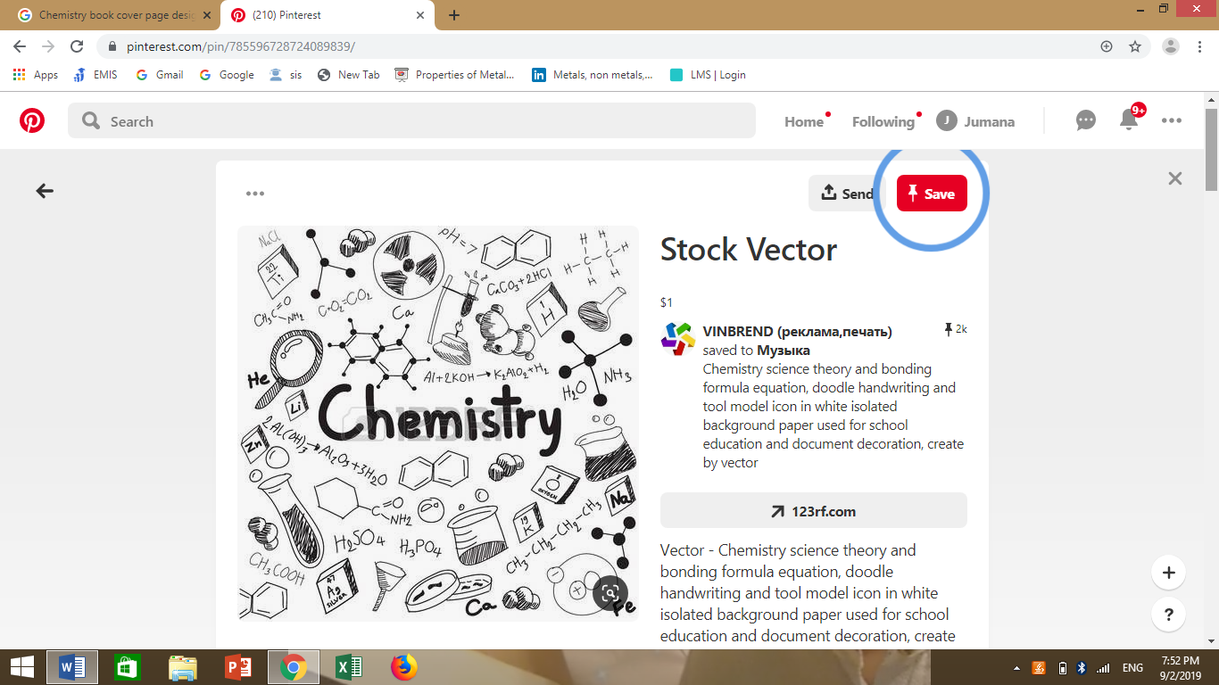

Unit 1
The Particle Model

Slide 2
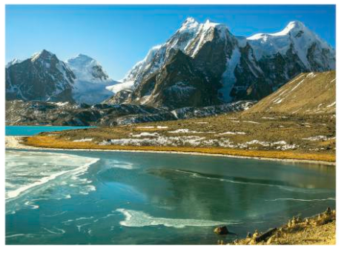
What do you see?
What are these things made of?

Slide 3
What is matter?
Matter is anything that has mass and takes up space .
What is matter made from?
The different types of matter (stuff) that things are made
from are materials.
All materials are made up of ting particles.
The three states of matter
Solid
Liquid
Gas

Slide 4
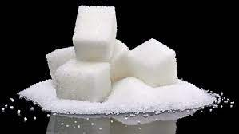
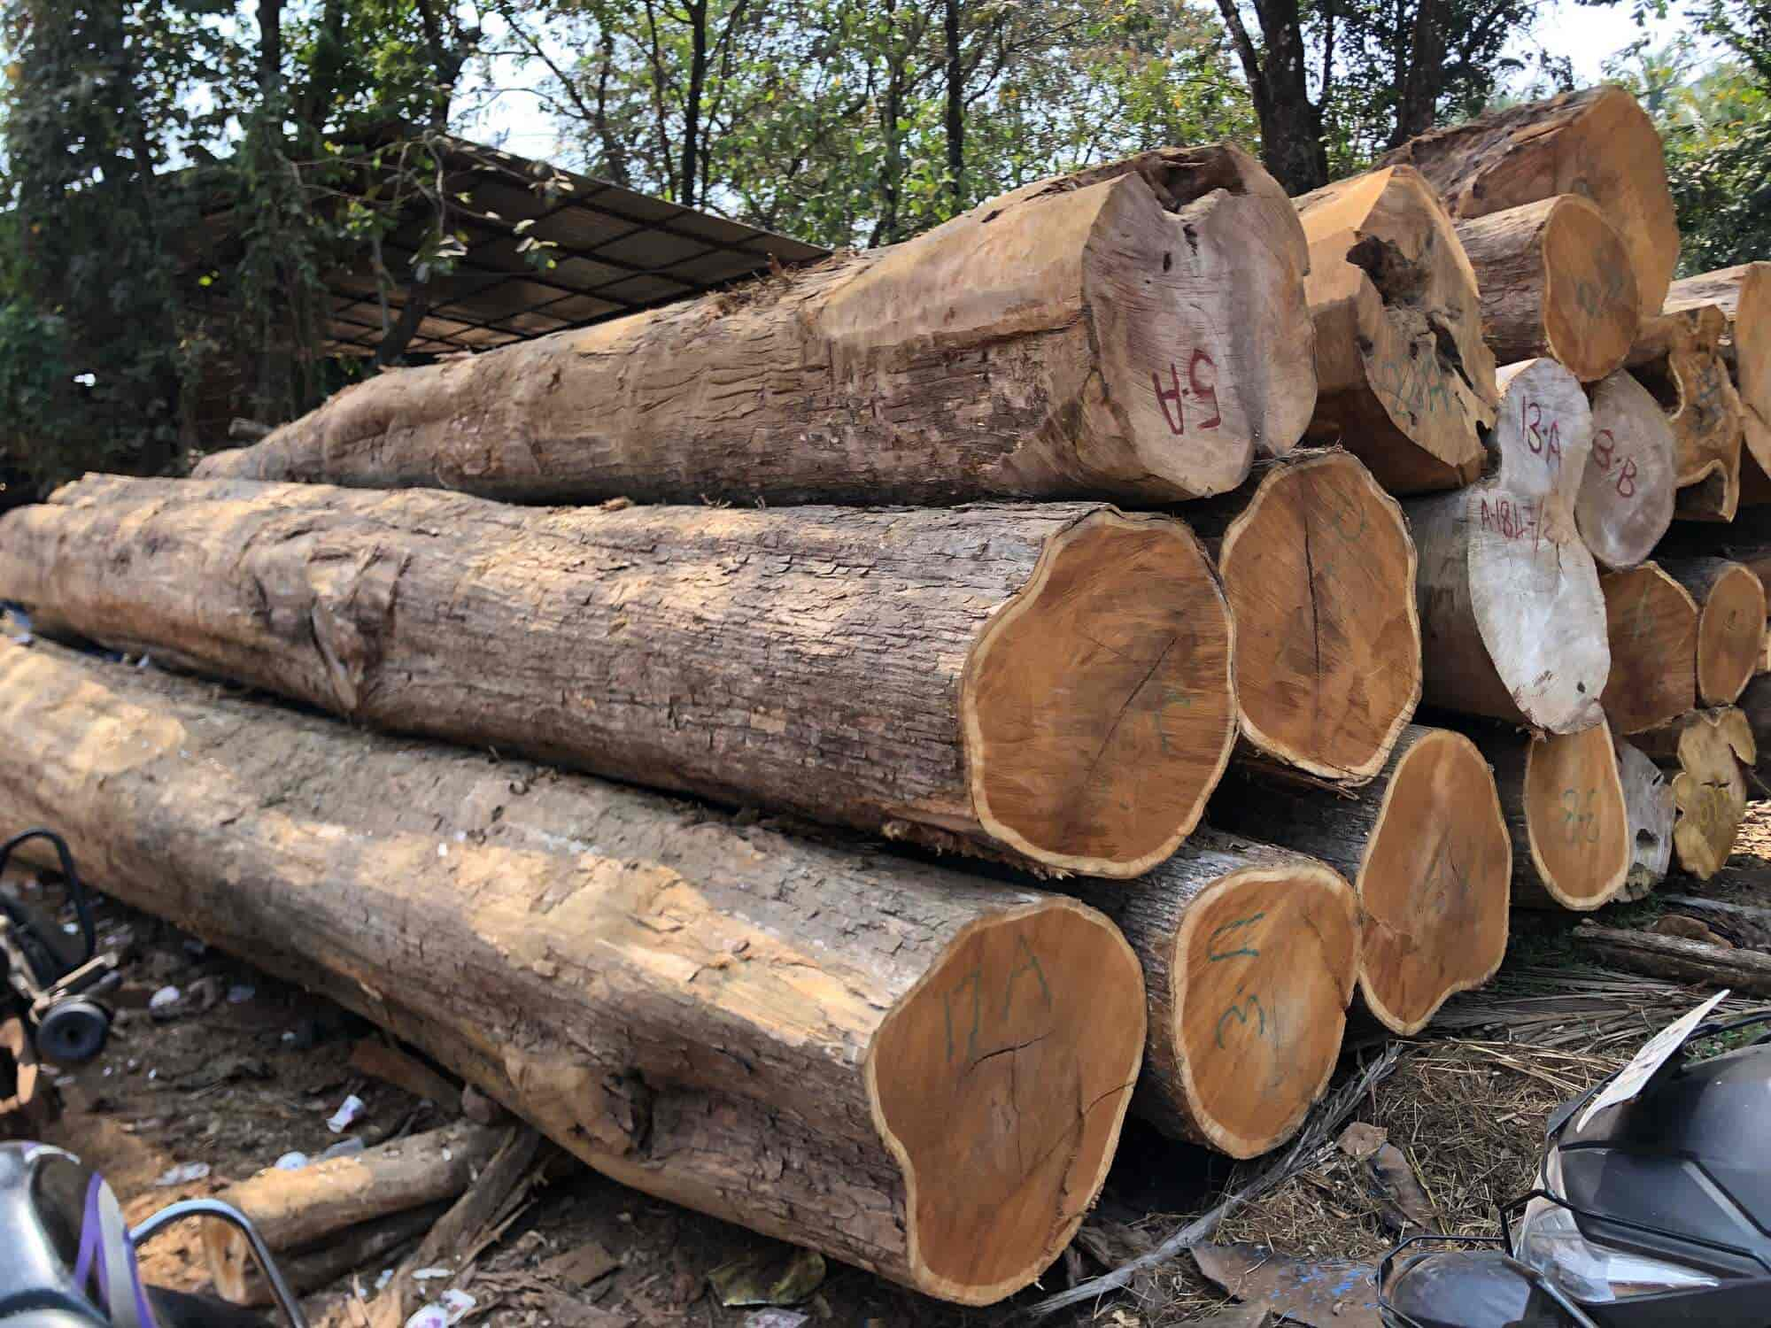
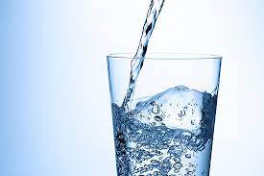
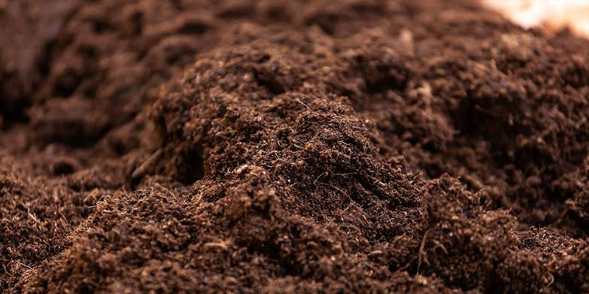
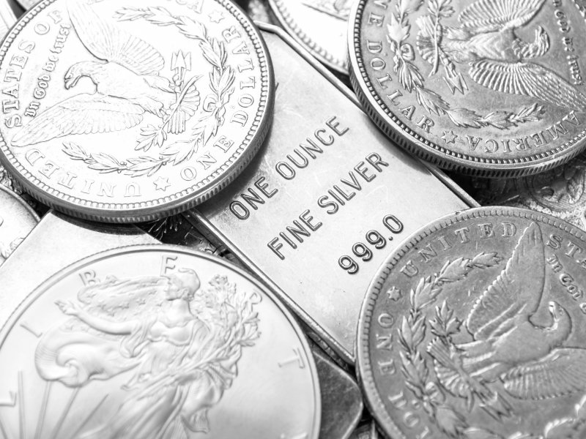
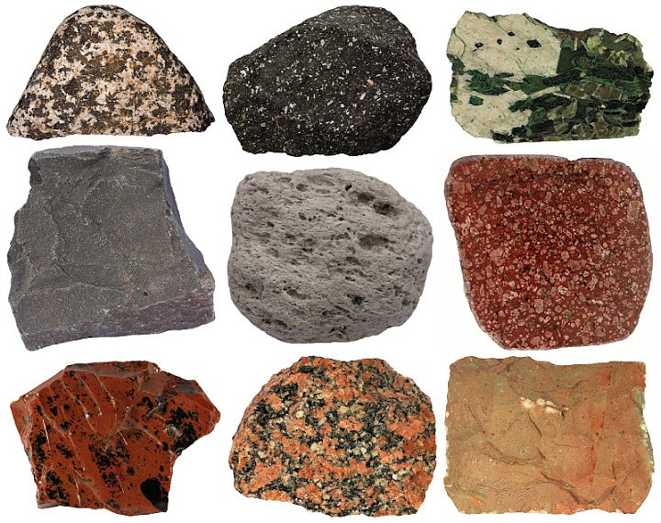
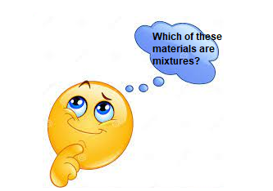
What is the difference?

Slide 5
Substance or material
Most materials are mixtures. Ex: Wood, soil and most rocks.
But some materials are not mixtures. They have just one type of matter.
A material that has one type of matter is called a substance.
Ex: Silver, sugar, diamond, pure water.

Slide 6
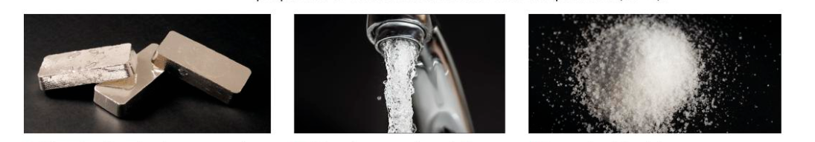



Describe the properties of the following substances at room temperature 20°C

Slide 7
What are properties
Every substance has its own properties. The properties of a substance describe what it is like and what it does.
The properties of a substance depend on five factors:
What its particles are like
How its particles are arranged
How its particles move
How far apart the particles are
How strongly its particles hold together

Slide 8
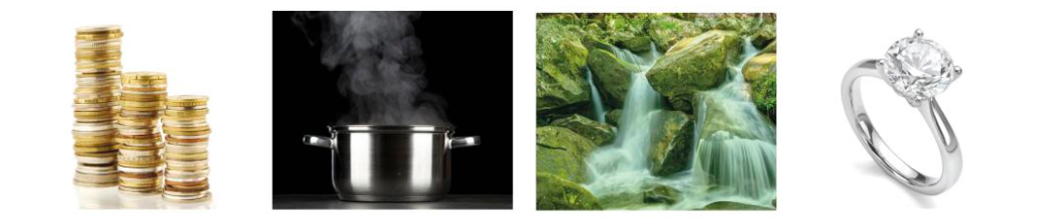

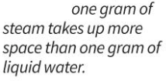


The particle model helps us explain some properties.

Slide 9
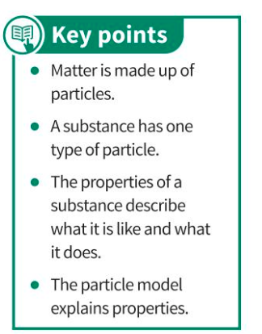


Slide 10
Answers to questions page 21
1- Substance : a material that has one type of matter.
Material: the different type of matter that things are made of.
Property: what a substance is like and what it does.
Particle model: describes the arrangement of particles in a substance.
2- Shiny, grey , shape stays the same unless you apply a force.
3- how strongly particles hold together.
4- Gold particles are heavier.

