Slide 1
How we see things?

Slide 2
Objectives
Describe how light travels
Explain how we see things
Describe how light interacts with objects

Slide 3
What is light?
Light is a way of transferring energy
Light sources give out light and we call them luminous objects
Objects that do not give out light we call nonluminous objects
Luminous Objects are categorized into two different categories: Natural Light Sources and Unnatural Light Sources.

Slide 4
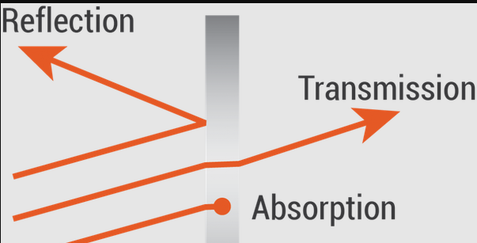
Light Vocabulary
When an object gives out light we say the object is emitting light.
When an object allows light to pass through we say the object is transmitting light.
When an object does not allow light to pass through we say the object is absorbing light.
When light gets bounced off an object we say the light is being reflected.

Slide 5
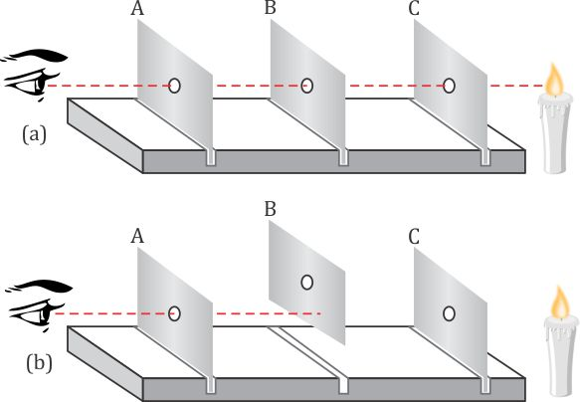
How does light travel?
Light travels in straight lines.

Slide 6
What does light travel through?

Slide 7
شكراً
Thank you

