Slide 1
Electrostatics

Slide 2
Why does the balloon stick to the wall?

Slide 3
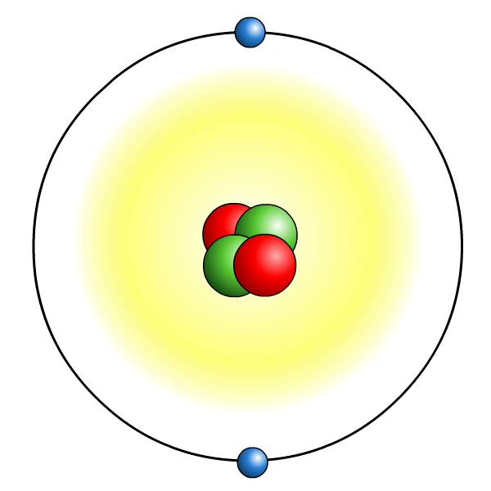
Where does static charge come from?
All materials are made of atoms, which contain electric charges.
Around the outside of an
atom are electrons, which
have a negative charge.
The nucleus at the center of
an atom contains protons, which have a positive charge.
An atom has equal amounts of negative and positive charges, which balance each other, so the atom has no overall charge.
Electrons do not always stay attached to atoms and can sometimes be removed by rubbing.

Slide 4
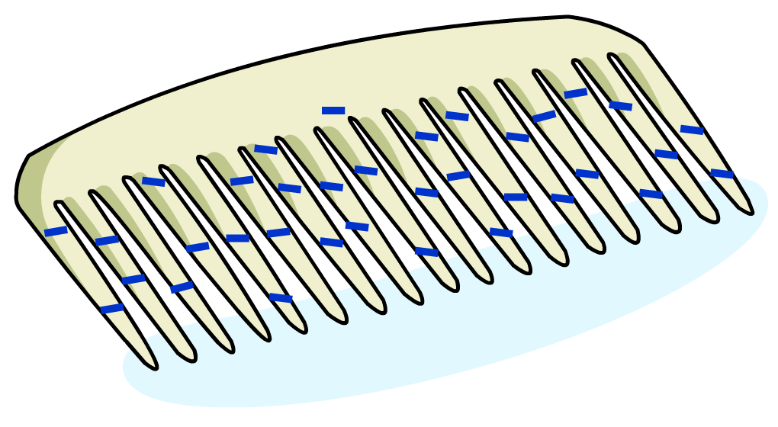
What causes static electricity?
Static electricity is due to electric charge that builds up on the surface of an insulator, such as a plastic comb.
The charge that has built up cannot easily flow away from the insulator, which is why it is called static electricity.

Slide 5
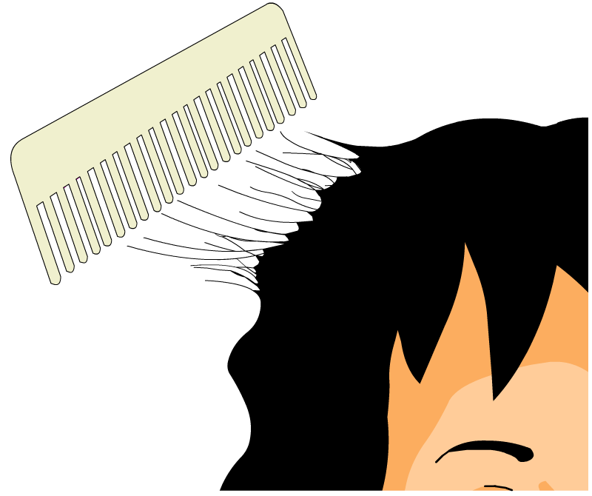
How does static charge build up?
Static charge can build up when two insulating materials are rubbed together, such as a plastic comb moving through hair.
Friction between the materials causes electrons to be transferred from one material to the other:
One material ends up with more electrons, so it now has an overall negative charge.
One material ends up with fewer electrons, so it now has an overall positive charge.

Slide 6
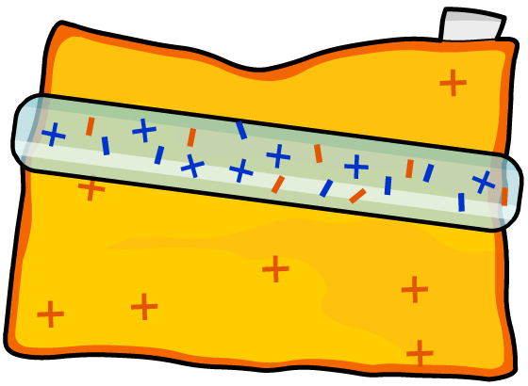
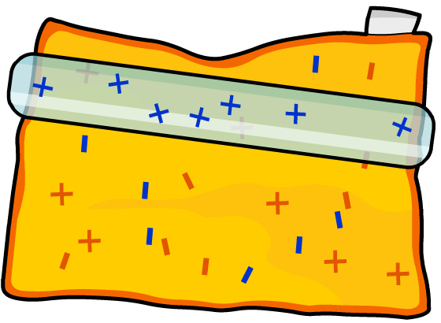
How can static charge be created?
Friction can be used to create a static charge.
If an insulator is rubbed with a cloth, it can become charged in one of two ways:
Electrons move from
the cloth to the insulator.
Electrons move from
the insulator to the cloth.
OR
The insulator ends up with an overall negative charge.
The insulator ends up with an overall positive charge.

Slide 7
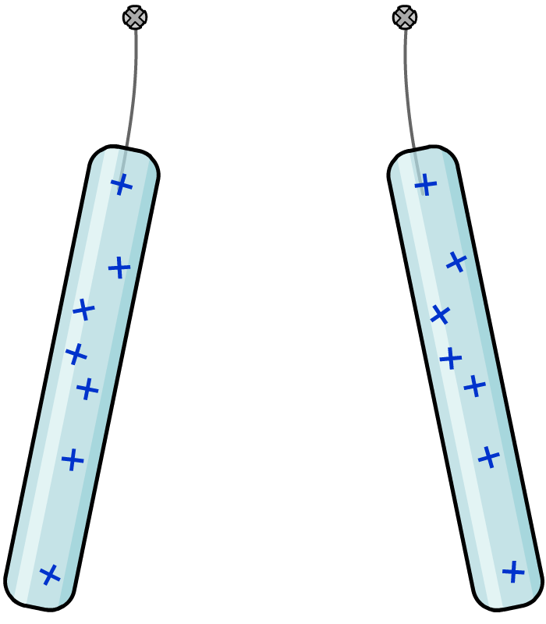
What are the forces between charges?
The forces between charges can be investigated using rods made of insulating materials.
perpex rods
What happens when two positively-charged perspex rods are placed near each other?
The rods repel each other because they have the same overall charge.
What will happen if one rod is replaced with a charged Polythene rod?
rods repel
each other

Slide 8
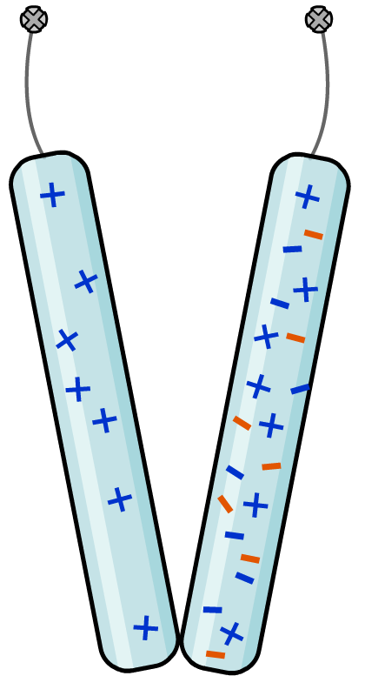
How do opposite charges behave?
When a charged Perspex
rod is placed near a
charged Polythene rod,
the rods attract each other.
Perspex rod
Polythene rod
Why does this happen?
The Perspex rod has an overall positive charge and the Polythene rod has an overall negative charge.
The overall charges of these rods are opposite and so they attract each other.
rods attract
each other

Slide 9
شكراً
Thank you

