Slide 1
Idioms and Expressions Ex. 1 Page 13

Slide 2
have something in common When you meet Alice, you'll find that you have a lot in common, including your love of classical music.

Slide 3
to share interests, experiences, or other characteristics with someone or something.

Slide 4
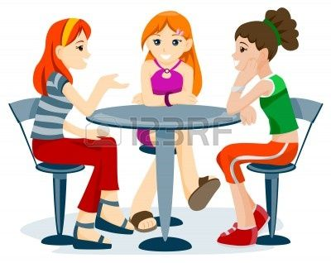
hang out I don't know why he hangs out with James, they've got nothing in common.

Slide 5
to spend a lot of time in a place or with someone.

Slide 6
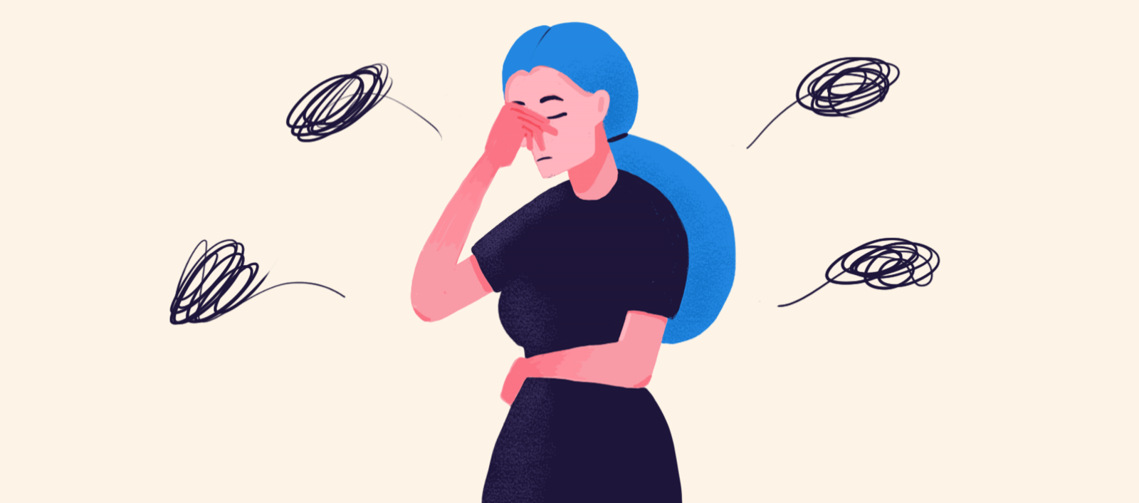
get on someone's nerves Please stop making that noise! It really gets on my nerves.

Slide 7
to annoy someone a lot.

Slide 8
Natural He reads the news in a natural, conversational way.

Slide 9
as found in nature and not involving anything made or done by people.

Slide 10
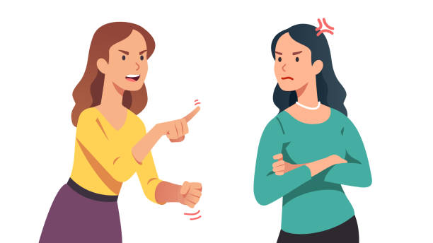
fall out with “He had fallen out with his family"

Slide 11
have an argument.

Slide 12
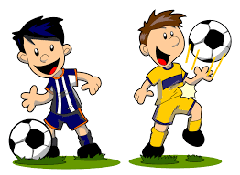
Mad about All my friends are mad about football- I am not.

Slide 13
Like something very much.

Slide 14
keep in touch Jen and I never kept in touch after college.

Slide 15
to be so close together that there is no space between; to be in contact.

Slide 16
See red People who don't finish a job really make me see red.

Slide 17
to become very angry

Slide 18
Green light They finally got the green light for their project.

Slide 19
permission to start doing something.

Slide 20
Disarmament isn't a black-and-white issue for me.

Slide 21
black-and-white Clear and straightforward.

Slide 22
be (as) good as gold She's been as good as gold all morning.

Slide 23
(of a child) to behave very well:

Slide 24
true colours It was only when they started to work together that she began to see his true colours.

Slide 25
to see someone's real character for the first time, especially when it is unpleasant:

