Slide 1
Daily message
Today, we are going to read a new story.

Slide 2
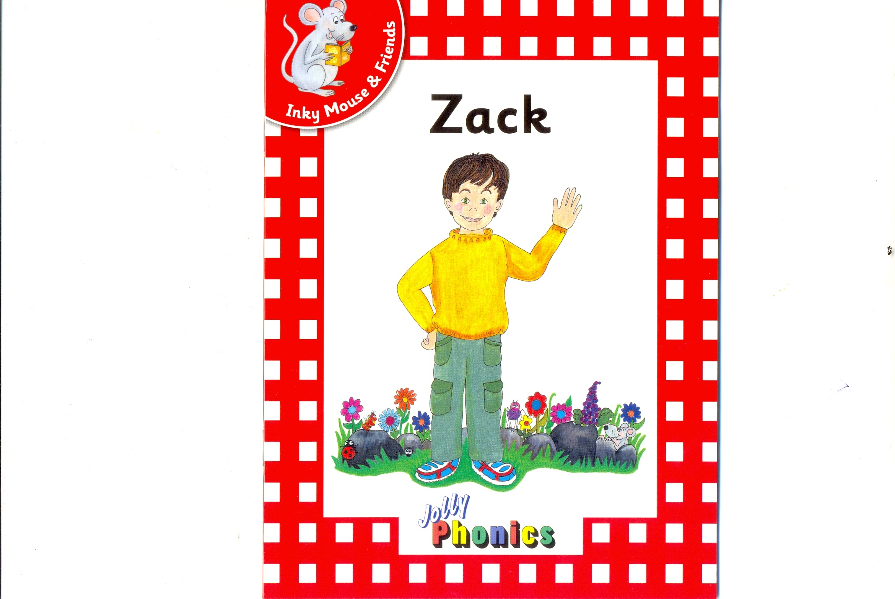

Slide 3
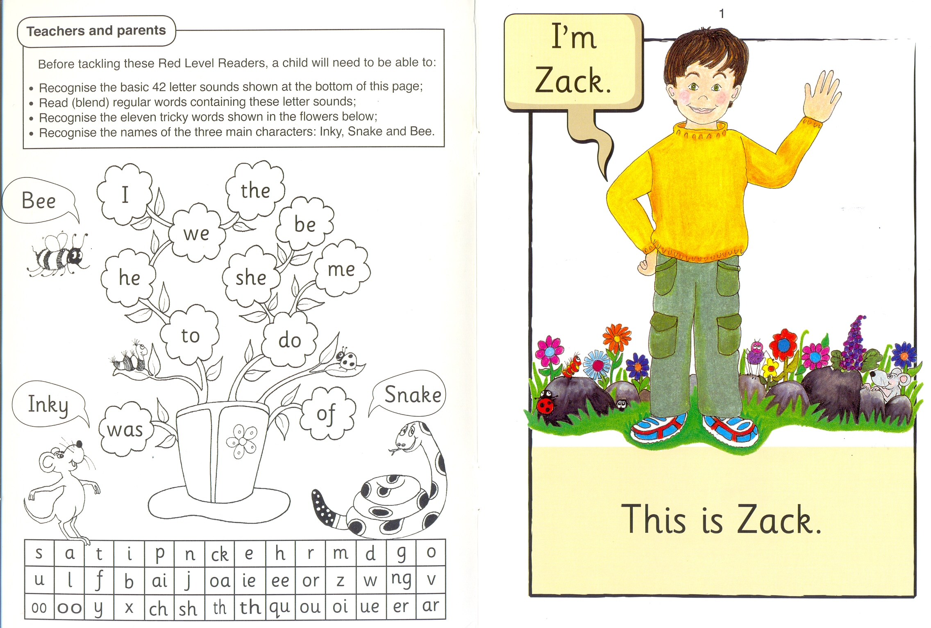

Slide 4
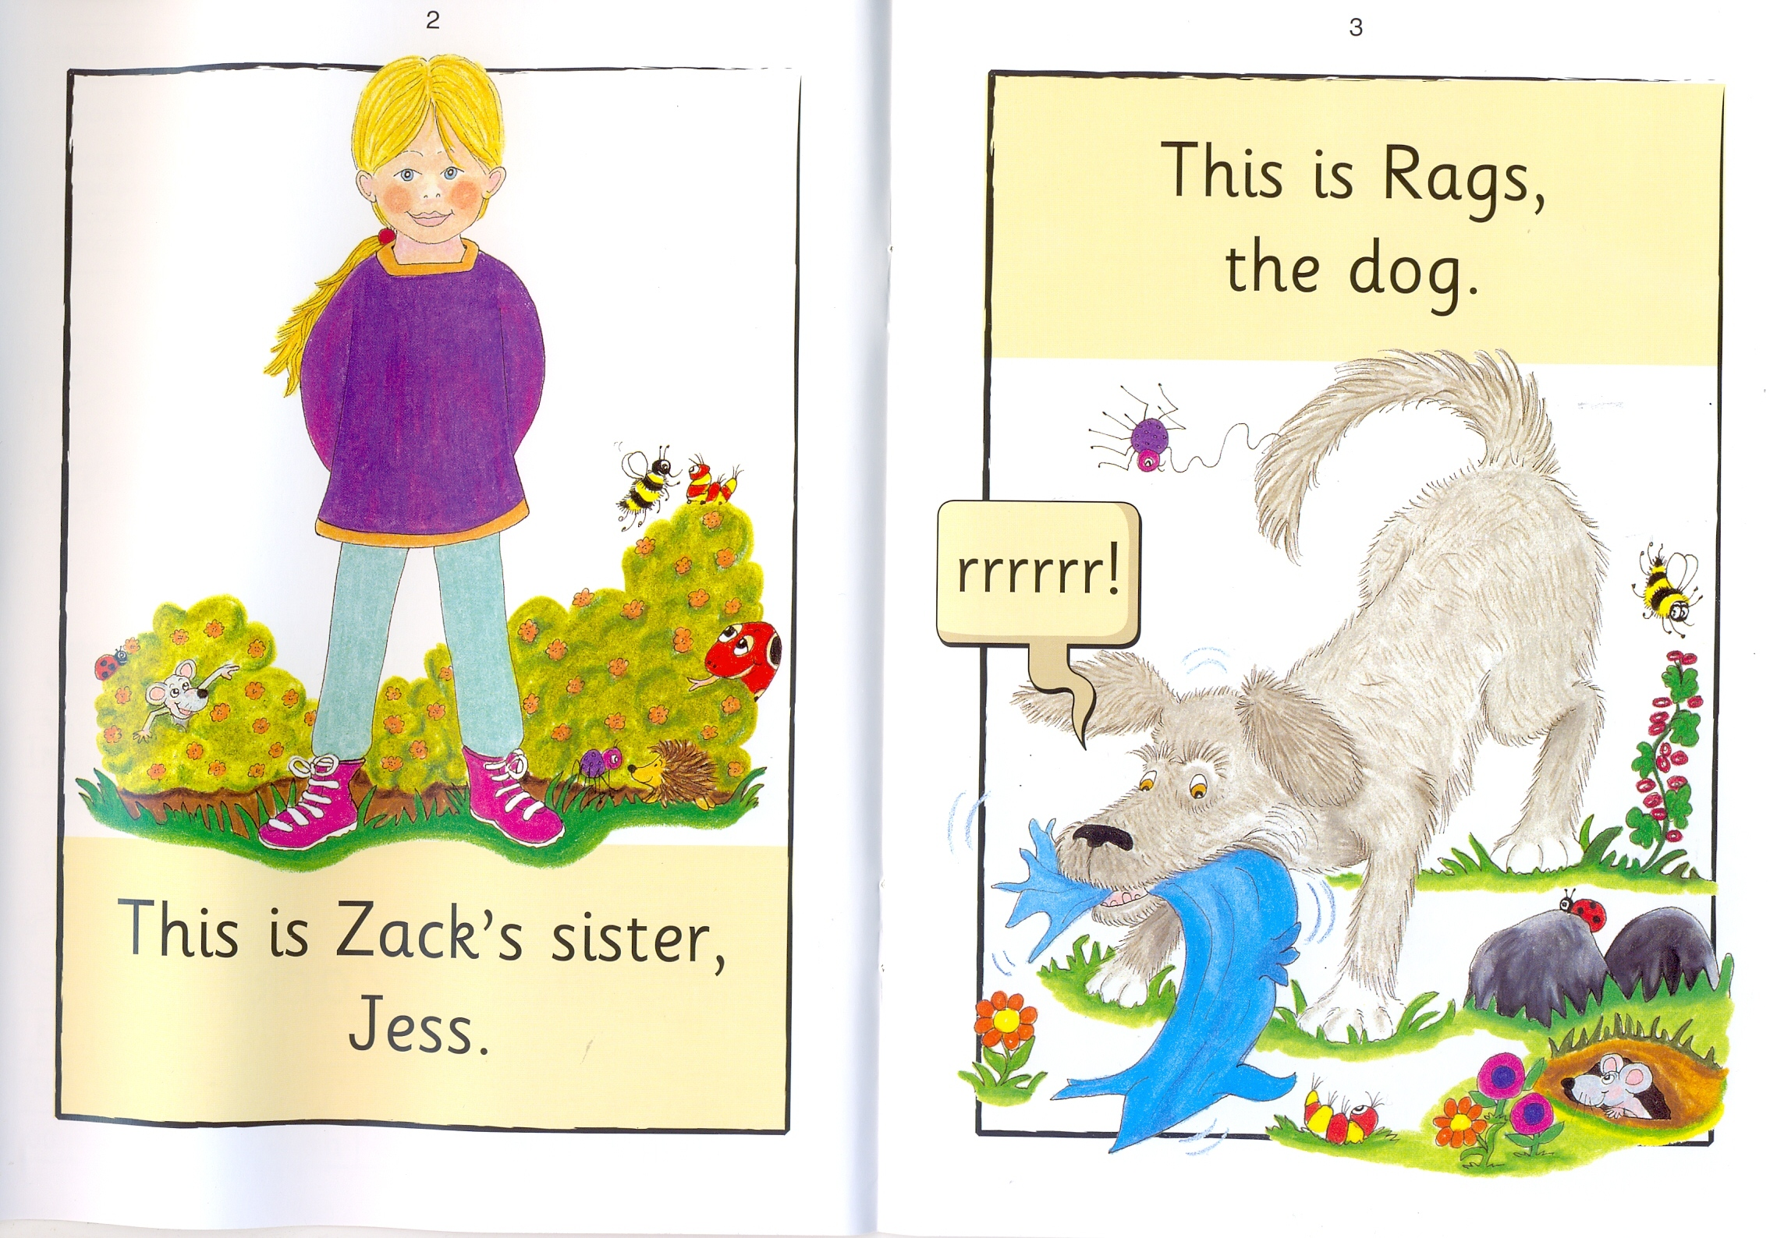

Slide 6
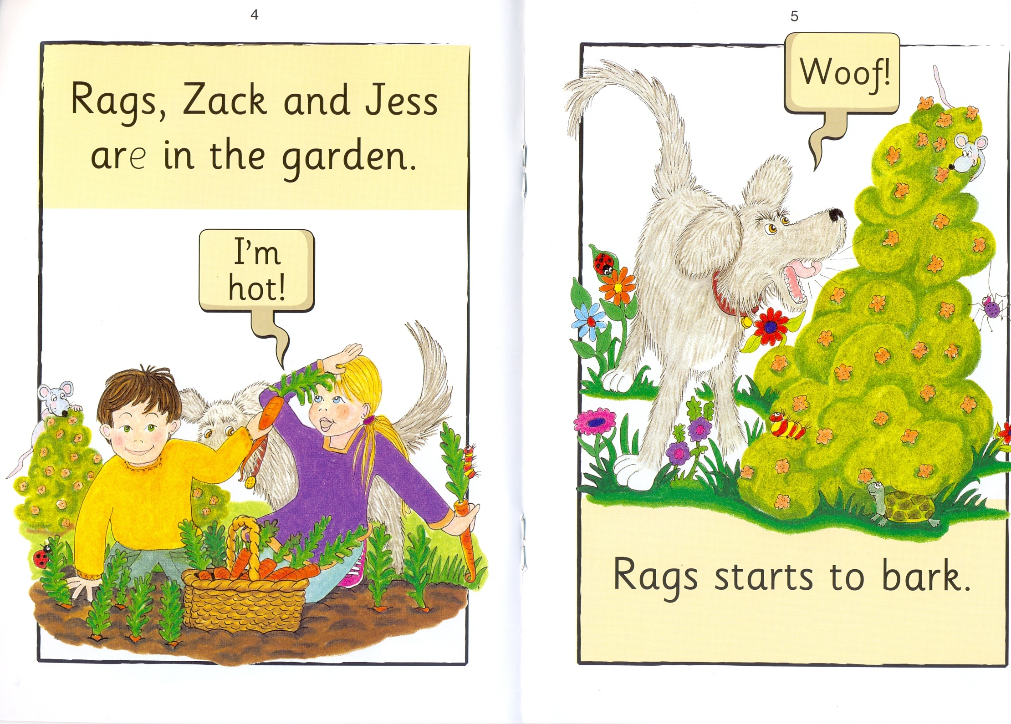

Slide 8
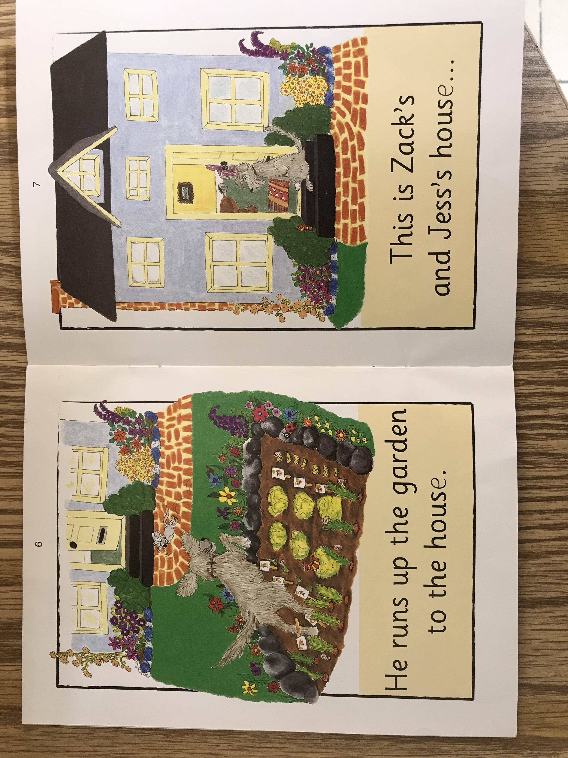

Slide 10
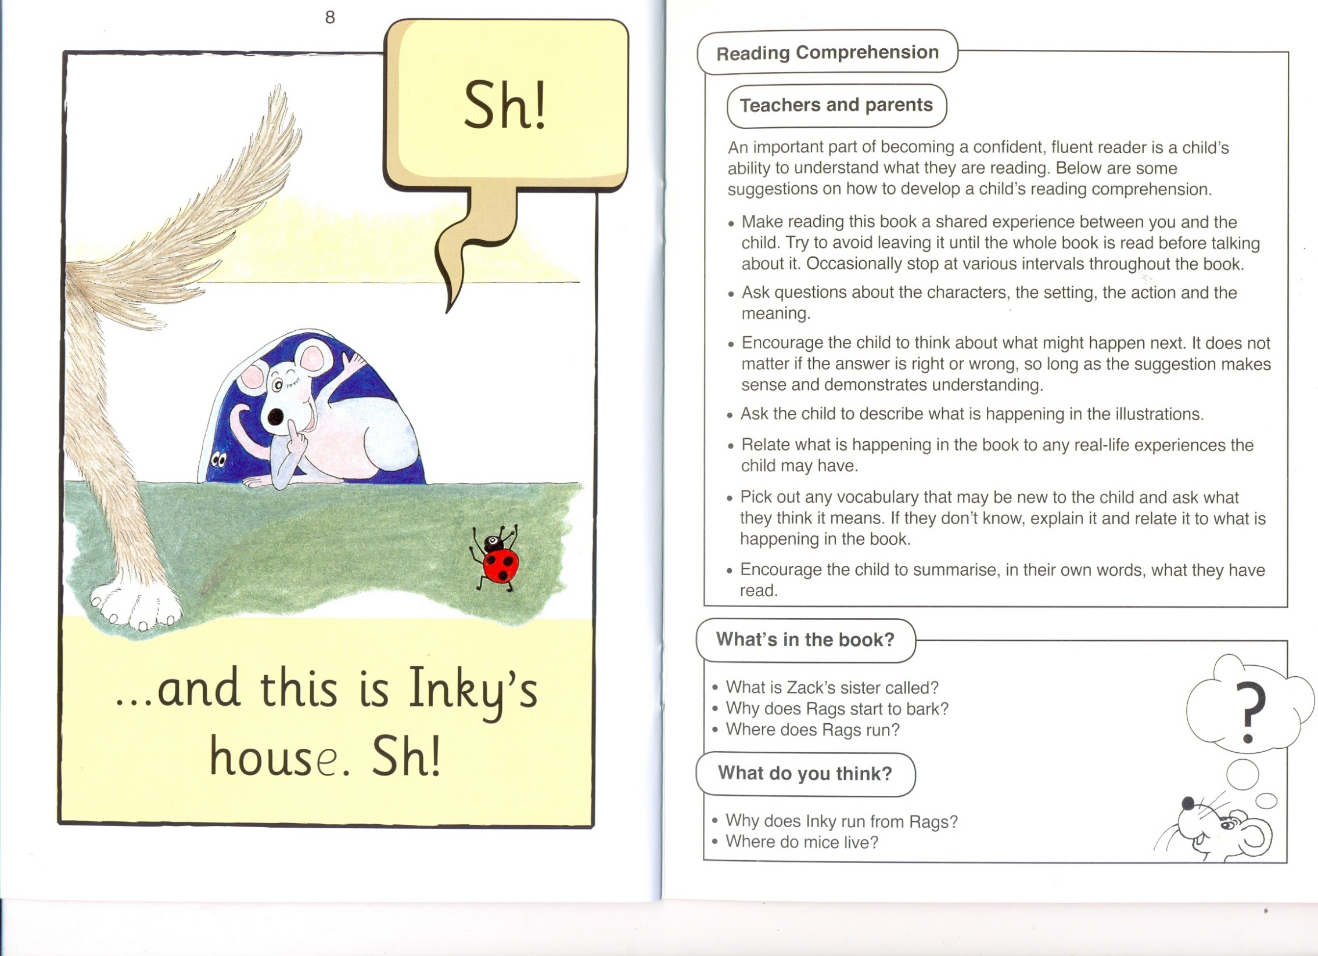

Slide 11
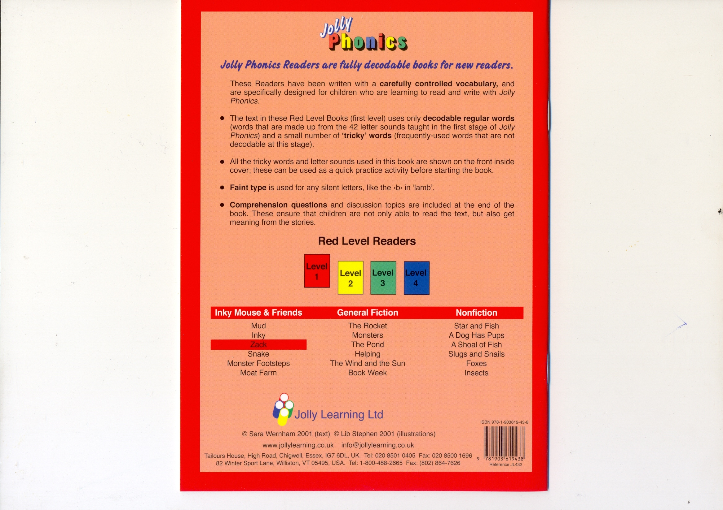

Slide 12

Zack

Slide 13
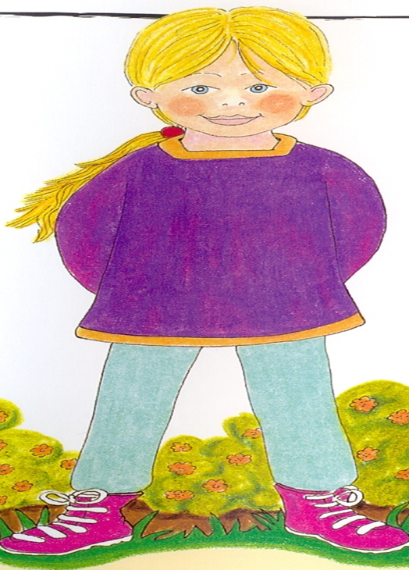
Jess

Slide 14
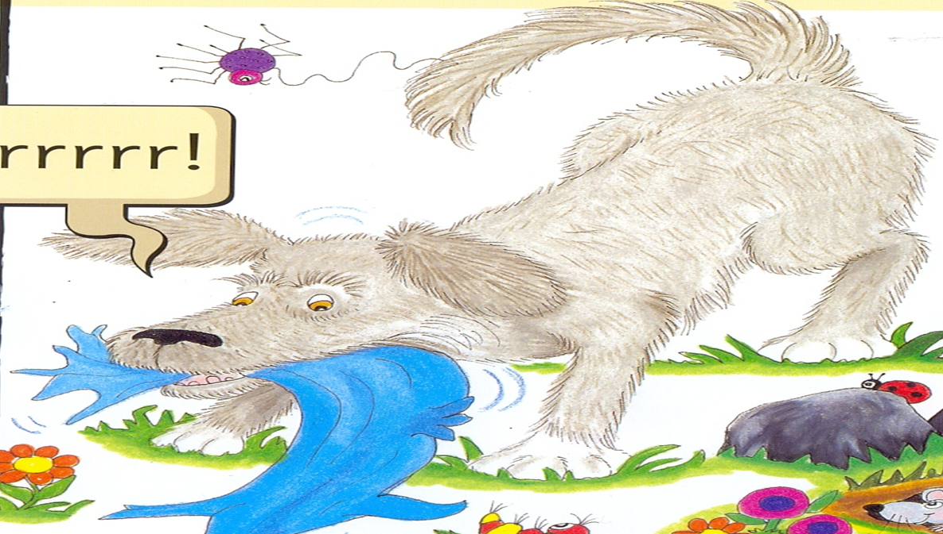
Rags

Slide 15
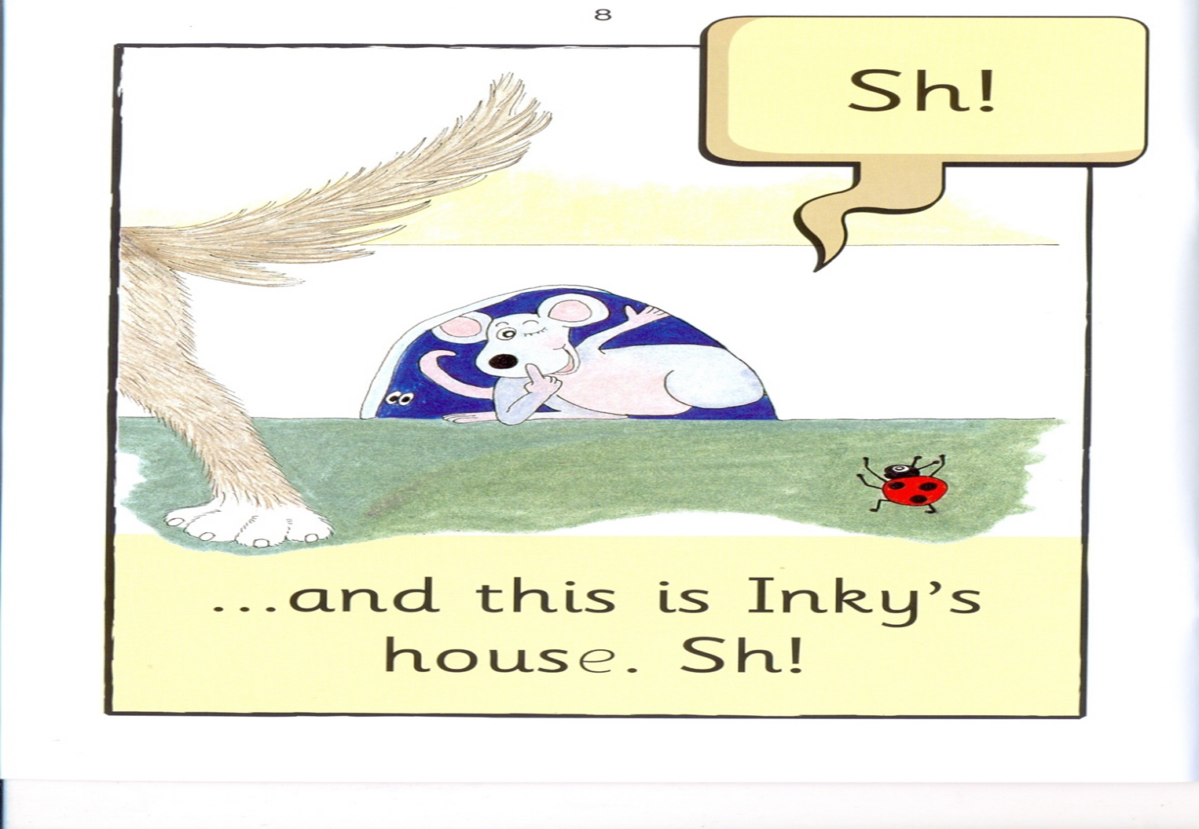
Inky

Slide 16
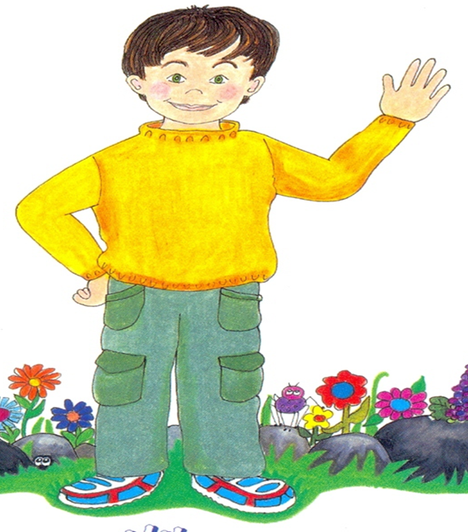

Jess
Zack
Inky
I 2 3

Slide 17
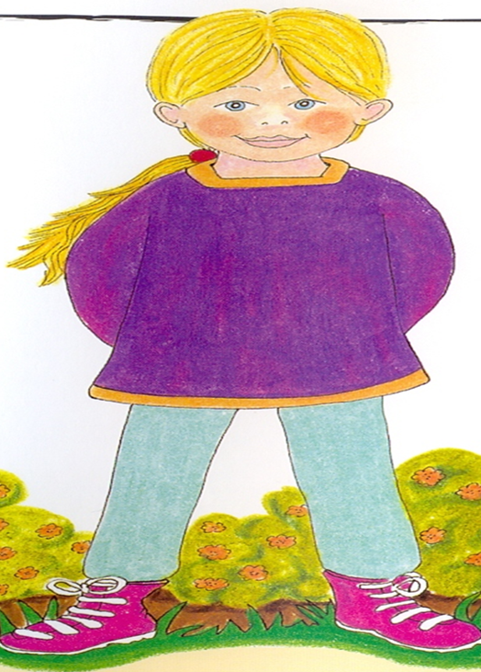
Rags
Jess
Zack
I 2 3

Slide 18
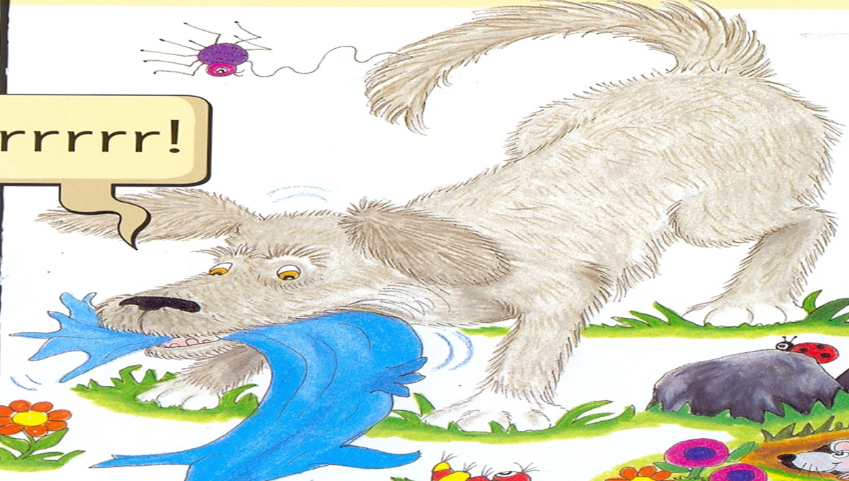
Zack
Rags
Inky
I 2 3

Slide 19
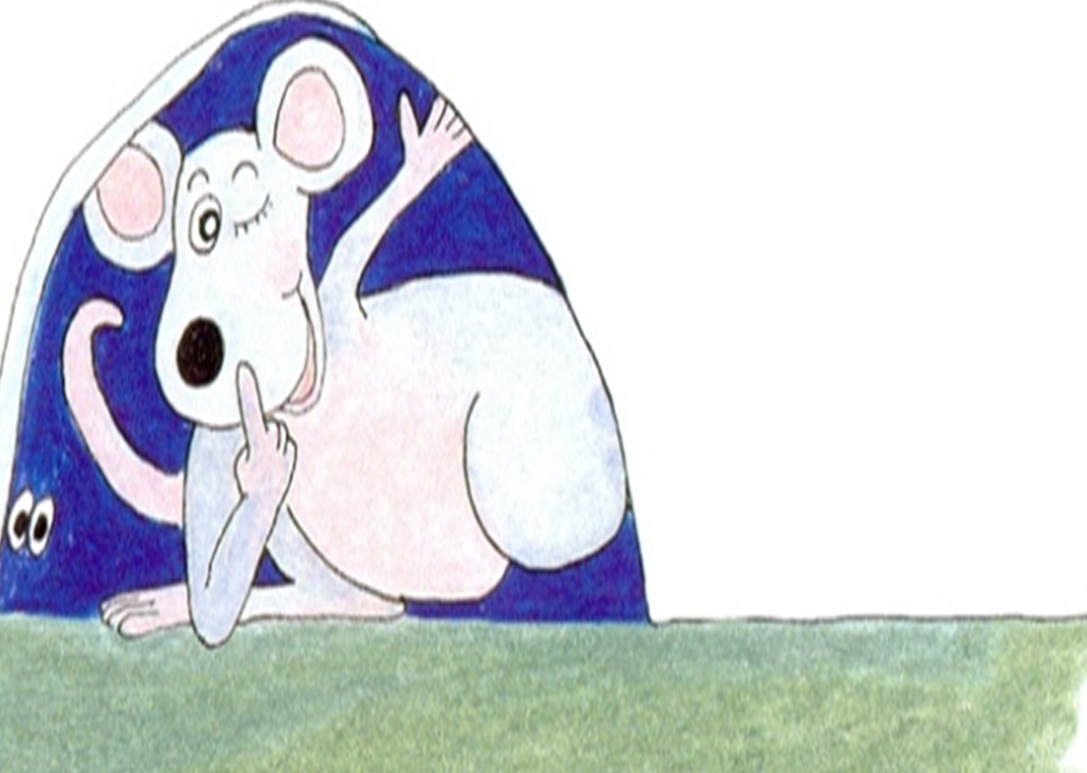
Inky
Zack
Jess
I 2 3

Slide 20


is
This
2
I

Slide 21

sister
Rags
I 2

Slide 22
is
sister

Slide 23
Zack
I`m
This
I 2 3
Jess
is
sister
4 5 6

Slide 24
I`m Zack.
This is Zack.

Slide 25
This is Zack`s sister, Jess.

