Slide 1
Tricky words

Slide 2
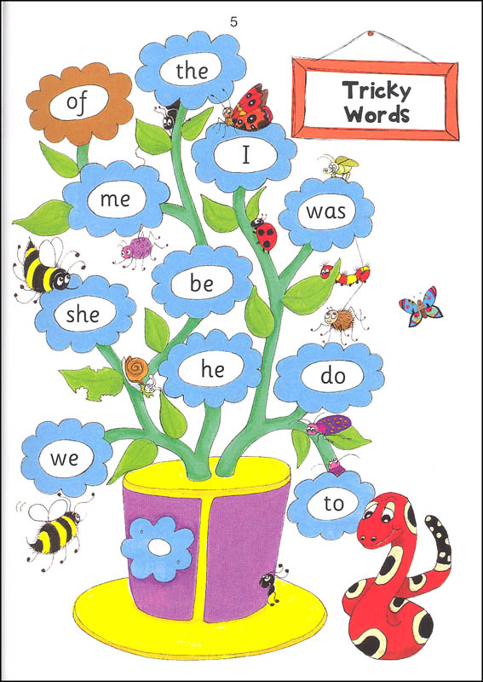

Slide 3
he

Slide 4
be

Slide 5
we

Slide 6
me

Slide 7
she

Slide 8
the

Slide 9
I

Slide 10
to

Slide 11
do

Slide 12
all

Slide 13
was

Slide 14
are

