Slide 1
Missing numbers
3
0
I 2
4
5
6
7
8
9
I0

Slide 2
I0
9
8
7
6
5
4
3
2
I
0

Slide 3

0
I
2
3
4
5
four
zero
five
three
one
two

Slide 4


one
two

Slide 5

three zero

Slide 6


four
one

Slide 7


three
five

Slide 8


three
four

Slide 9
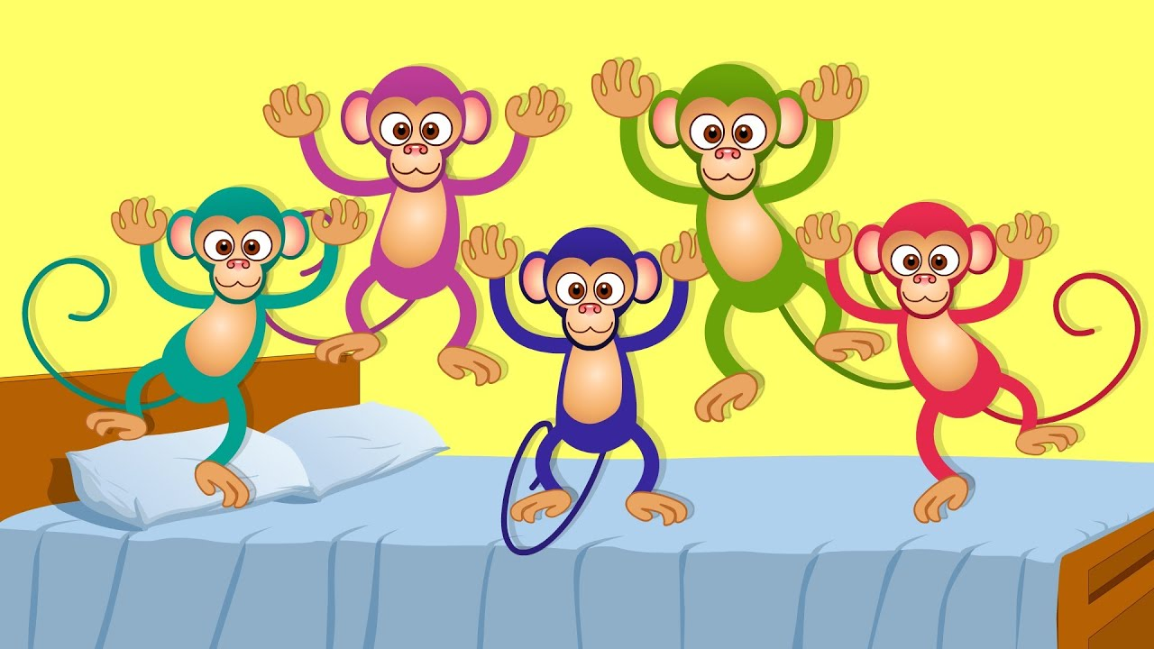

five
four

