Slide 2
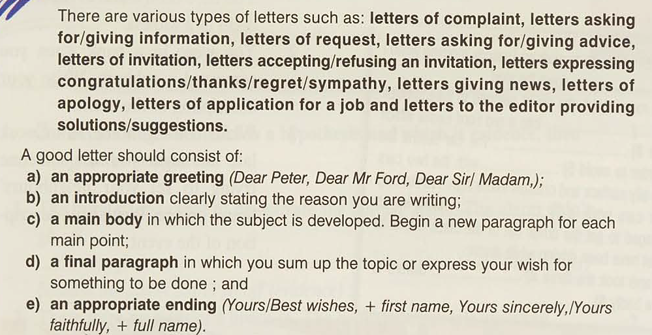

Slide 4
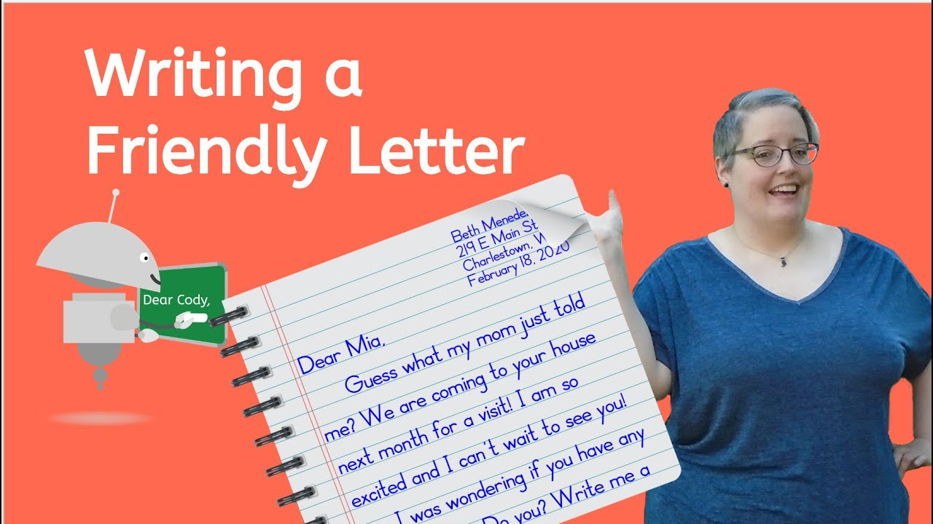

Slide 5
Model

Slide 6
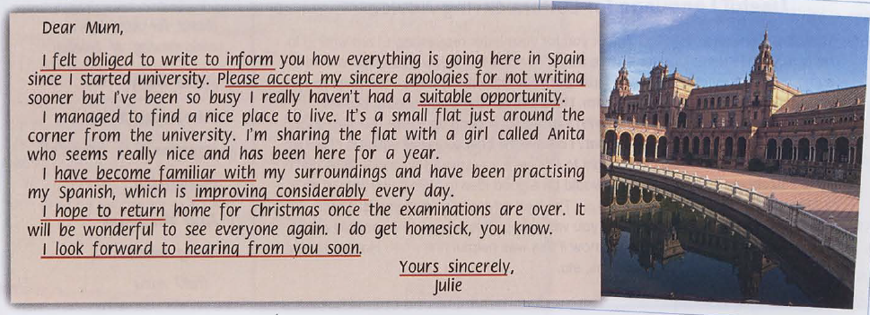

Slide 7
Group work

Slide 8
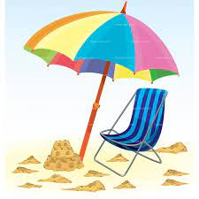
You have been on a holiday abroad for a week. Write letter to your parents describing your holiday so far.

