Slide 1
Unit 1 “Integers, powers and roots”

Slide 2
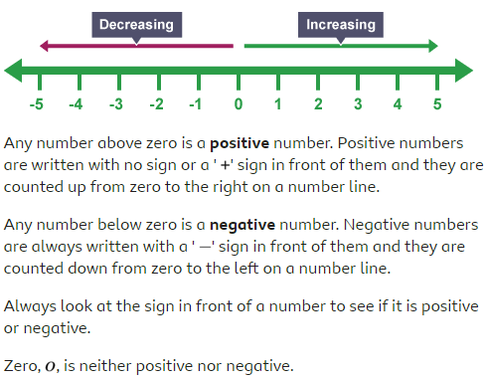
What are positive and negative numbers?

Slide 3
Example: Decide what number is greater?
a) -3 __<_ 1 b) 12 __>__ -20
c) 10 _>__ -3 d) -5 __<_ 5
e) 14 _>__ -25 f) -15 _<__ -2

Slide 4
Adding negative numbers
In adding negative numbers, remember that:
Same signs add the numbers and put the common sign.
Example:
-2 + (-3) (here we have the same signs so we will add)
-2 + (-3) = -5

Slide 5
Subtracting negative numbers.
If we have different signs subtract the numbers and the sign of the answer is according to the sign of the bigger number.
Example:
-7 + 3 (here we have different signs so we will subtract)
-7 + 3 = -4 (the answer is negative because the bigger number (7) is negative)

Slide 6
When we have two negative signs (- -) turn the sign to positive (+).
Example:
6 - - 7 = ( - - becomes + )
So it will be:
6 + 7 = 13
Ex. 1A, P. 9
Q2 + 3 + 5 + 7 + 9 + 10 + 12

Slide 7
Multiplying and dividing negative numbers.
if you have same signs (+ +) or (- -) The sign of the answer is positive (+).
Example:
7 x 2 (same signs the answer is +)
7 x 2 = +14
-2 x (-5) (same signs the answer is +)
-2 x (-5) = +10

Slide 8
If you have different signs (+ -) The sign of the answer is negative (-)
Example:
-7 x 3 = (different signs, the answer is -)
-7 x 3 = - 21
-25 ÷ (-5) (same signs, the answer is +)
-25 ÷ (-5) = +5
Ex. 1B, P. 11
Q 2 + 4 + 5 + 7

Slide 9
To review watch the video below:
https://www.youtube.com/watch?v=_BgblvF90UE

Slide 10
The order of operations
The order you should do your calculation is:
Brackets
Indices
Division and multiplication. (Start on the left and work them out in the order that you find them)
Addition and subtraction.
Ex. 1D, P. 13
Q1 + 2 + 6

Slide 11
To review watch the video below:
https://www.youtube.com/watch?v=dAgfnK528RA

Slide 12
The End ☺

