Slide 1

sun

Slide 2

spider

Slide 3
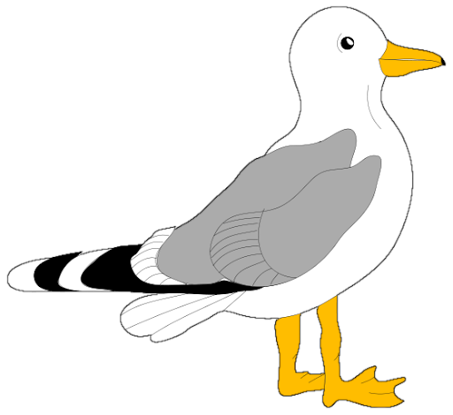
seagull

Slide 4

submarine

Slide 5
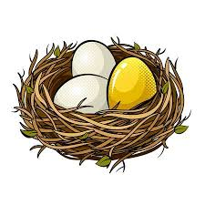
nest

Slide 6

grass

Slide 7

bus

