Slide 1
What is a business
A business is an organization that provides a service or produces and sells goods which satisfy people needs and wants.
Book pg.31

Slide 2
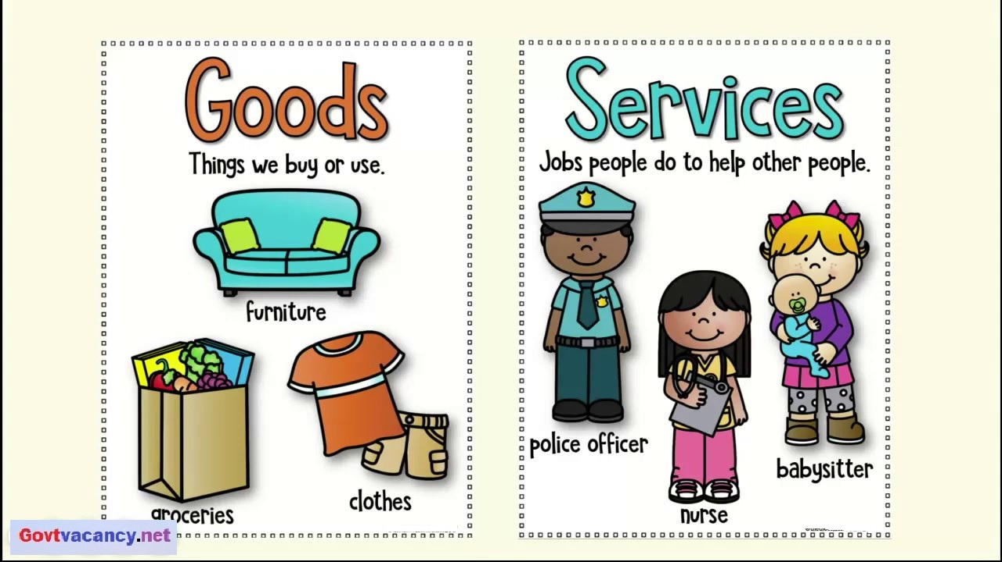
What do you think is the difference between goods and services??
Goods
tangible , produced.
Services
intangible , provided.

Slide 3
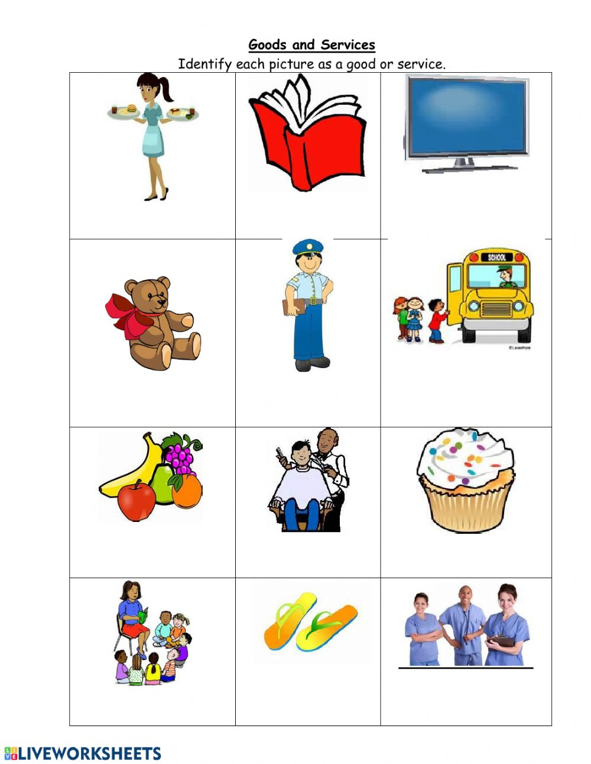

Slide 4
Definitions to learn : book pg.31 /book activity 2.2
Goods: are tangible items that can be physically seen and touched for sale.
Services : are intangible activities , work done for someone by someone else ,usually for pay.
Consumer: a buyer of goods and services.
Consume: to use up goods and services .

Slide 5
What do you think is the difference between needs and wants??
Needs: Are things essential for living.
Water
Clothing
Warmth
Protection
Food

Slide 6
Wants: Are goods or services which people would like to have, but which are not essential for living.

Slide 7
Why are businesses important ?
They raise the standard of living.
They provide jobs for people to earn money.
They provide consumers with important products that make life easy.
They satisfy consumers needs and wants.

Slide 8
How do people start a business??

Slide 9
Step 1 : choosing a business
You need :
To be passionate about it
To have the knowledge that enables you to do it.
To think of problems you want to solve
Book pg.37
Activity (lMS assignment )

Slide 10
Step 2: name your business
choosing a business is only the beginning, now you need to build your plan .
Start by describing you business . It should have a name :
A name that reflects the type of business
A name that is not related to the type of business
Ex : something that means a great deal to you or a family name .
Book pg.40
Book activity 2.5

Slide 11
Step 3: what are you selling ?
At this stage You have :
To decide and describe what are going to do
(sell goods or provide services)
To determine what people want and prefer?
To research for available competition .
To give your customers a good reason to buy your products. what can you do better ?

Slide 12
Step 4: The resources you need (Factors of production)
Are those resources needed to prepare your product(good/service). And there are 4 factors of production:
Land (natural resources)
The raw materials we got from nature like water , oil, wood , metal are called natural resources .
Natural resources must be used wisely to prevent depleting of spoiling the supply.
Labour (human resources)
The number of trained /skilled people available to help you make products.
Capital
The finance, machinery and equipment needed for the manufacture of the products
Enterprise
The skill and risk-taking ability of the person who brings the other resources or factors of production together to produce a good or provide a service, for example the owner of the business.

Slide 14
Specialization vs. interdependence
Specialization: when people and businesses concentrate on what they are best at.
Interdependence: when people and businesses rely on each other in order to make goods and services.
For example : factories specialize in making parts for the cars . These parts are then used by another business to assemble the cars.
Countries around the world specialize in things depending on their natural , capital and human resources , no country can produce all the goods and services alone , so they depend on each other to fulfill the basic needs .
Book. Page 46/47
Book. Activity 2.9

Slide 15
Step 5: Financial plan
After deciding on what business you want to start also named it and figured out all the resources you need . Your next logical step will
To make a financial plan(document relating to or involving money or finance)
Financial plans must contain the following :
Money you need to produce each item.
Money you will sell each item for.
Realistic selling price and close to prices in the market.
→continue next slide

Slide 16
How you are going to finance the project.
how much will it cost .
Other expenses , like salaries for employees , transportation ..etc.
Book.page52

Slide 17
Definitions to learn
Finance the management of money by a person or a company.
Cost the value of money that has been used up to produce something or deliver a service
Price the amount of money required, or given in payment for something.
Profit a valuable return/gain.

Slide 18
Profit and Costs Calculation
Calculate your profit by first adding up all the costs that are paid out to produce and/or sell a certain number of products. If you produce and/or sell ten items, then divide the total cost by the number of items.
If it costs you 20 dinars to make/sell ten items, 20 ÷ 10 = 2. The answer (2 dinars) is your cost per item.
In order to make a profit, your selling price per item must be more than two dinars.
Profit = total revenue(selling) - total cost
Cost per item =total cost ÷ number of items
book. Page 54/activity 2.12

Slide 19
Step 6: How you will let people know
In this step you need to decide on the effective way/s to reach the customers and inform them about your products.(advertising techniques)
Examples of advertising techniques:
Commercial on the radio or on the TV / posters / flyers / billboards
advertisement in the newspaper or a magazine.
Book. Page 56/57

Slide 20
Step 7: A place to operate
In this step you need to choose a place for your business to operate
To choose a location , keep in mind the below factors:
Distance your business should be close enough to you and your customers.
Convenient and easy to find.
Accessible , like have enough parking spaces for customers,
easy to access using public transpiration.
Book. Page 60/61

Slide 21
Step 8: Time to grow (Business Growth)
Different ways in which businesses can grow(expand):
Internal growth (organic growth): Occurs when a business expands its existing operations.
Examples :hiring new staff /developing new technology / opening new branches.
External Growth (integration):Is when a business takes over or merges with another business. Its often called integration.
Take over is when one business buys out another business.
Merge is when the owners of two businesses agree to join their businesses together to make one business.

Slide 22
Time to Grow
Don’t stop here and keep improving your skills , and work hard to become a successful entrepreneur .
GOOD LUCK
Book. Page 64
Activity 2.19

