Slide 1
Ss

Slide 2

sun

Slide 3

spider

Slide 4
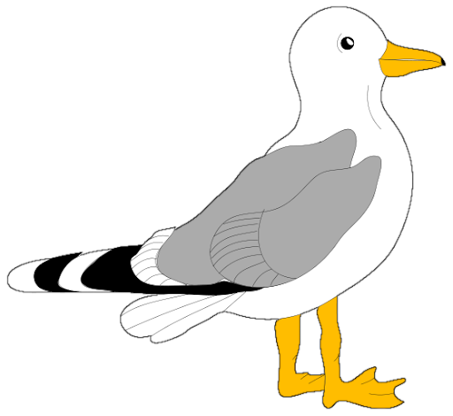
seagull

Slide 5

submarine

Slide 6

nest

Slide 7

grass

Slide 8

bus

