Slide 1
Daily message
Today , we are going to read new tricky words.

Slide 2
Tricky words

Slide 4
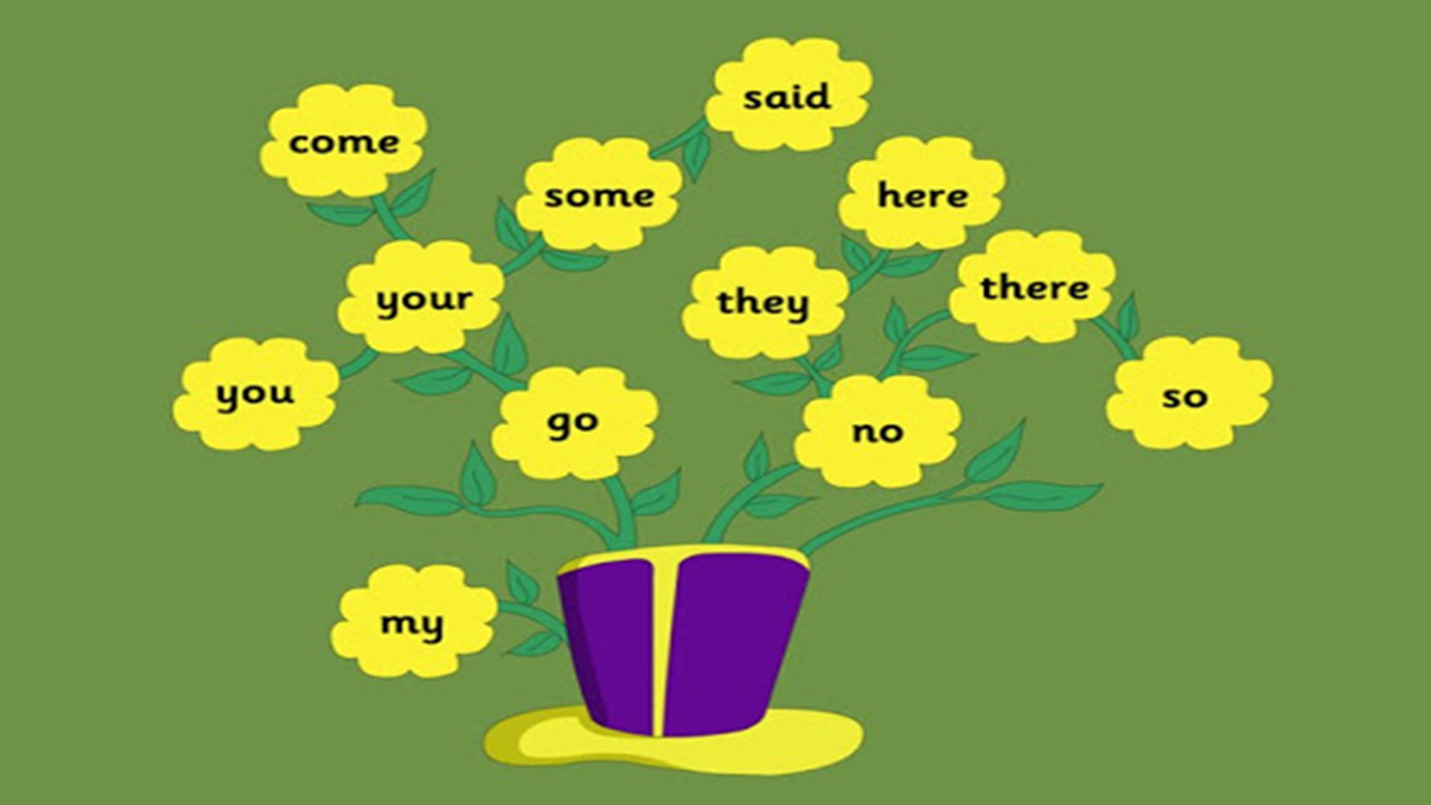

Slide 5
he

Slide 6
be

Slide 7
we

Slide 8
me

Slide 9
she

Slide 10
the

Slide 11
I

Slide 12
to

Slide 13
do

Slide 14
all
o

Slide 15
was

Slide 16
are

