Slide 1
Reviewing the Periodic table, Acids and Alkalis

Slide 2
Learning Objectives:
Understand that the periodic table is a way to sort elements.
Identify different groups in the periodic table.
Describe Acids , Bases and Alkalis.
Key words:
Atom
Element
Compound
Chemical Symbol
Chemical formula
pH indicator
Neutralization

Slide 3
A Russian scientist born in 1834. He created the Periodic Table almost 150 years ago.
When creating the Periodic Table, Mendeleev even predicted elements would be discovered in the future. Those elements have, in fact, been discovered in recent years

Slide 4
The Periodic Table
A column in the periodic table is called a group.
The groups are numbered along the top, from Group 1 to Group 7, with Group 8 on the end.
The middle section is not included in this group system because the elements here behave differently to those in the labelled groups.
1
2
3
4
5
6
7
8

Slide 5
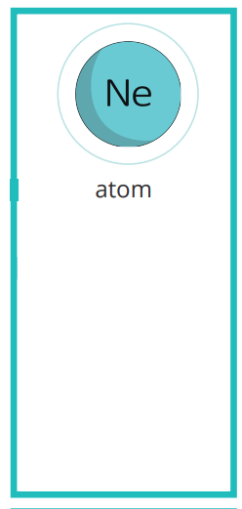
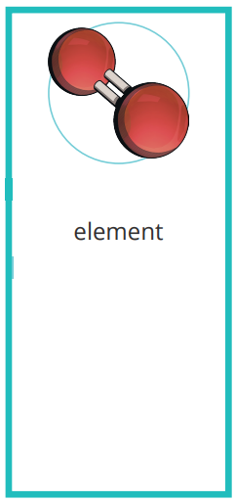
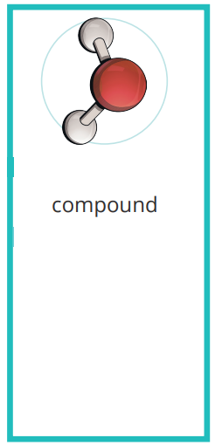
The smallest particle of a chemical element.
Contains electrons, protons and neutrons.
A substance that cannot be broken down into another substance.
Each element is made up of its own type of atom.
A substance made from two or more different elements that have been chemically joined.
Example:
H₂O

Slide 6
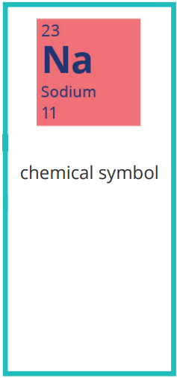
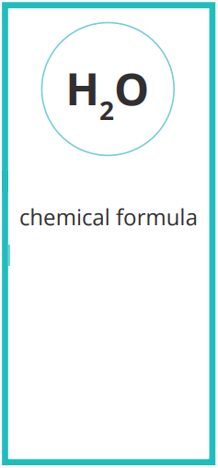
Most chemical elements are represented symbolically by two letters, generally the first two in their name.
Tells us the number of each element in a compound.
It contains the symbols of the elements present in the compound.

Slide 7
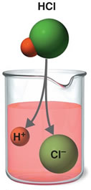
Acids
Substances that donate hydrogen ions, H⁺¹,, when dissolved in water.
Acids conduct electricity well, due to the positive and negative ions in the solution. Acids turn blue litmus paper into red
Corrosive: Can burn skin and react with metals. (stored in glass containers)
All acids contain the element Hydrogen.
Acids have a pH ranging from 0-6

Slide 8
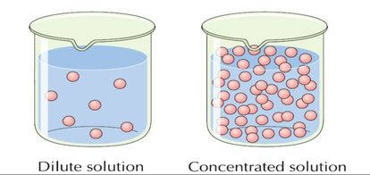
According to concentration acids are classified into :
A- Concentrated acids: more number of acid particles dissolved in water, so more H⁺¹ ions present. ( corrosive – can destroy skin and attack metals)
B- Diluted acids: low number of acid particles dissolved in water, so less H⁺¹ ions present. (irritant – skin may become red and blistered)

Slide 9
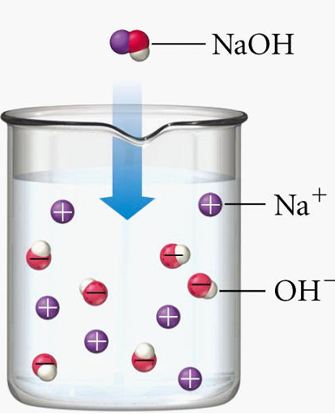
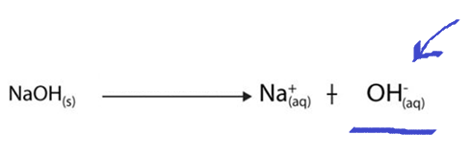
Bases and Alkalis
Substances that form hydroxide ions (OH⁻¹) ions when dissolved in water
Not all bases dissolve in Water. When a Base dissolves in water, the solution is called Alkali.
Taste bitter
Can burn skin (caustic).
Alkaline solutions conduct electricity well.
Alkalis turn red litmus paper into blue
Have a pH ranging from 8-14

Slide 10
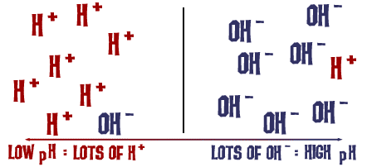
Universal Indicator
A mixture of indicators that give range of colors, used to show how strong or weak an acid or an alkali is.

Slide 11
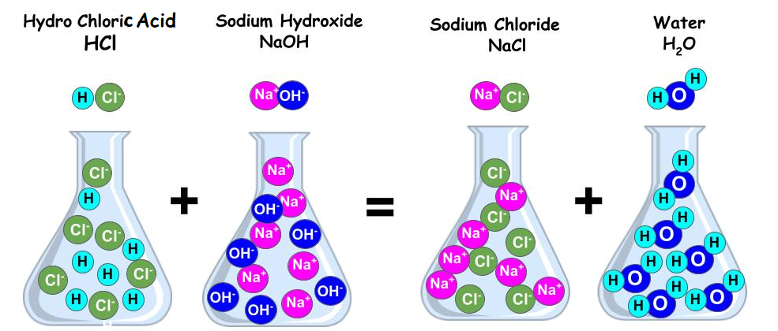
Neutralization
It is a chemical reaction between an acid and an alkali to form water and salt.
Water is neutral (pH=7) , therefore, the pH changes when we mix acids and alkalis.

