Slide 2


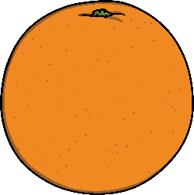

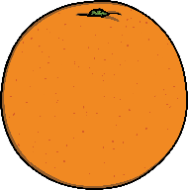
Countable Nouns
These are nouns
we can count.
a banana
an orange
some bananas/oranges

Slide 3


Uncountable Nouns
These are nouns
we can’t count.
Some water

Slide 4

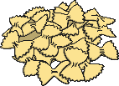
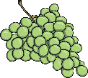
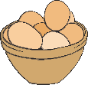

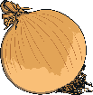


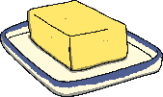
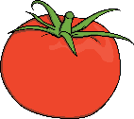
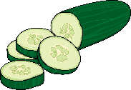


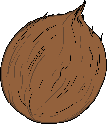


Countable and Uncountable Nouns
Click the food card to sort them into ‘Countable Nouns’
and ‘Uncountable Nouns’.
Countable
Uncountable
milk
pasta
grapes
eggs
banana
onion
orange
bread
butter
tomato
cucumber
sugar
carrot
coconut
water
rice

