Slide 1
circle

Slide 6
sun

Slide 14
sphere

Slide 22
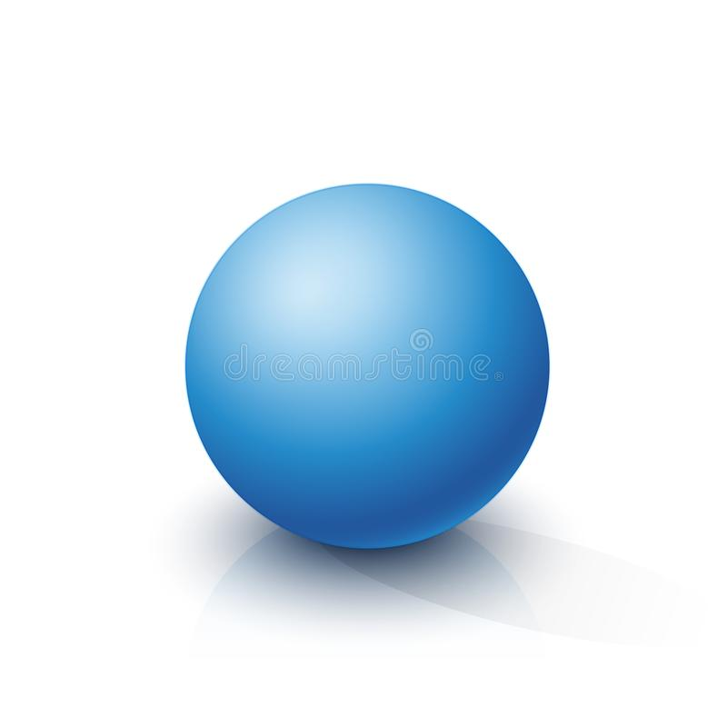
2D 3D

