Slide 1
Ss

Slide 2
sun

Slide 3
spider

Slide 4
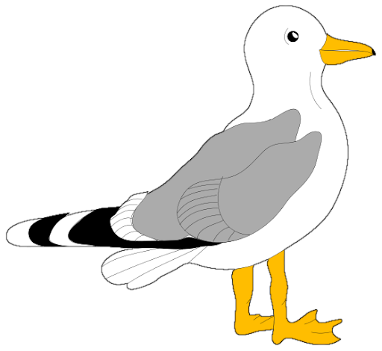
seagull

Slide 5
submarine

Slide 6
nest

Slide 7
grass

Slide 8
bus

