Slide 2
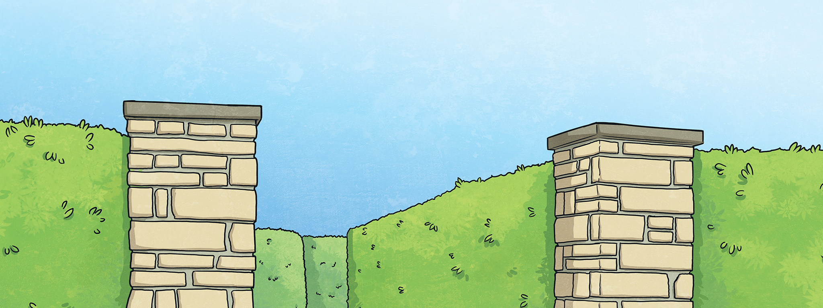
Can you find the centre of the maze?
Choose the correct quantifier to complete the sentence.
If you make a mistake, you might get lost!

Slide 3
Remember:
We use how many with plural countable nouns to ask about quantity.
We use how much with uncountable nouns to ask about quantity.
We use some in affirmative sentences with uncountable or plural countable nouns.
We use any in negative or question sentences with uncountable or plural countable nouns.

Slide 4
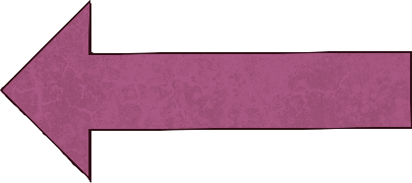
Back at the beginning!
Click here to start again.

Slide 5
How brothers and sisters do you have?
many
(Turn left.)
much
(Turn right.)

Slide 6
I’d like more pizza, please.
some
(Straight ahead.)
any
(Turn left.)
many (Turn right.)

Slide 7
Do you have pets at home?
any
(Straight ahead.)
some
(Turn right.)

Slide 8
Sorry, I don’t have time to help you.
many
(Straight ahead.)
any
(Turn left.)
some (Turn right.)

Slide 9
How milk do you want in your coffee?
much
(Straight ahead.)
many
(Turn right.)

Slide 10
I need more bread, please.
some
(Straight ahead.)
any
(Turn right.)

Slide 11
How people live in your town?
much
(Straight ahead.)
any
(Turn left.)
many (Turn right.)

Slide 12
There aren’t mountains in my home town.
any
(Turn left.)
some
(Turn right.)

Slide 13
How water do you drink every day?
much
(Straight ahead.)
many
(Turn left.)
any (Turn right.)

Slide 14
Annette has pencils in her bag.
some
(Straight ahead.)
much
(Turn right.)

Slide 15
How biscuits are on the plate?
much
(Turn left.)
many
(Turn right.)

Slide 16
How rice is in the cup?
some
(Straight ahead.)
much
(Turn left.)
many (Turn right.)

Slide 17
Oh no! A dead end!
Click here to start again.

Slide 18
Congratulations! You found the centre of the maze!

