Slide 1

https://wordwall.net/ar/resource/21643456

Slide 2
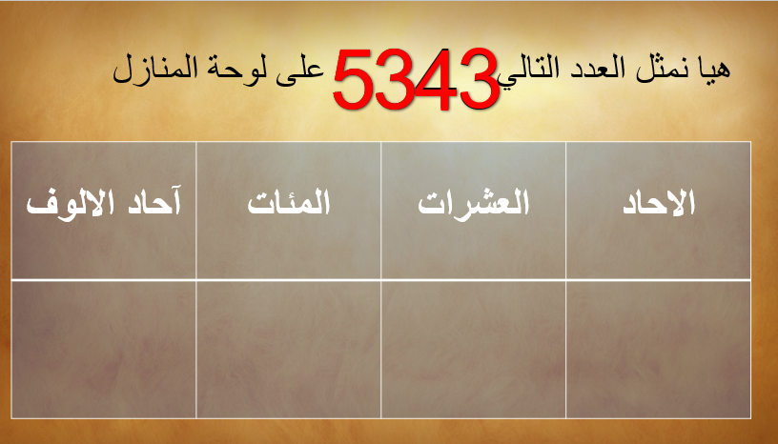
5
3
4
3

Slide 3
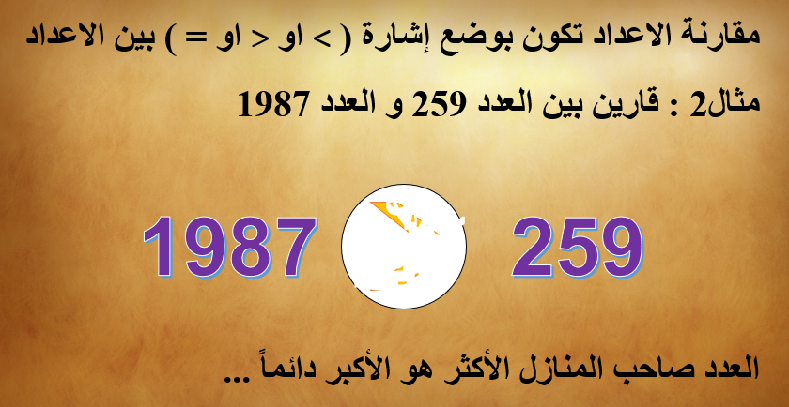
>

Slide 4
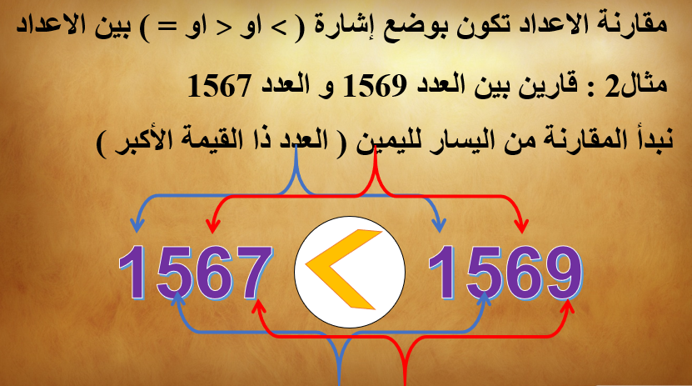

Slide 5


Slide 6
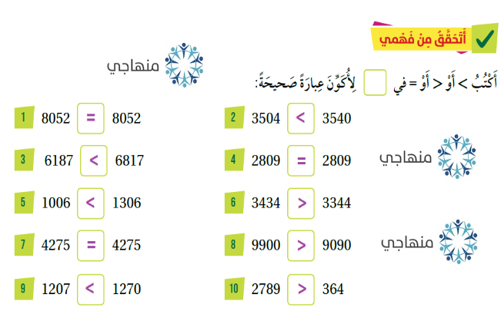

Slide 7



Slide 8
