Slide 1
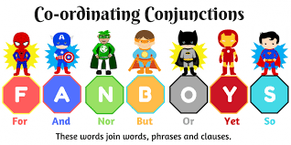
FANBOYS
Making Compound Sentences

Slide 2
, For
, And
, Nor
, But
, Or
, Yet
, So
-Each of the “FANBOYS’’ needs a comma in front of it!

Slide 3

FOR
I went to Metrotown, for I needed to buy clothes.
For means: because

Slide 4

AND
I drove to the bank, and I checked my account balance.
And means: another, addition

Slide 5

NOR / BUT
I could not spend a fortune, nor could I spend the whole day, but I would have fun!
Nor means: not
But shows contrast , subject and verb reverse after nor

Slide 6

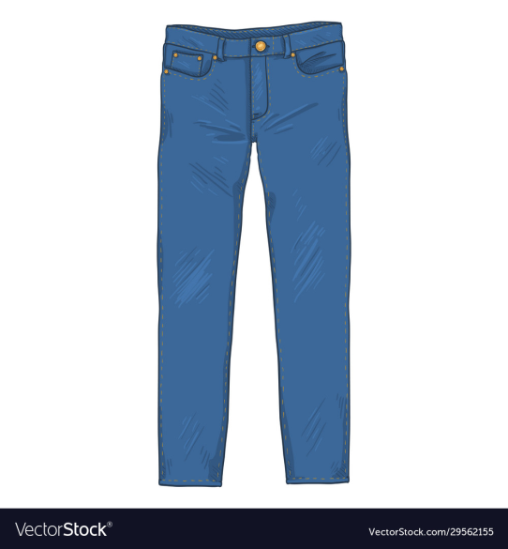
OR
I could buy jeans and a coat, or I could buy several other things up to that amount.
Or means: a choice
You can have one thing or a different thing but not both

Slide 7

YET
I had a really good time, yet it was soon dark.
Yet shows contrast, like but

Slide 8
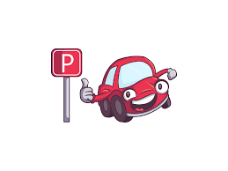

SO
I went to the parking lot, so I could drive home for dinner.
So gives result

Slide 9

F | or |  | Because, Why
A | nd |  | Showing additional information
N | or |  | Not either
B | ut |  | Contrast
O | r |  | Choice
Y | et |  | Contrast
S | o |  | As result of

