Slide 1
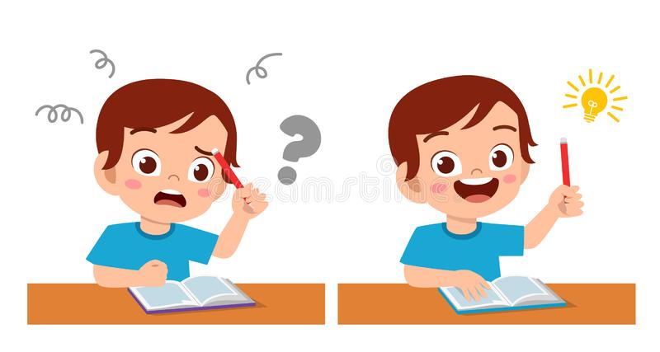
Jolly Phonics 1
Tricky Words

Slide 2
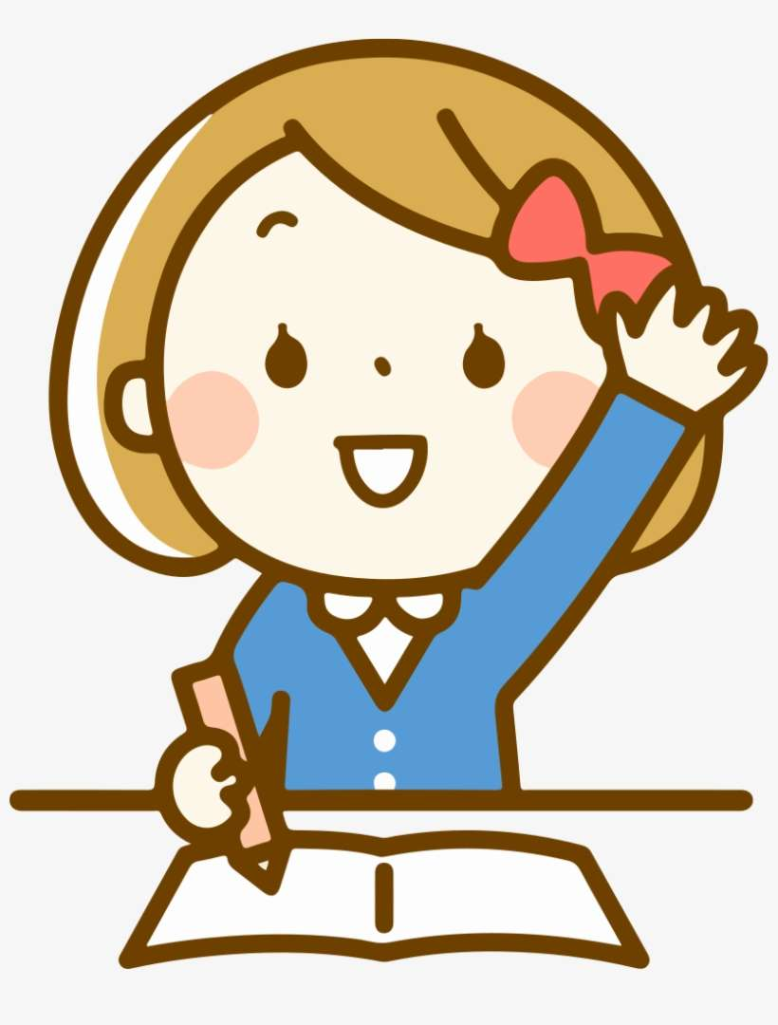
Let’s review some words together!

Slide 3
I

Slide 4
the

Slide 5
he

Slide 6
she

Slide 7
me

Slide 8
we

Slide 9
be

Slide 10
where
was

Slide 11
to

Slide 12
do

Slide 13
are

Slide 14
all

Slide 15
Great job!

