Slide 2
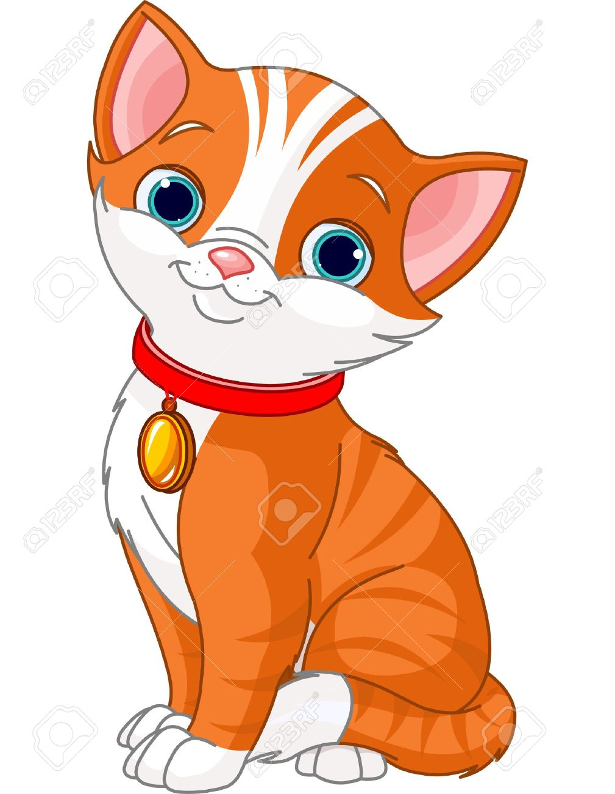
cat

Slide 3
candy

Slide 4
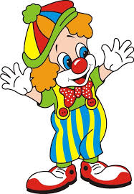
clown

Slide 5
crab

Slide 6
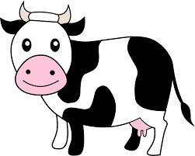
cow

