Slide 1
The Earthworm and the Spider. Page 10 Student’s Book Before you read

Slide 2
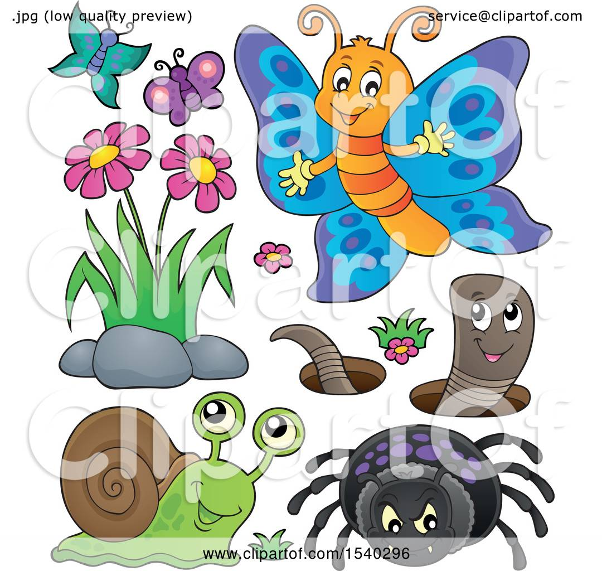
https://www.youtube.com/watch?v=lRKxu1COExg

Slide 3
After Reading Page 12 Ex.A and B

Slide 4
Ex. A page 12
Purpose 1
The author is trying to persuade us to try new things / meet new people/ to not be isolated.
Purpose 2
To entertain.
We wonder what will happen when the stranger comes to the village

Slide 5
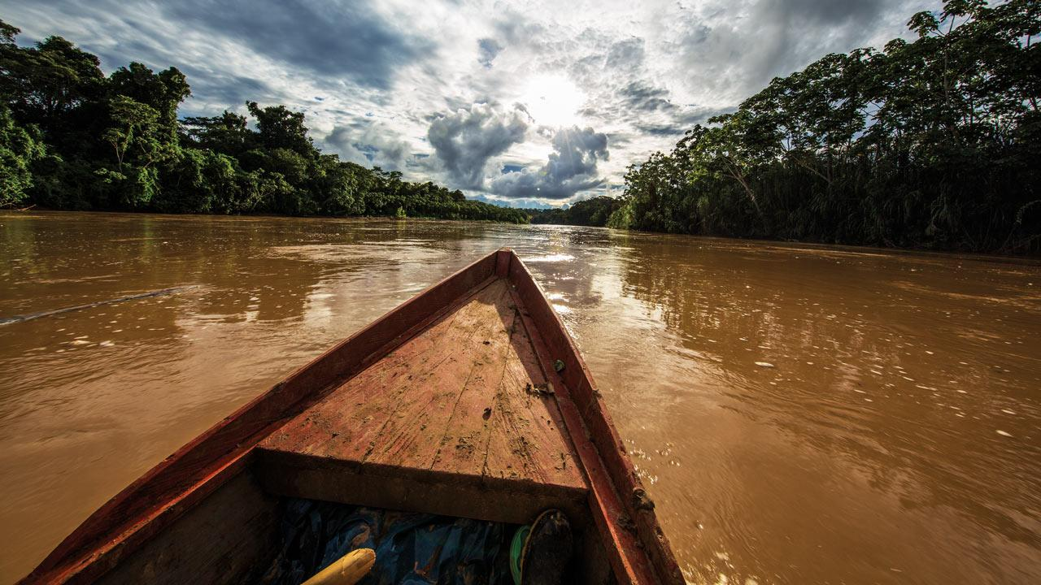
Q. 1 Because his people were isolated , they might be forgotten and fade away.

Slide 6
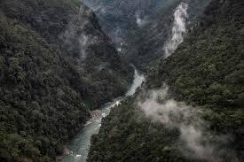
Q. 2 The people were prevented from leaving Koi because the mountain and the river kept them separated.

Slide 7
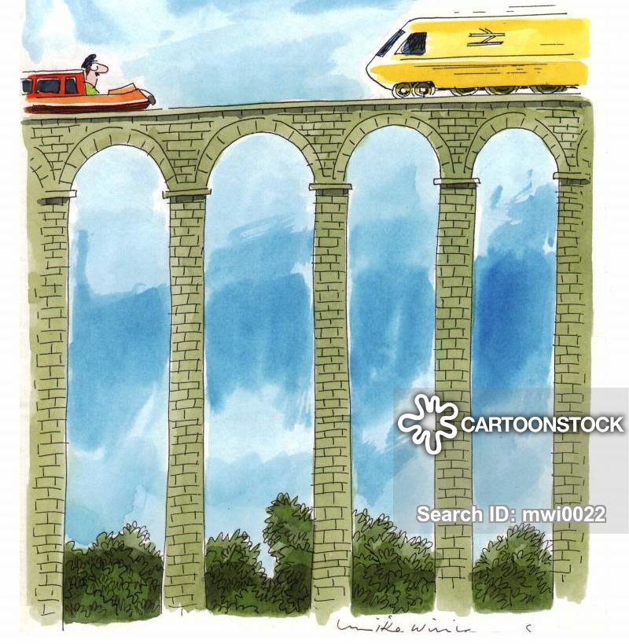
Q.3 Seeing the spider build a web between two blades of grass , gave him the idea.

Slide 8
Q. 4 They were afraid that the bridge would bring enemies. They were afraid that the stranger spoke of their land.

Slide 9
Q.5 The meaning of the stranger’s gift was friendship and trust. The stranger bought the most precious gift he could.

Slide 10
Q. 6 The narrator is happy at the end of the story. He would like to meet new people.

Slide 11
Group work Imagine the story has a different ending, what might happen? Read out your new ending to the class.

