Slide 1
Words page 8

Slide 2
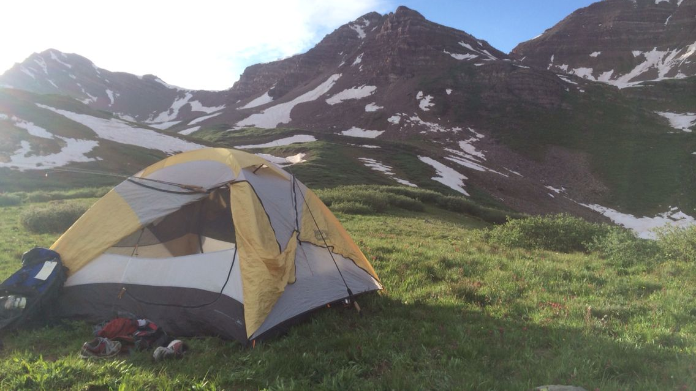
The camp is located in an isolated area.

Slide 3
Remote or apart from other people

Slide 4
These are hazardous chemicals that can cause death if inhaled.

Slide 5
Adj/ dangerous

Slide 6
She managed to wriggle free of her ropes.

Slide 7
Verb/ twist or move from side to side.

Slide 8
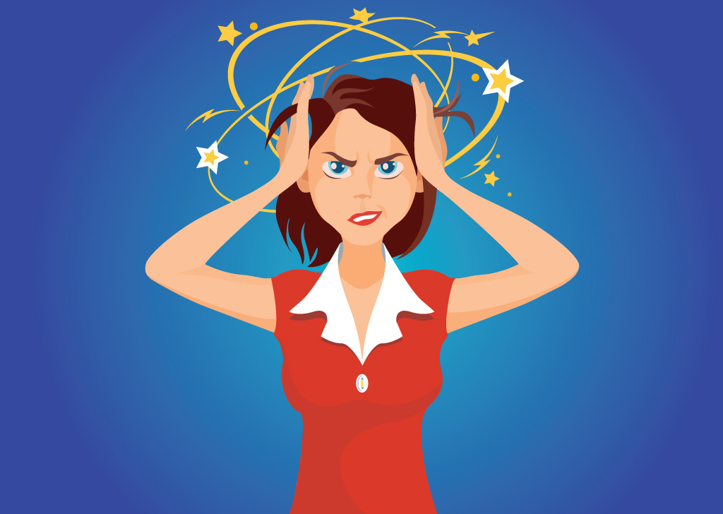
She's highly skeptical of the researchers' claims.

Slide 9
Adj/ having doubts that a statement is true or that sth will happen.

Slide 10
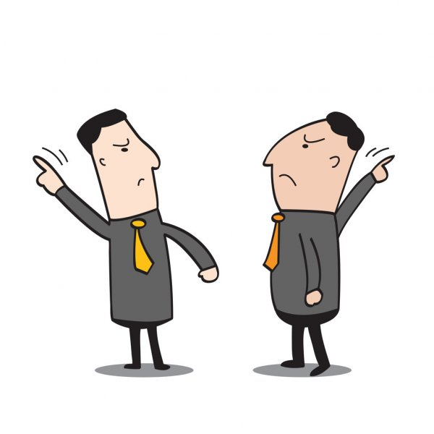
“Come on, let's go.” “Oh, all right, if you insist.”

Slide 11
Verb/ to say or demand that you must have or do something.

Slide 12
They all admired her courage.

Slide 13
Verb/ to respect or like someone or something very much

Slide 14
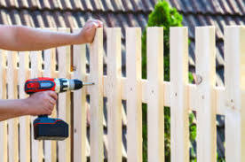
Getting the job done will require many hours of difficult labor.

Slide 15
Verb/ to work hard, especially on sth that is difficult.

Slide 16
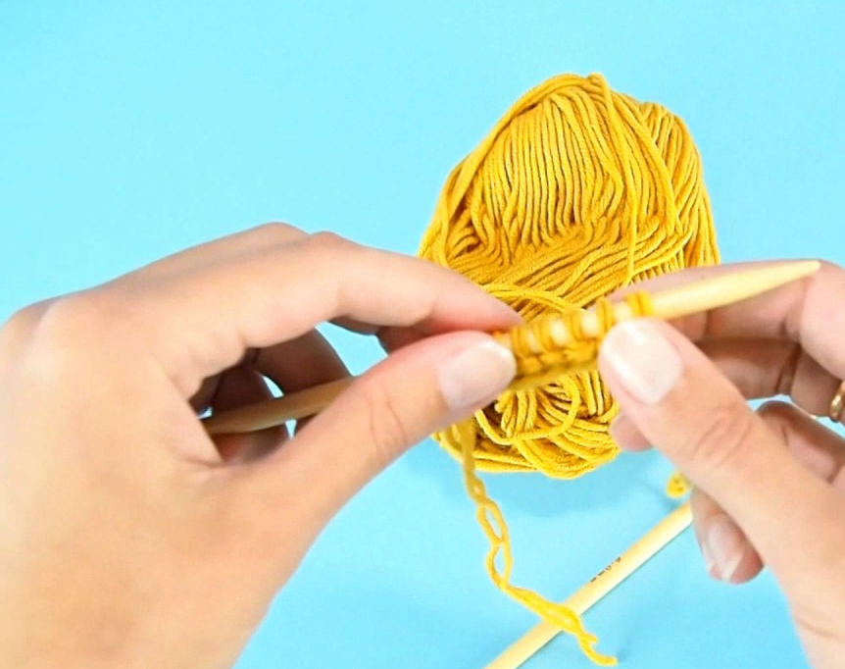
She tried to blow a gray strand of hair from her eyes.

Slide 17
noun/ a single piece of cotton, wool, hair, Etc.

Slide 18
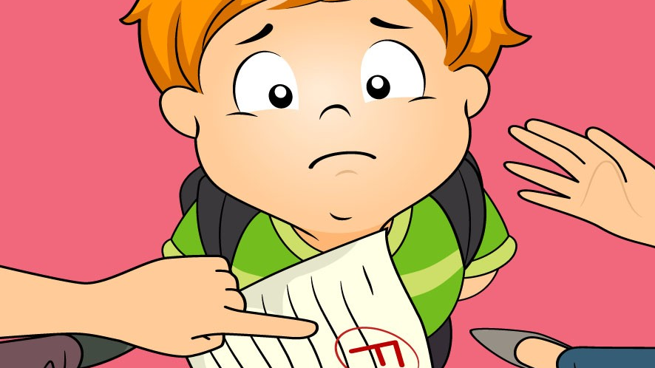
Try not to let losing discourage you.

Slide 19
Adj/ having lost hope, not feeling confident about sth.

Slide 20
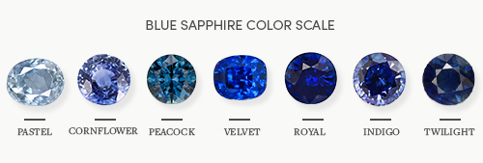
She wore huge diamond earrings and her fingers were loaded with rings of sapphire.

Slide 21
Noun/ a bright blue stone that is very valuable.

Slide 22
We were instructed to report any suspicious activity in the neighborhood.

Slide 23
Adj/ feeling that someone has done something wrong or illegal.

Slide 24
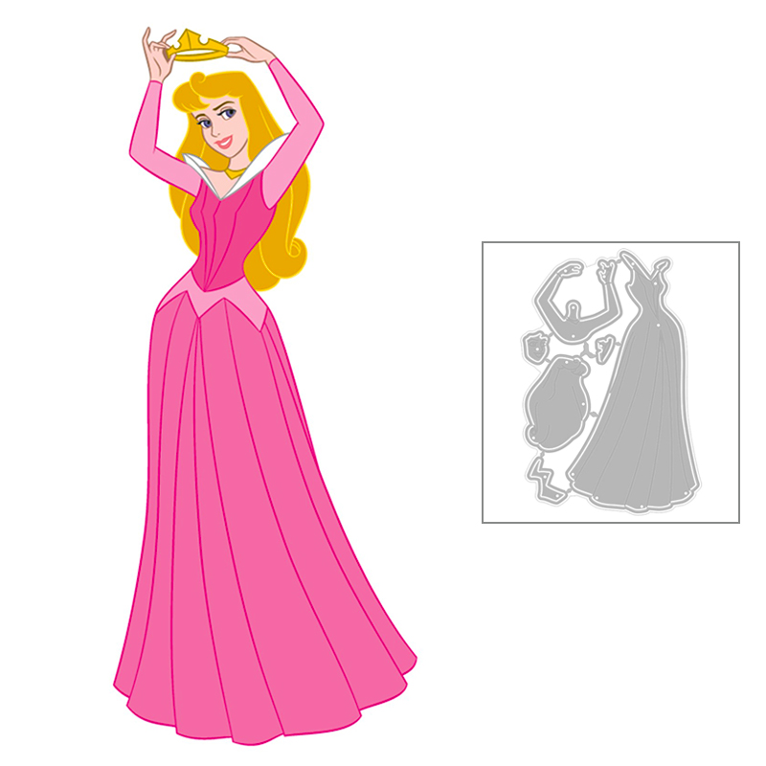
Her wedding gown was simply exquisite. She looked like a princess.

Slide 25
Adj/ very beautiful.

Slide 26
Our flight departs at 6:15 a.m.

Slide 27
Verb/ to leave a place, usually at the beginning of a trip.

Slide 28
Game

