Slide 1
Integers, powers and roots
Chapter 1

Slide 2
Objectives
To learn about multiplying and dividing integers.
To learn about squares and square roots, cubes and cube roots.
To learn about laws of indices.
To learn about the order of operation.
To learn about LCM, HCF and prime factorization.
To learn about natural and rational numbers.

Slide 3
Multiplying and dividing negative numbers
+ × − = −
Different signs /negative answer
+ ÷ − = −
− × − = +
+ × + = +
Same signs /Positive answer
− ÷ − = +
+ ÷ + = +
https://www.youtube.com/watch?v=K_tPbVPfHgk

Slide 4
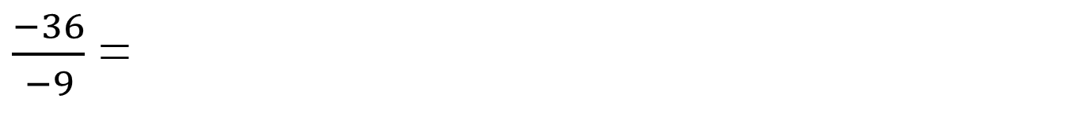
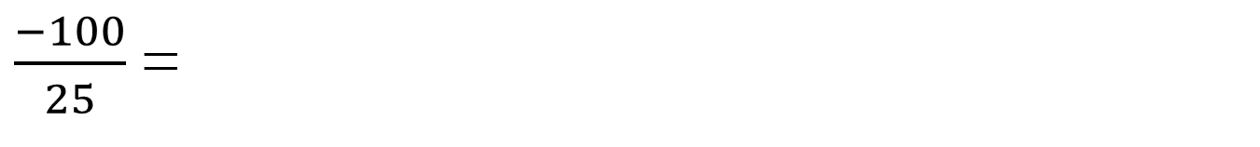
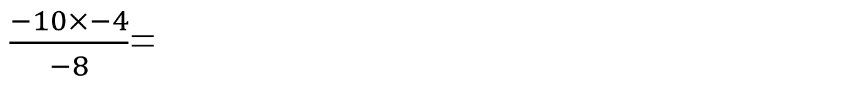
Examples
− 7 × 4=
$\frac{−100}{25}$ =
–28
–4
− 3 × − 2 =
6
$\frac{−36}{−9}$ =
4
− 20 ÷ − 5 =
4
–60
$\frac{−10×−4}{−8}$=
–5
− 3 × − 5 × − 4 =

Slide 5

Examples: find the missing number:
___× 5 = −30
−6
___× −6 = 42
−7
___× −6 = –48
8
−2 × ___× −6 = 36
3
−3 × −5 × ___= −75
−3 × −5 × ___= −75
−5
Solve the following:
P. 10 Ex. 1B Q2 (f,g,h,j,k), Q3 (c,d,f,h,i), Q4 (b,d,f,h), Q5(d,e,f), Q6(a,c,g,h), Q7 (all). Q8, Q9.
P. 11 Ex. 1C Q2(c,d,e), Q4, Q5, Q6(a,c,g,h), Q7, Q8, Q9(a,c), Q10.
___× −4 × −2 = 72
9

Slide 6
Squares numbers
Square numbers come from squaring integers (multiplying a whole number by itself)
Example: 2 × 2 = 4 and 4 × 4 = 16
This can be written using indices 2² = 4 and 4² = 16
Note:
2.7²= 2.7 × 2.7 = 7.29 which is not a square number because 2.7 is NOT an integer

Slide 7
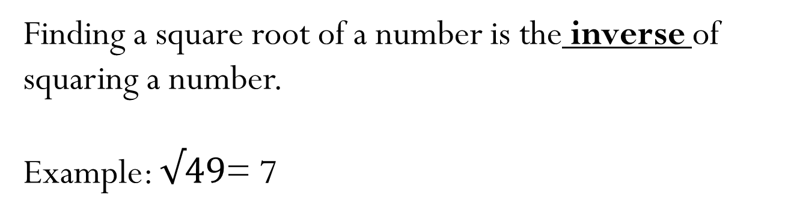
Square roots
Finding a square root of a number is the inverse of squaring a number.
Example: $√49$= 7
because 7 × 7 = 49 so √49 = 7
Note: you also know that −7 × −7 is also 49
Therefore, √49 = +7 and −7

Slide 8



Square roots continue
Example:
Find the square root of the numerator then the denominator.
Example:
Convert decimals to fractions then find their square roots
Example:

Slide 9
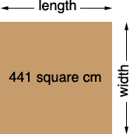
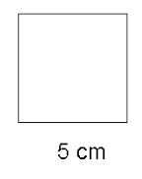
Area of a square = l × w
Example 1: what is the area of the square below:
Example 2: what is the side length of the square below:
In the above square we know that the area is found by multiplying a number by itself to get 441 cm². Since the inverse of squaring a number is the square root, the side length of the square
= √441 = 21 cm
Since the side is known and a square has 4 equal sides, the area of the square
= 5 × 5 = 25 cm²

Slide 10
Cubes
Cube numbers come from cubing integers (multiplying a whole number by itself and then multiplying by itself again)
Example: 2 × 2 × 2 = 8 and − 4 × − 4 × − 4 = − 64
This can be written using indices 2³= 8 and (−4)³= − 64
Note:
3.1³= 3.1 × 3.1 × 3.1 = 29.791 which is not a cube number because 3.1 is NOT an integer

Slide 11


cube roots
Finding a cube root of a number is the inverse of cubing a number.
Example: = 5
Cubes and cube roots are useful for finding volumes and side lengths of cubes
5 x 5 x 5 = 125 so = 5
Example: = −2
The answer is −2 because −2 × −2 × −2= −8

Slide 12
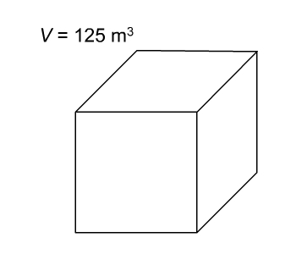
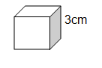
Volume of a cube = l × w × h
Example 1: what is the volume of the cube below:
Example 2: what is the side length of the cube below:
Since the inverse of cubing a number is the cube root, the side length of the cube is
= = 5 m
Volume = l × w × h
= 3 × 3 × 3 = 27 cm³

Slide 13
Solve the following questions:
P. 13 Ex. 1D
  Q1 (a, b, f)
  Q2 (a, d, f)
  Q3
  Q4 (a,b)
  Q5 (b,c,f)
  Q6 (b, d)
  Q7 (a, b)
  Q8 (a,c)
  Q9 (a,c)
  Q10
  Q11
  Q13 (a,b)
  Q14 (b,e)
https://www.youtube.com/watch?v=B4zejSI8zho

Slide 14
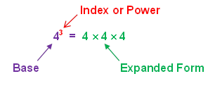
Index notation
Index notation means using powers.
Example: 2 × 2 × 2 = 2³
5 × 5 × 5 × 5 = 5⁴
7 × 7 × 7 × 7 × 7 × 7= 7⁶
Solve P.14 Ex. 1E
Q1 (c, d), Q2 (b, d, e), Q3 (b, c,e), Q4
https://www.youtube.com/watch?v=-zUmvpkhvW8

Slide 15
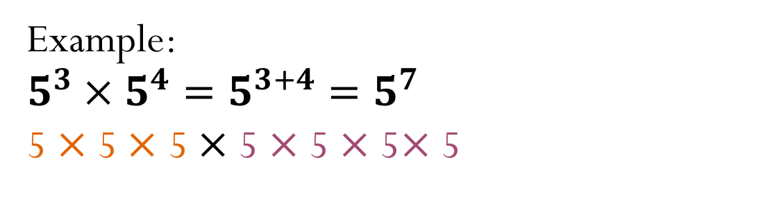
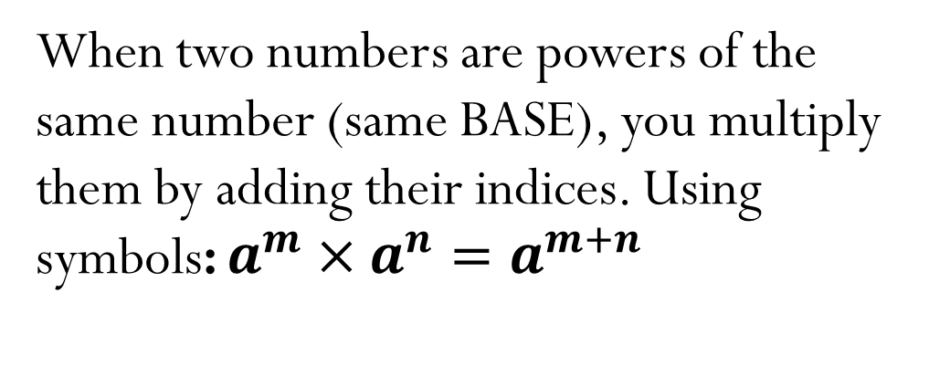
Multiplying powers of the same number
When two numbers are powers of the same number (same BASE), you multiply them by adding their indices. Using symbols: $a^{m}×a^{n}=a^{m+n}$
You can always write them in expanded form to double check your answer.
Example:
$5^{3}×$ $5^{4}=5^{3+4}=5^{7}$
5 $×$ 5 $×$ 5 $×$ 5 $×$ 5 $×$ 5$×$ 5

Slide 16
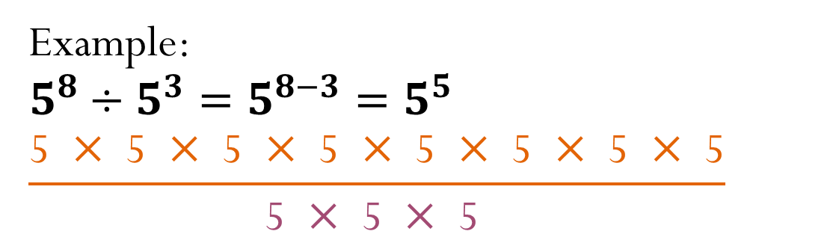
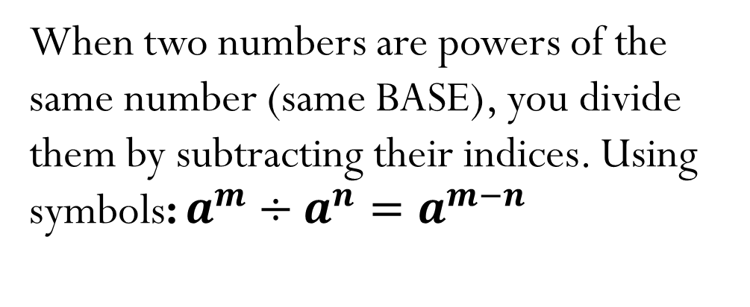
Dividing powers of the same number
When two numbers are powers of the same number (same BASE), you divide them by subtracting their indices. Using symbols: $a^{m}÷a^{n}=a^{m−n}$
You can always write them in expanded form to double check your answer.
Example:
$$5^{8}÷5^{3}=5^{8−3}=5^{5}$$
$$\frac{\text{5 }×\text{ 5 }×\text{ 5} × \text{5 }×\text{ 5 }×\text{ 5} ×\text{ 5 }×\text{ 5}}{\text{5 }×\text{ 5 }×\text{ 5} }$$

Slide 17
Solve the following questions:
P. 15 Ex. 1F
  Q1 (b,f)
  Q2
  Q4
  Q5
  Q6 (b)
  Q7
  Q8
  Q9 (a,d)
  Q10 (a,d)
  Q11(g,h,i,j)

Slide 18
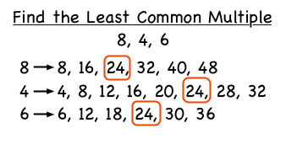
Lowest common multiple
LCM (lowest common multiple of two or more numbers is the common multiple with the lowest value.

Slide 19
Highest common factor
HCF (highest common factor) of two or more numbers is the common factor with the highest value. Factors of a number are the whole numbers that divide into it with no remainder.
It’s a good idea to look for factors in pairs, so that you don’t miss any out.
Example: Find the HCF of 20 and 24:
Factors of 20: 1 , 2 , 4 , 5 , 10 , 20
Factors of 24: 1 , 2 , 3, 4 , 6 , 8 , 12 , 24
Common factors are: 1 , 2 , 4
Highest Common factor is: 4
https://www.youtube.com/watch?v=0NvLtTwnUHs&list=PLbzagEi1JQaMR8nAaTKzcjRkrhnYx4SdH
Solve P. 16 Ex. 1G
Q1 (b), Q2

Slide 20
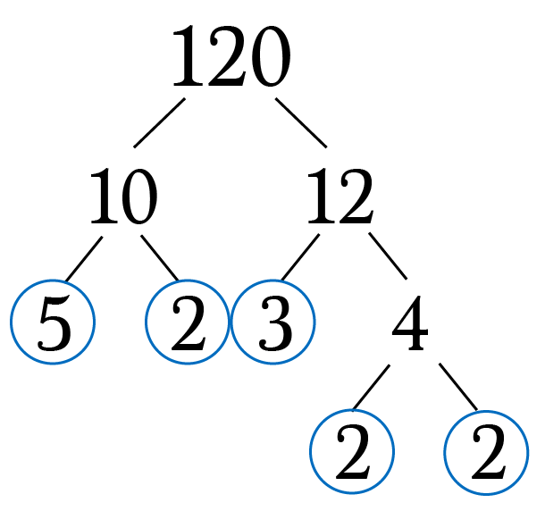
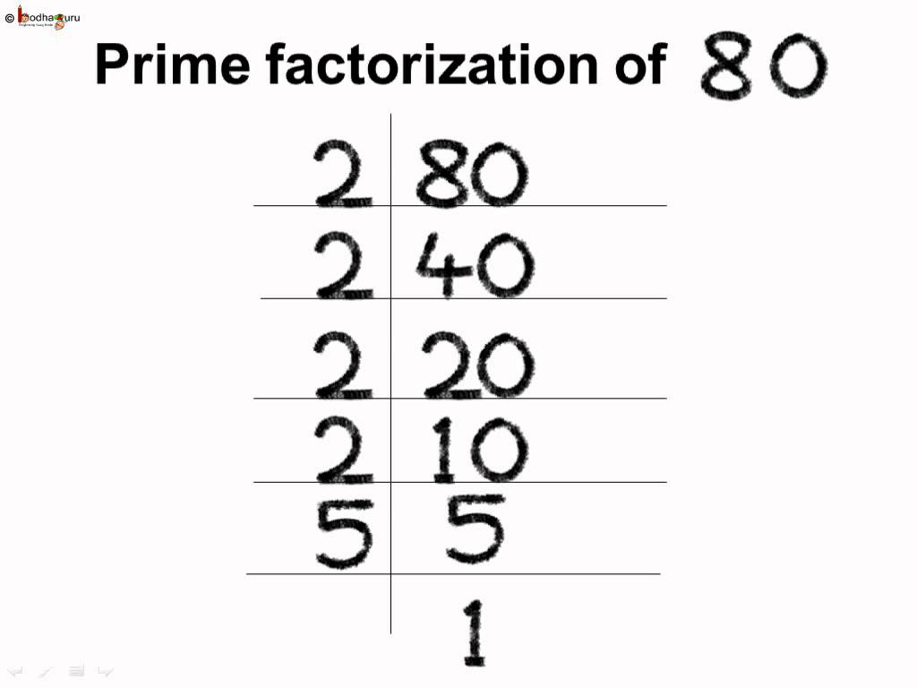
Prime numbers
A number that has two factors only, 1 and itself is called a prime number.
A number that has more than two is called a composite number.
Every number can be written as a product of prime. The two most common ways to do this are by using factor trees and division by primes.
120 = 2 × 2 × 2 × 3 × 5
Using index notation: 2³ × 3 × 5
80 = 2 × 2 × 2 × 2 × 5
Using index notation: 2⁴ × 5
https://www.youtube.com/watch?v=XGbOiYhHY2c&list=PLbzagEi1JQaMR8nAaTKzcjRkrhnYx4SdH&index=3

Slide 21
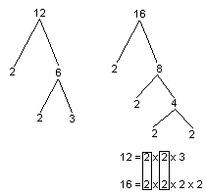
Finding LCM and HCF using factor tree or division by prime
HCF
12= 2 × 2 × 3 = 2² × 3
16 = 2 × 2 × 2 × 2 = 2⁴
circle the common numbers and use one from each group or use the lowest power of common factors
HCF = 2² = 2 × 2 = 4
LCM
12= 2 × 2 × 3 = 2² × 3
16 = 2 × 2 × 2 × 2 = 2⁴
Put the common numbers in groups, take one from every group and collect any left over numbers as well. OR: Use the highest power of All numbers.
LCM = 2⁴ × 3 = 48
Remember:
LCM of prime numbers is the product of the numbers.
Example: LCM of 3, 5 and 7 is 3 × 5 × 7
Solve P. 18 Ex. 1H
Q1,Q2 ,Q3(a,c), Q4(c,d), Q5 (a,b)

Slide 22
BIDMAS
When there’s multiple operations in a question you should ALWAYS follow the correct order of operation.
Watch the link below:
https://www.youtube.com/watch?v=dAgfnK528RA
Solve P. 19 Ex. 1I
Q1, Q2 (b, c, d), Q3 (b, c), Q4, Q5 (a), Q6(c), Q7(a)

Slide 23
Remember….
Know your square numbers up to 20 x 20
Know your cube numbers up to 10 x 10 x 10
Revision questions page 22 and workbook Ch. 1

Slide 24
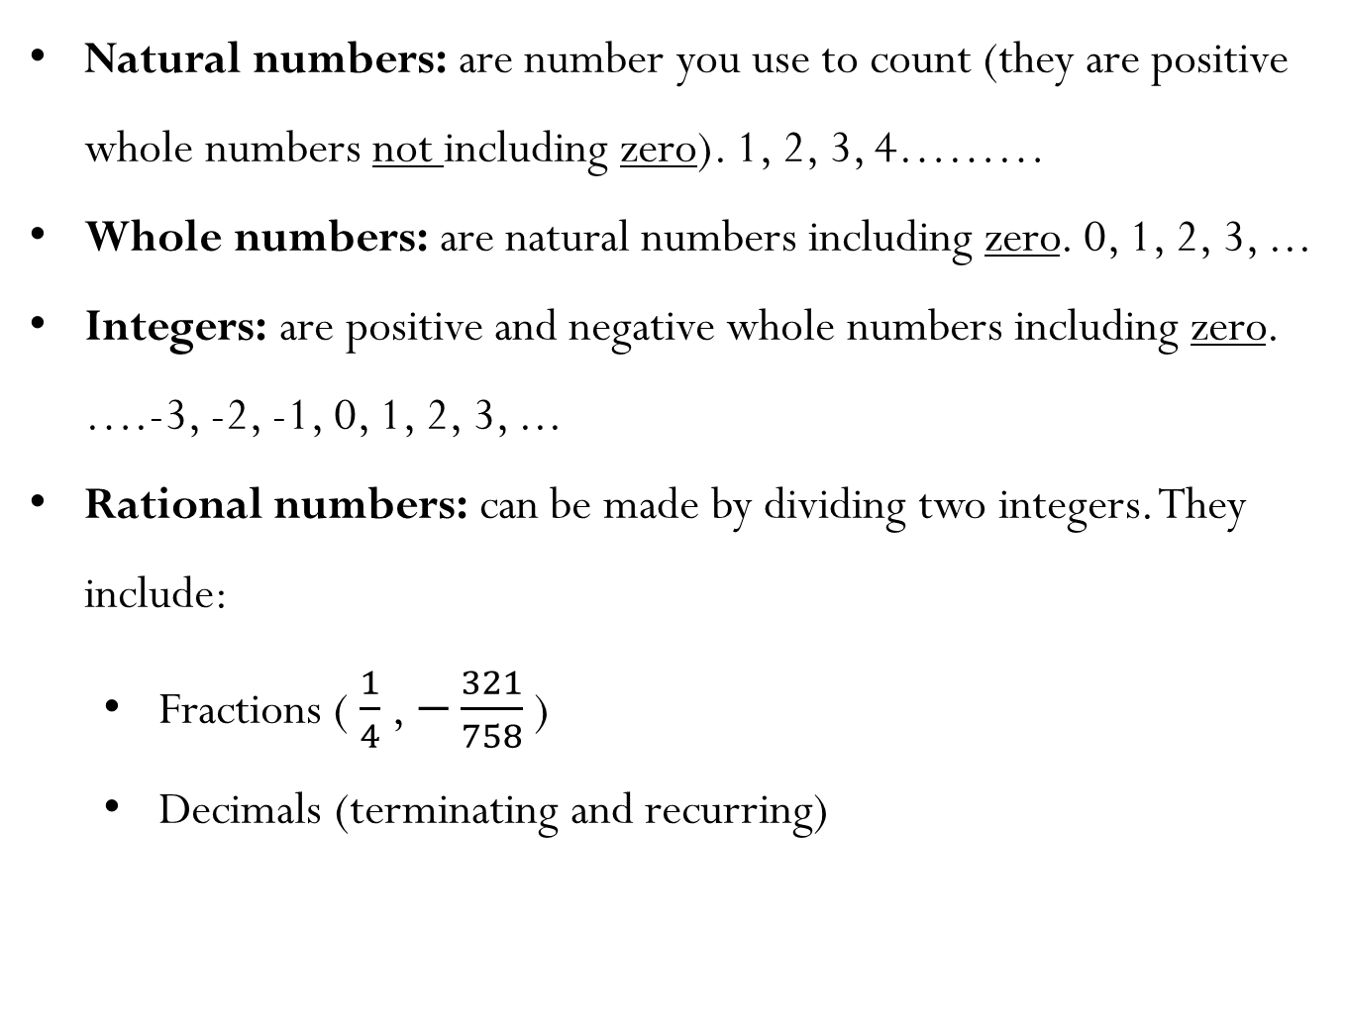
Natural and rational numbers
Natural numbers: are number you use to count (they are positive whole numbers not including zero). 1, 2, 3, 4………
Whole numbers: are natural numbers including zero. 0, 1, 2, 3, ...
Integers: are positive and negative whole numbers including zero.
….-3, -2, -1, 0, 1, 2, 3, ...
Rational numbers: can be made by dividing two integers. They include:
  Fractions ( $\frac{1}{4}$ , $−\frac{321}{758}$ )
  Decimals (terminating and recurring)
Solve P. 20 Ex. 1j
Q2, Q4

