Slide 1

8 parts of speech

Slide 2
NOUN - (Naming word)
A noun is the name of a person, place, thing or idea.
Examples of nouns: Daniel, London, table, dog,
teacher, pen, city, happiness, hope
Example sentences:
Steve lives in Sydney.
Mary uses pen and paper to write letters.

Slide 3
PRONOUN - (Replaces a Noun)
A pronoun is used in place of a noun or noun phrase
to avoid repetition.
Examples of pronouns: I, you, we, they, he, she, it,
me, us, them, him, her, this, those
Example sentences:
Mary is tired. She wants to sleep.
I want her to dance with me.

Slide 4
ADJECTIVE - (Describing word)
An adjective describes, modifies or gives more
information about a noun or pronoun.
Examples: big, happy, green, young, fun, crazy
Example sentences: The little girl had a pink hat.

Slide 5
VERB - (Action Word)
A verb shows an action or state of being.
A verb shows what someone or something is doing.
Examples: go, speak, run, eat, play, live, walk,
have, like, are, is
Example sentences: I like Woodward English.
I study their charts and play their games.

Slide 6
ADVERB - (Describes a verb)
An adverb describes/modifies a verb, an adjective
or another adverb. It tells how, where, when,
how often or to what extent. Many adverbs end in -LY
Examples: slowly, quietly, very, always, never, too,
well, tomorrow, here
Example sentences: I am usually busy.
Yesterday, I ate my lunch quickly.

Slide 7
PREPOSITION - (Shows relationship)
A preposition shows the relationship of a noun or
pronoun to another word. They can indicate time,
place, or relationship.
Examples: at, on, in, from, with, near, between, about,
under
Example sentences: I left my keys on the table for you.

Slide 8
CONJUNCTION - (Joining word)
A conjunction joins two words, ideas, phrases or
clauses together in a sentence and shows how they
are connected.
Examples: and, or, but, because, so, yet, unless, since, if.
Example sentences: I was hot and exhausted but
I still finished the marathon.

Slide 9
INTERJECTION - (Expressive word)
An interjection is a word or phrase that expresses a
strong feeling or emotion. It is a short exclamation.
Examples: Ouch! Wow! Great! Help! Oh! Hey! Hi!
Example sentences: Wow! I passed my English test.
Great! – Ouch! That hurt.

Slide 10
SHOWS ACTION OR BEING
JUMP, SLEEP, RUN, MOVE, LEARN, GO
TABLE, DOG, FLOWER, CUP, CANDY,SCHOOL, HOUSE
NOT, ALMOST, TOO, VERY, ALWAYS
PARTS OF SPEECH
NOUNS
PRONOUNS
ADJECTIVES
INTERJECTIONS
CONJUNCTIONS
ADVERBS
VERBS
PREPOSITIONS
DESCRIBES VERBS, ADJECTIVES OR OTHER ADVERBS
NAME-PERSON, PLACE, THING OR IDEA
TAKES THE PLACE OF A NOUN
HOOK OR JOIN WORDS, PHRASES OR SENTENCES
I, HE, WE, SHE, THEY, HIM, IT
AND, BUT, FOR, YET, OR, NOR, THOUGH, SINCE, UNLESS
DESCRIBES A NOUN OR
A PRONOUN
EXPRESS EMOTIONS OR ARE FILLERS IN A SENTENCE
PRETTY, OLD, NICE, BLUE
IDICATES TIME, PLACE
OR POSITION
DOWN, BEFORE, AFTER, UPON, UP, AROUND
OH!, WOW!, YES!, UH-OH!, HELP

Slide 11
Use this chart for your homework or use your own words.
noun | pronoun | adjective | verb | adverb | preposition | conjunction | interjection
Daniel, London, table, dog, teacher, pen, city, happiness, hope | I, you, we, they, he, she, it, me, us, them, him, her, this, those | big, happy, green, young, fun, crazy, beautiful, angry, yellow | go, speak, run, eat, play, live, walk, have, like, are, is, swim, jump | slowly, quietly, very, always, never, too, well, tomorrow, here | at, on, in, from, with, near, between, about, under | and, or, but, because, so, yet, unless, since, if | Ouch! Wow! Great! Help! Oh! Hey! Hi!

Slide 12
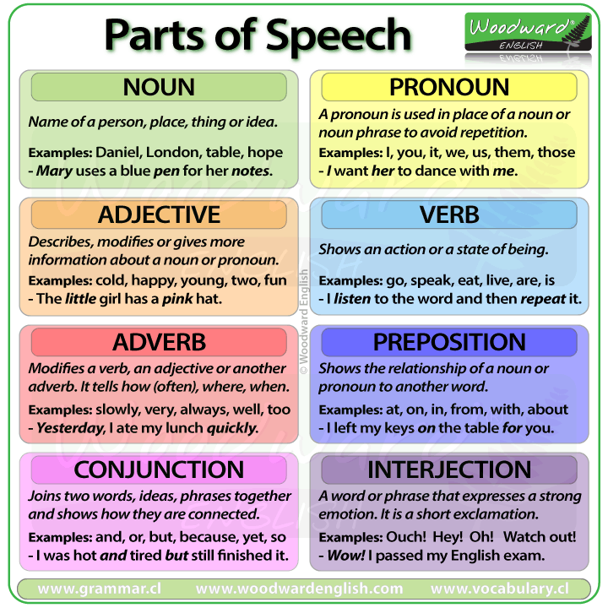
Homework
Make 2 sentences with each part of speech
Underline parts of speech
Explain in braces what does it mean in this context

Slide 13
Examples
The little girl had a pink hat. (pink is an adjective, it indicates color)
I am usually busy. (usually is an adverb, it answers to the question when? and ends with –LY)
Wow! I passed my English test. (Wow! is an interjection, it has an exclamation mark and expresses excitement)

