Slide 1
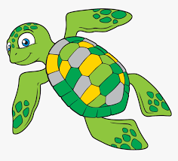
Sea Turtle Life Cycle
https://youtu.be/ZEI0IYlNEh8

Slide 2
Stage 1 Word bank:
eggs
sand
nest
Time connectives:
First
Next
Second
Then
Third
After that
Finally

Slide 3
Stage 2 Word bank:
Time connectives:
First
Next
Second
Then
Third
After that
Finally
hatchling
hatch
eggshells
Baby turtles

Slide 4
Stage 3 Word bank:
Time connectives:
First
Next
Second
Then
Third
After that
Finally
juvenile
Young turtles
Bigger shell

Slide 5
Stage 4 Word bank:
Time connectives:
First
Next
Second
Then
Third
After that
Finally
adult sea turtle
large
lays eggs

