Slide 1
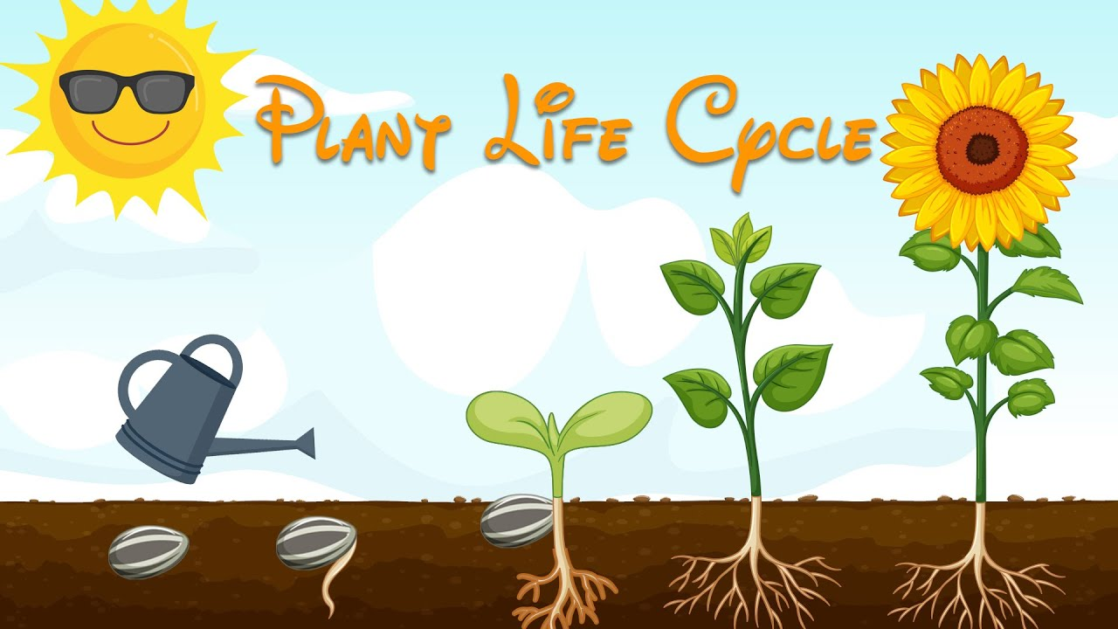
Plant Life Cycle

Slide 2
Stage one
first
Seed
gets planted

Slide 3
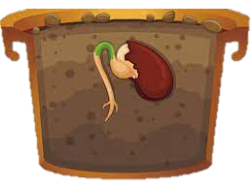
Stage two
germination
sprout
second
roots
stem

Slide 4
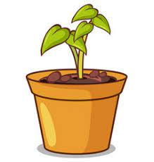
Stage three
leaves
Then
grow
seedling

Slide 5
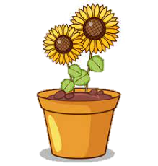
Stage four
water
sunlight
adult plant
Finally
good weather

