Slide 1
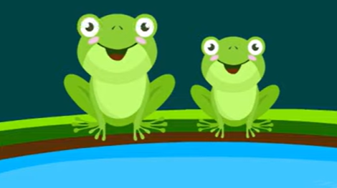
Frog Life Cycle

Slide 2
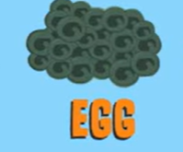
Stage 1 Word bank:
eggs
jelly like layer
body of water
Time connectives:
First
Next
Second
Then
Third
After that
Finally

Slide 3
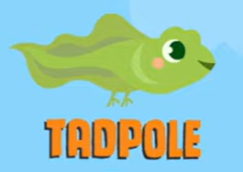
Stage 2 Word bank:
Time connectives:
First
Next
Second
Then
Third
After that
Finally
tadpole
hatch
gills
long tail
hind legs
small plants (algae)

Slide 4
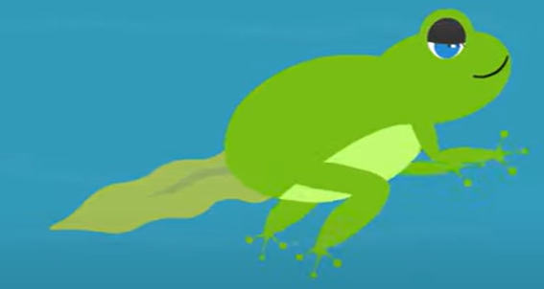
Stage 3 Word bank:
Time connectives:
First
Next
Second
Then
Third
After that
Finally
froglet
develop lungs
two front legs
breathe air
young frog

Slide 5
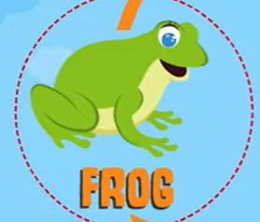
Stage 4 Word bank:
Time connectives:
First
Next
Second
Then
Third
After that
Finally
adult frog
tail disappears
lays eggs
insects
small animals

