Slide 1
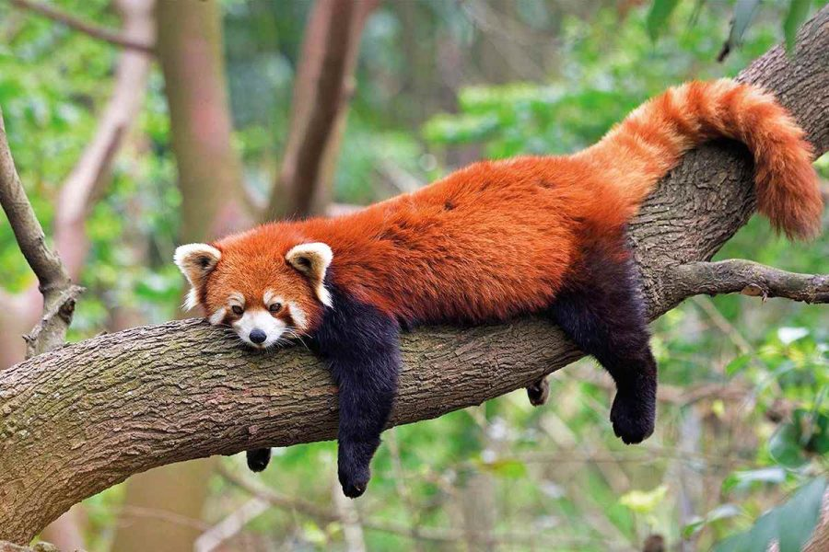
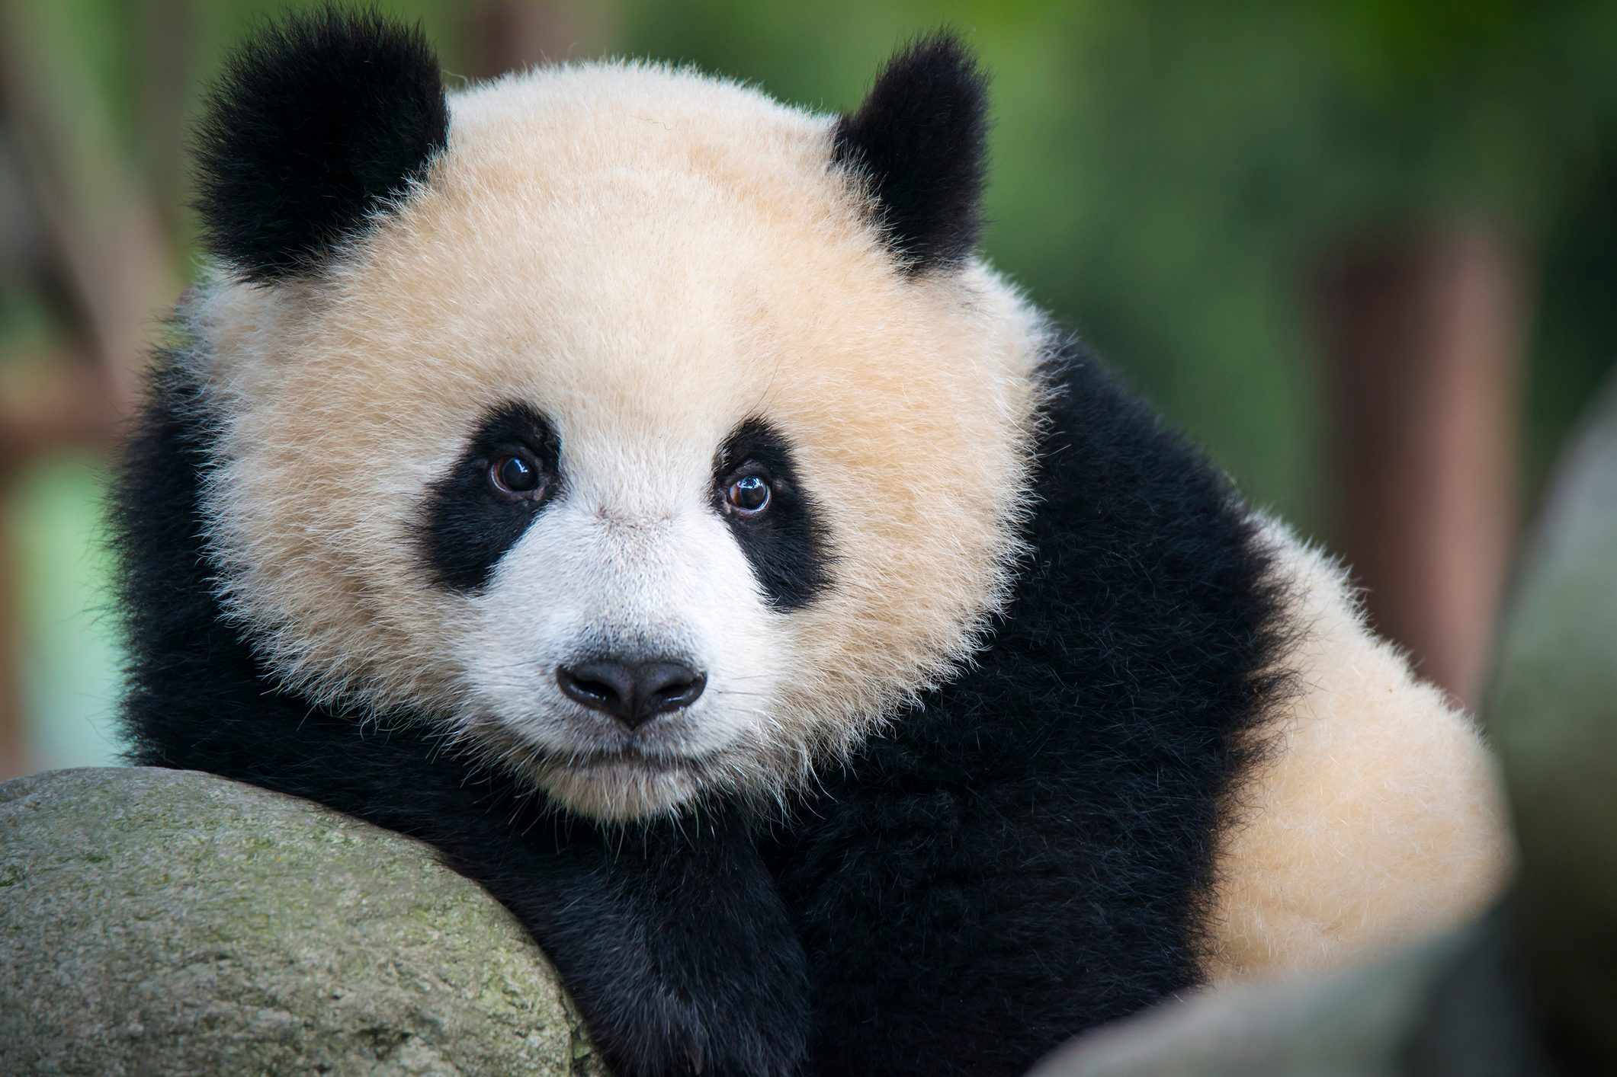
Pandas
non – chronological report

Slide 2
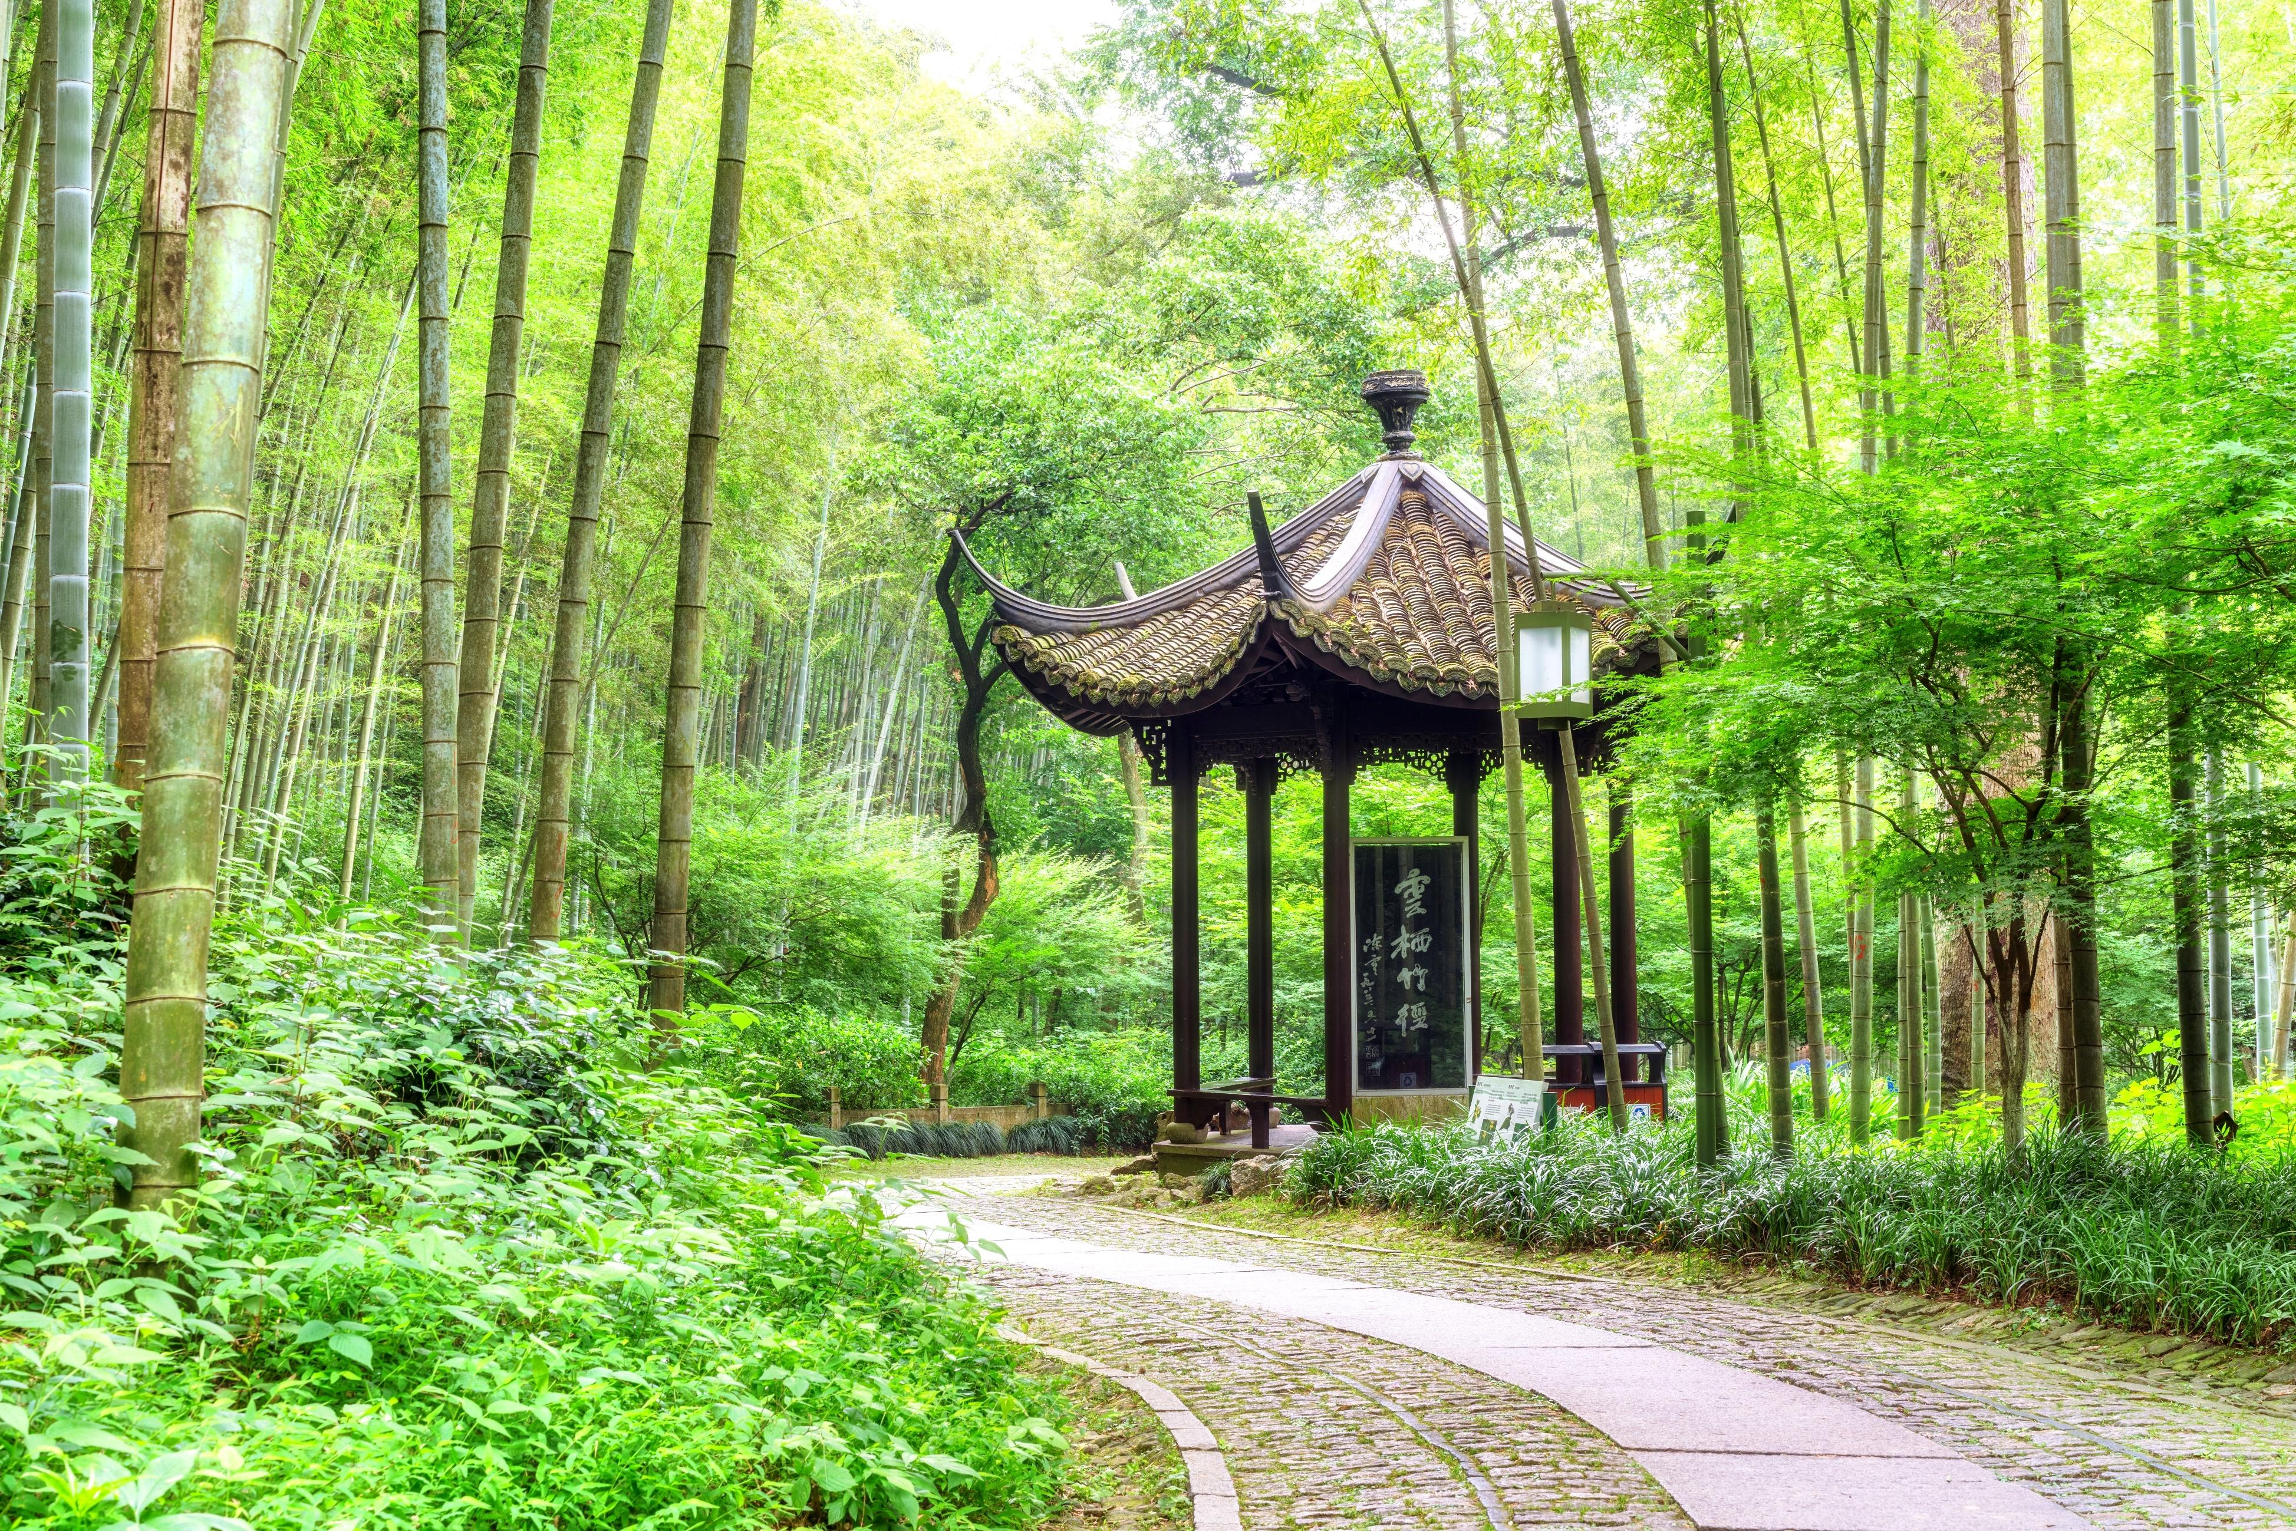

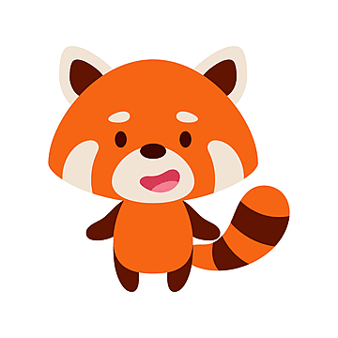
Pandas live in China
non – chronological report

Slide 3
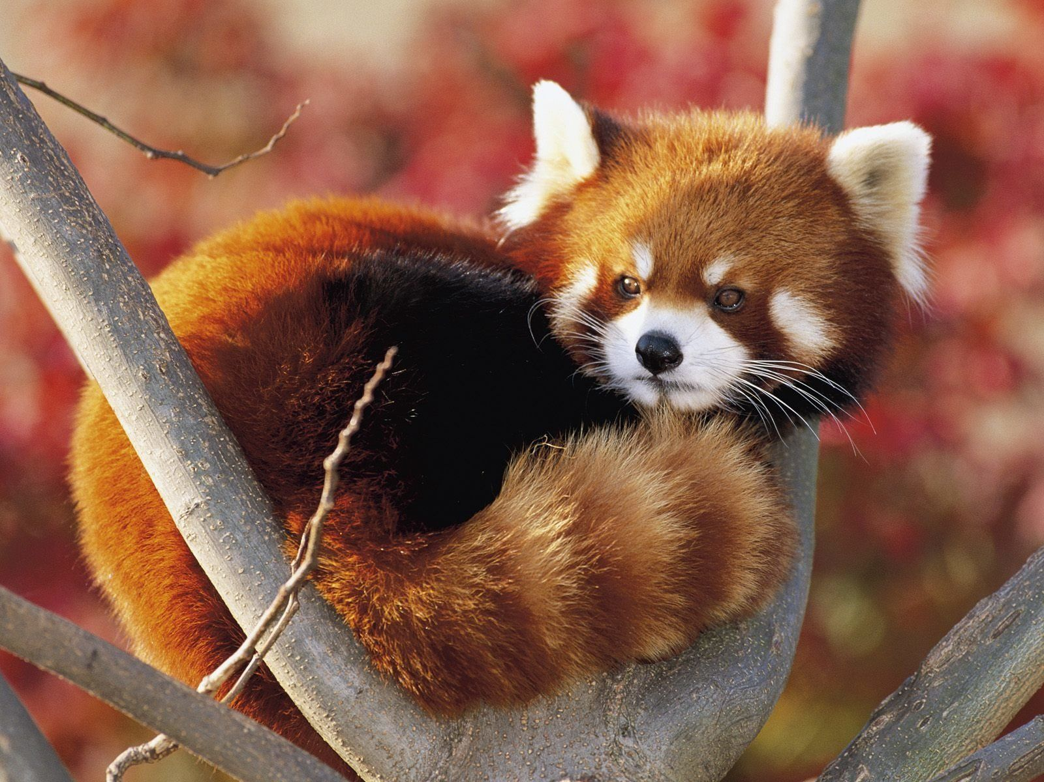
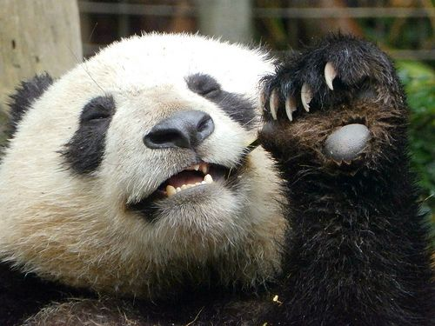
How Pandas look like
Red pandas
have long tails,
small as a cat.
have claws
Climb trees
Giant pandas
-big
-have black and white fur
-have claws
-climb trees

Slide 4
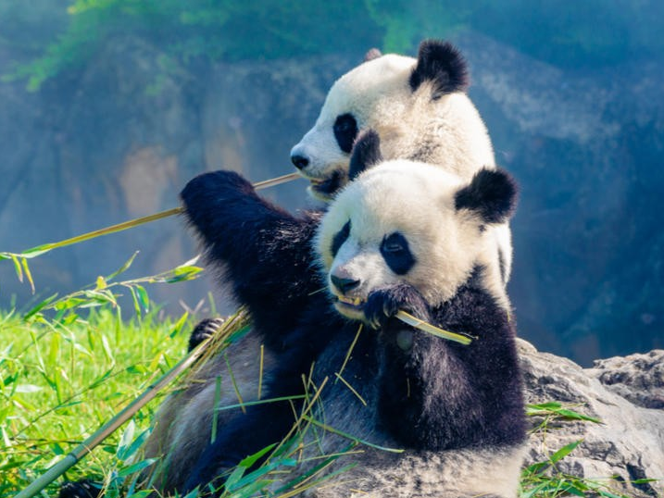
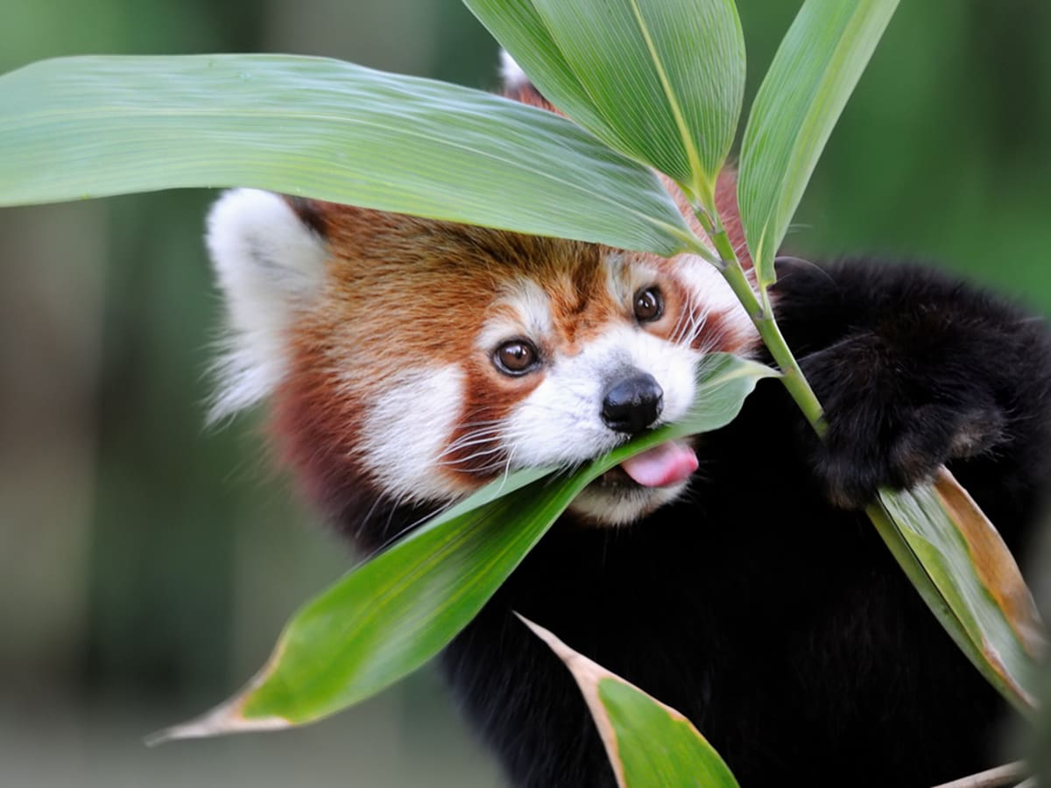
Their food
Both Pandas
-eat bamboo
-eat grass
Giant pandas eat so much

Slide 5
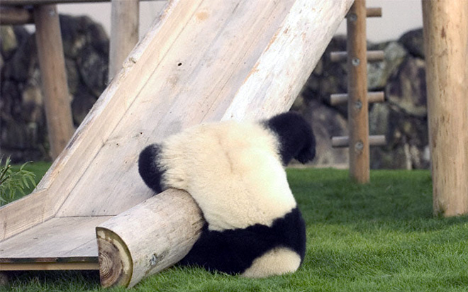
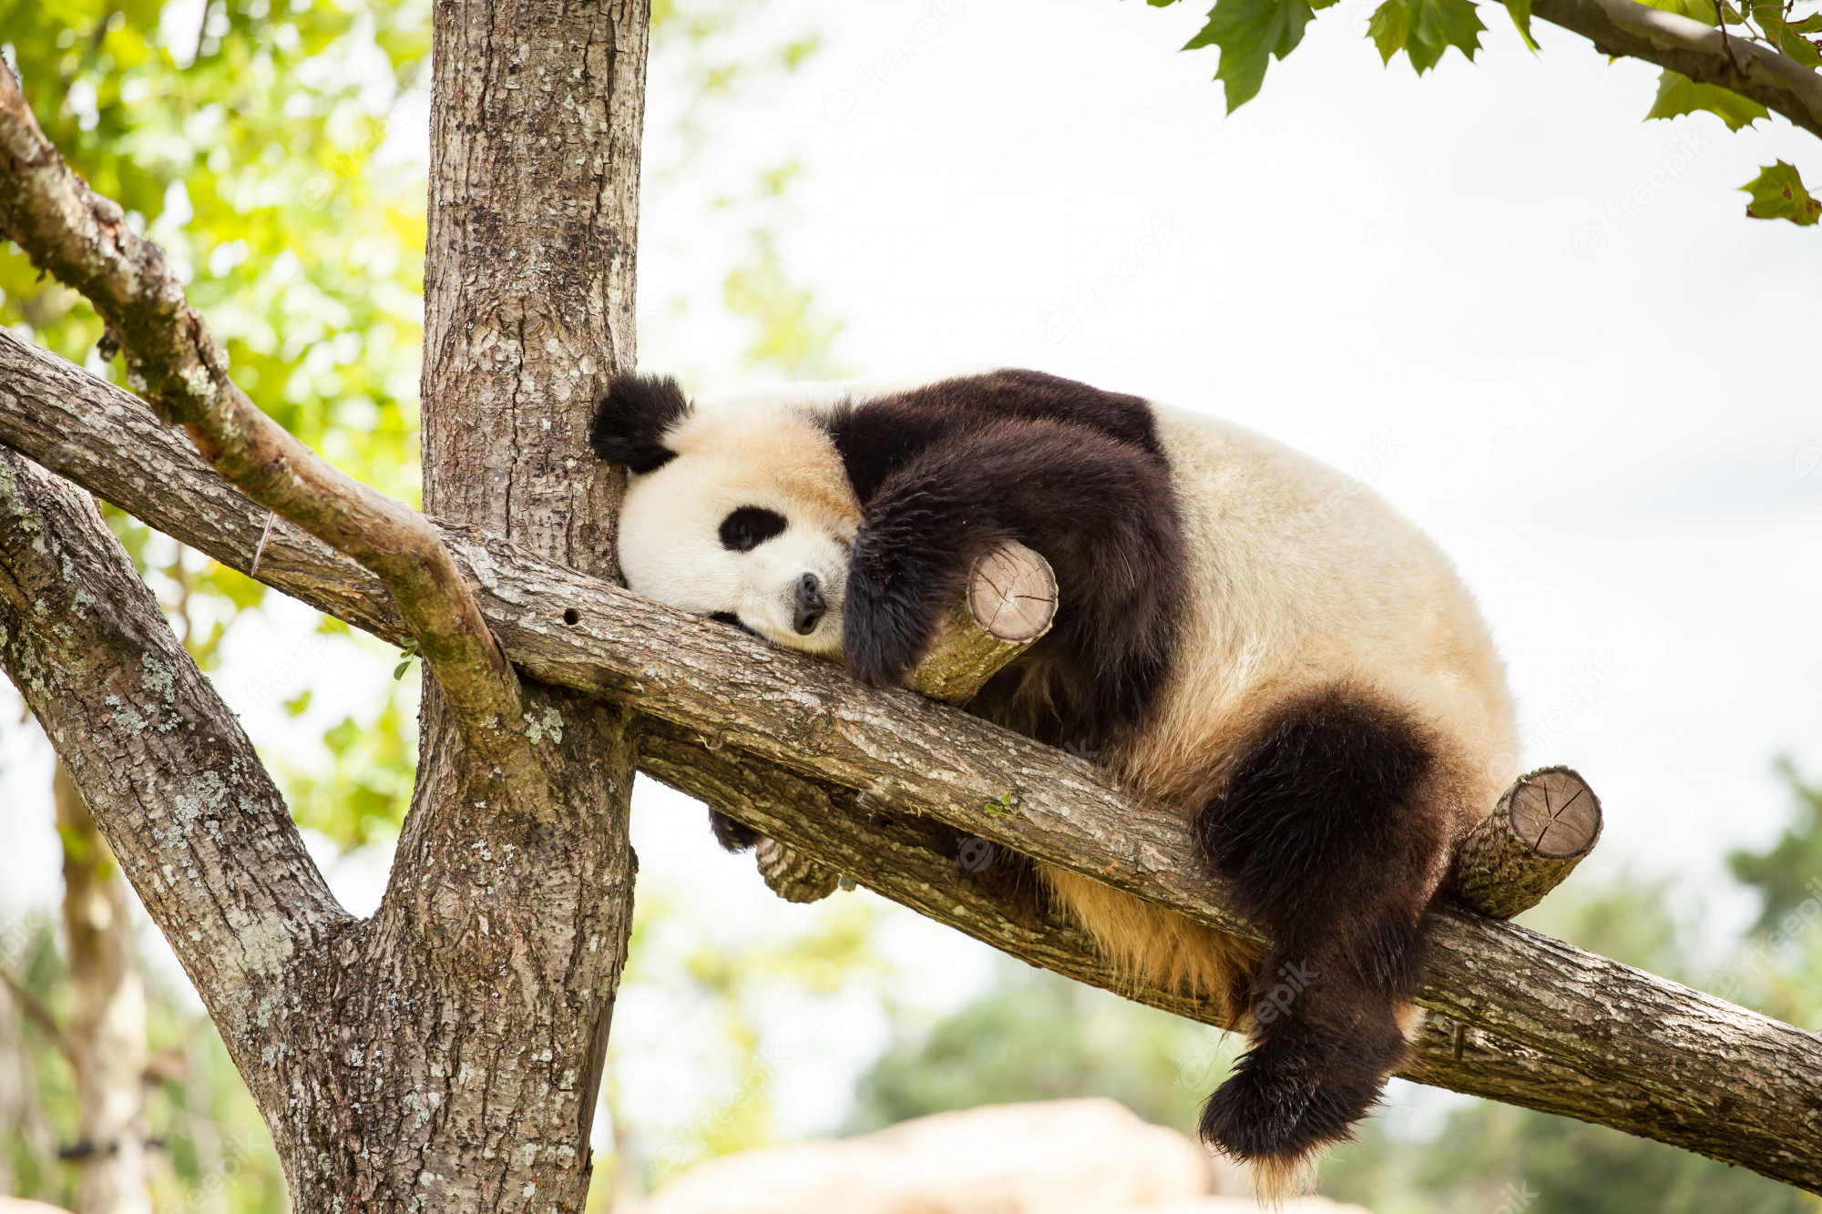
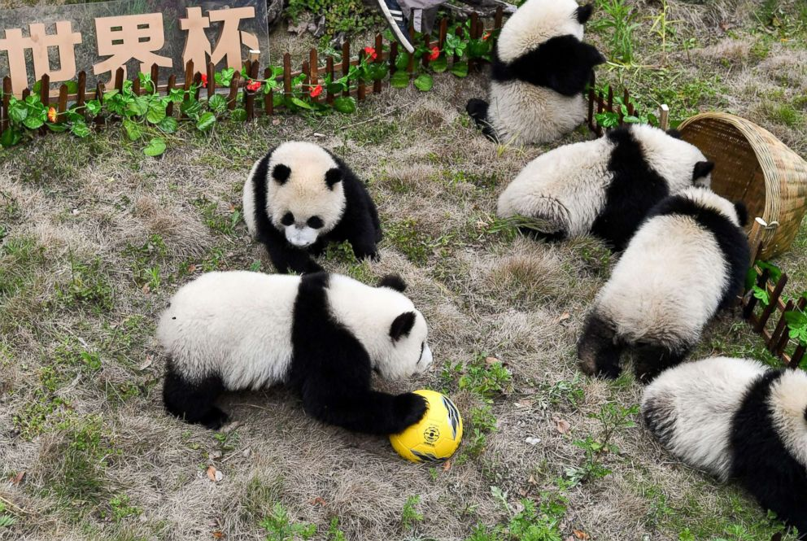
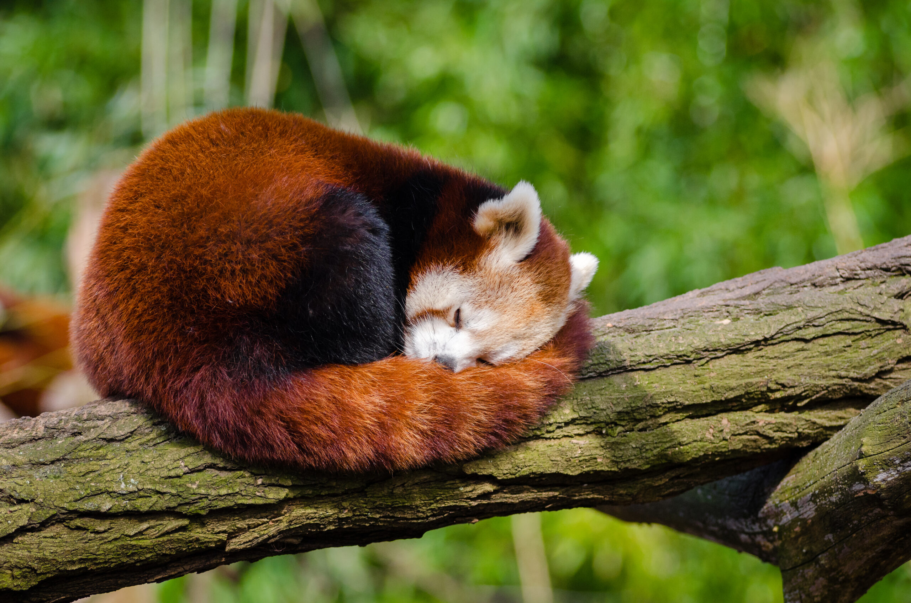
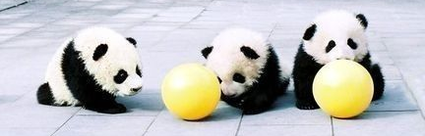
Their time
Baby pandas love to play with each other
Pandas spend most of their time
-eating
-sleeping

Slide 6
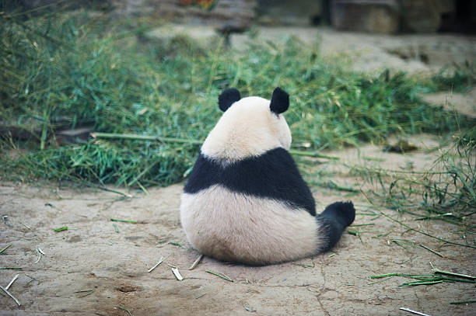
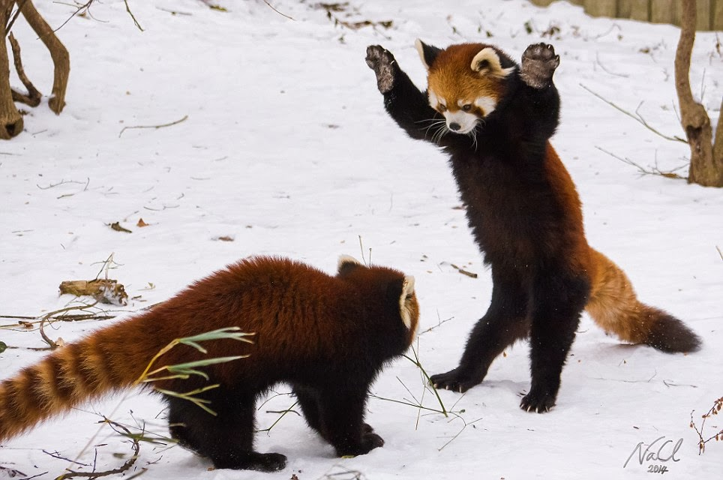
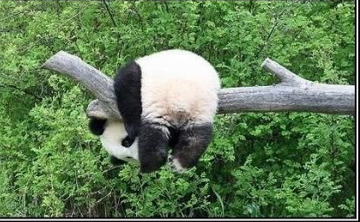
Did you know that Pandas are solitary creatures? They enjoy
being alone.
Finally, some peace and quiet
Leave me alone!
YOU leave me alone!
WOOO!

